Slide 1
Supplier Training Tool/Gage Form Submissions

Slide 2
Purpose
To understand the how and why to tag customer/GHSP owned tooling.

Slide 3

Put a copy of the tool/gage submission form here
Items in Red are recent changes to the Form

Slide 5
Make sure to submit form in Excel. No PDF
Be sure to include ALL tools that were issued a PO by GHSP (Customer and GHSP owned tooling)

Slide 6
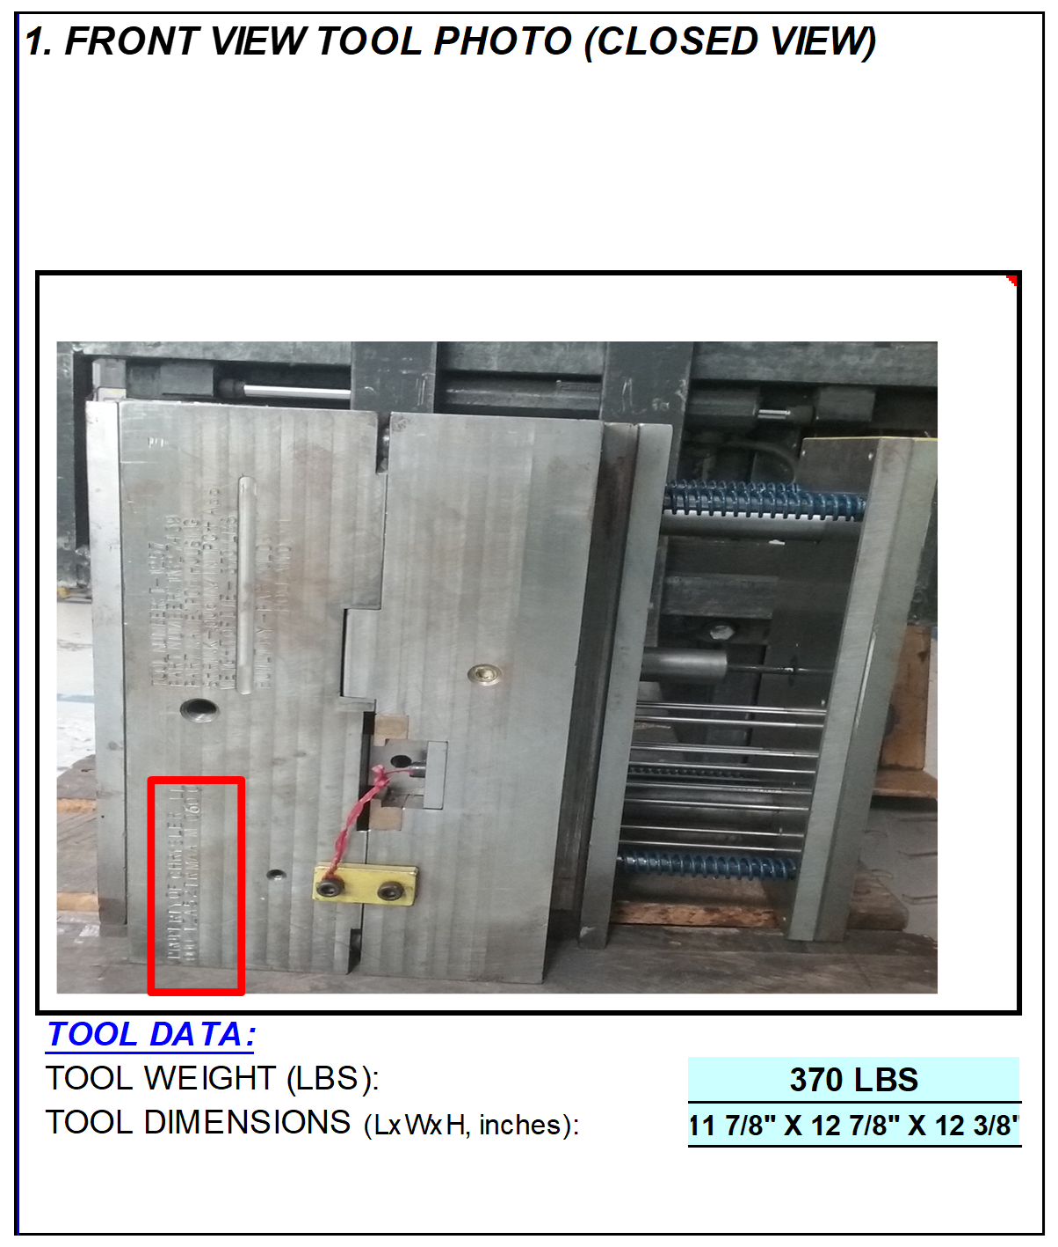
Show Entire Tool
If Front View Doesn’t Show Customer ID#, Supply Additional Full View Photo With ID# Visible
Add Tool Data as Shown

Slide 7
Open:
Show Both Halves Facing Straight On
Show Entire Tool; ID# Must Be Identifiable in Photo.
Like Tools (If Applicable): For Multiple Identical Tools Include Family Photo of All Tools Together With ID# Visible (Racks, Cutting Fixtures, etc.)
Add Tool Data as Shown

Slide 8
Asset # Must Be Clearly Legible.
Do Not Crop Tightly.
Must Show Correlating Features Between Full View And Close Up View.
Add Tool Data As Shown

Slide 9

Insert Photo Of The Completed Part
Add Tool Data As Shown

Slide 10

End Result

Slide 11
Questions?

