Slide 1
Supplier Management Review

Slide 2
Purpose
A multi-level Supplier Management Review (SMR) with suppliers who have experienced significant performance events, or chronic performance issues.
Intended to be a collaborative effort between GHSP and the supplier to improve specific areas that are impacting the business relationship.

Slide 3
Process
Chronic poor performance identified
SMR 1 Conducted
No - minor issues
Goal reached?
Yes
SMR complete. Celebrate!!
No - Major issues
SMR 2 Conducted
No - minor issues
Goal reached?
Yes
SMR complete. Celebrate!!
No - Major issues
Next steps

Slide 4
SMR 1
Problem solving meeting to discuss the issue and corrective action plan to resolve the issues.
Iterative process

Slide 5
Triggers for SMR 1
Systemic / repeat quality or delivery issues
Poor customer service responses
Lack of support during project development phases
Failure to adhere to GHSP expectations

Slide 6
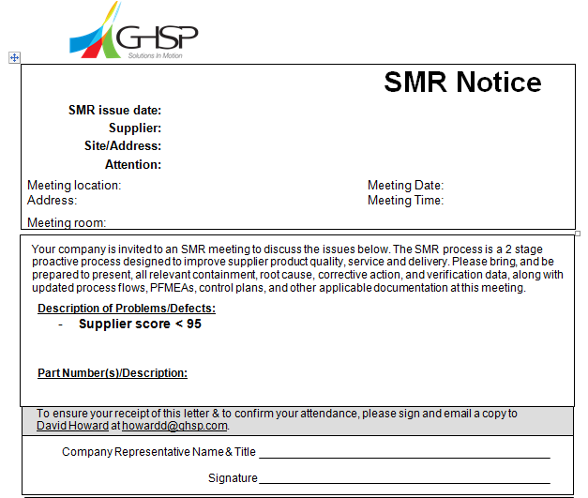

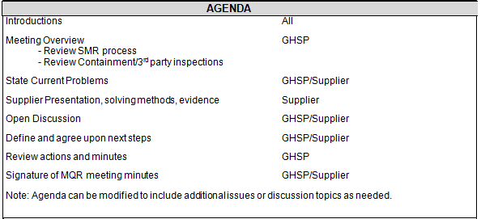
Example of Notice

Slide 7

SMR 1 – Attendees / Agenda
Attendees
Appropriate supplier functional managers and support team.
GHSP buyer, SDE, purchasing manager, SDE manager
Agenda
Supplier presentation
  Problem statement
  Definition of the problem
  Evaluation of possible root causes
  Action plan that includes actions and due dates

Slide 8
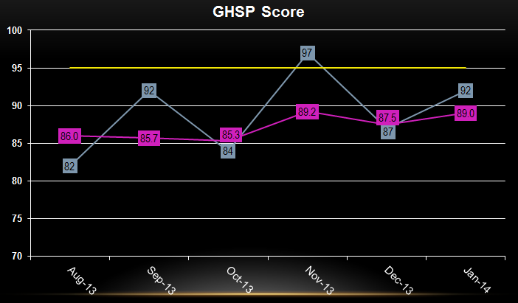
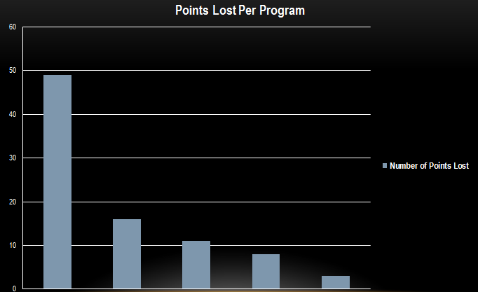
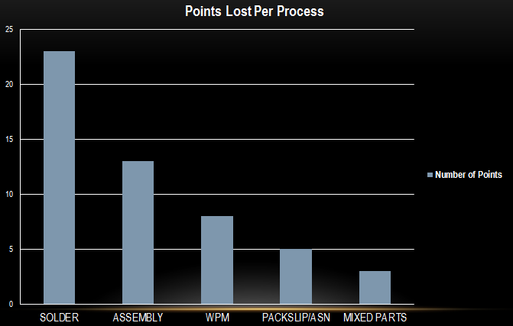
Example
Break the problem down into manageable chunks.

Slide 9

SMR 2
Escalation of SMR 1 or response to a major issue effecting GHSP.
Upper management review of the issue

Slide 10
Triggers for SMR 2
Chronic, documented, unresolved SMR 1 problems spanning more than 2 quarters or deemed high risk requiring immediate action.
Unreasonable response from the supplier or indications that no progress has been made to resolve SMR 1 issues.
Continued customer dissatisfaction on a supplier’s product quality, shortages or logistical issues, including a mandate to change to a known capable supplier.
Supplier’s inability or unwillingness to work with GHSP to make fundamental quality system improvements.
      Unresolved product safety characteristics, as defined on the print, do not meet Ppk or Cpk requirements as expressed in AIAG PPAP requirements and/or engineering documents.

Slide 11
SMR 2 – Attendees / Agenda
Attendees
Owners and upper management from the supplier
GHSP upper management
Agenda
Similar to SMR 1 but customized for upper management discussions

Slide 12
SMR Summary
Good News
Bad News
GHSP is willing to work with suppliers to improve the performance and the relationship.
Supplier controls (for the most part) the corrective action plan with support from GHSP.
New business holds are often implemented in SMR 1
Failure to exit the SMR process can lead to resourcing and the end of the business relationship.
Not GHSP’s goal. Expensive for both parties

