Slide 1
Supplier Training – RFQ Process

Slide 2
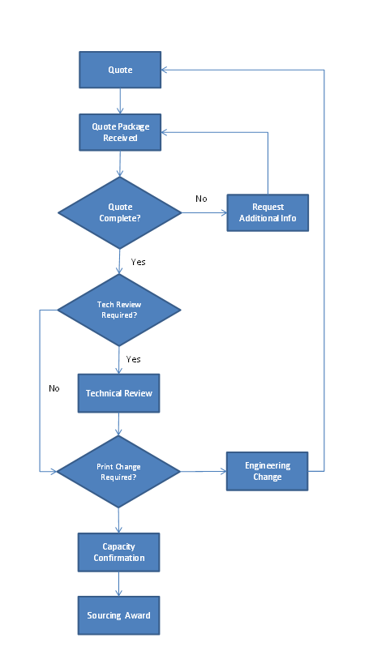

Slide 3
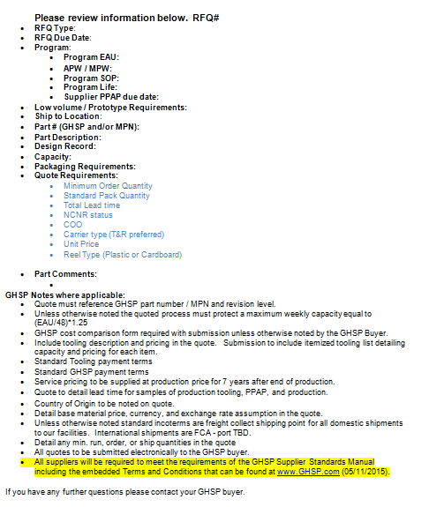
Request for Quote
  RFQ package from your buyer may include:
    RFQ form
    Print & CAD
    Team feasibility form
    SSOW
    Cost breakdown form

Slide 4
Request for Quote
  A complete quote package needs to be submitted by the due date on the RFQ
    All forms returned with quote
    All ‘Quote requirements’ referenced on quote
    All ‘GHSP notes’ addressed

Slide 5
Request for Quote
Most Common Issues:
  Timeliness
  Incomplete
    RFQ requirements not addressed
    No cost breakdown (by request only)
    No Technical Feasibility form
    All costs to meet notes/specifications on print not considered
  Missing RFQ# on quote response

Slide 6
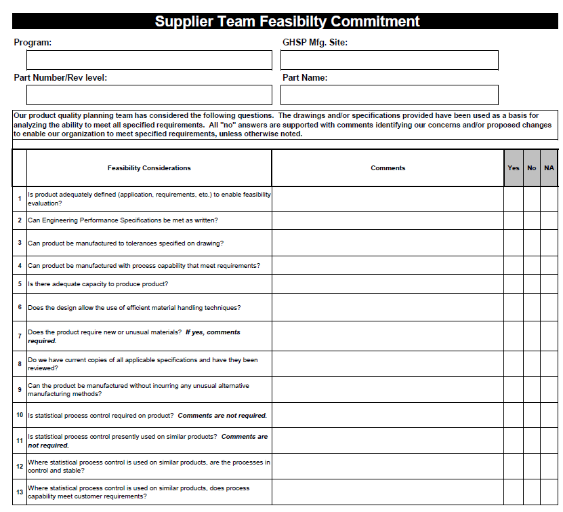
Supplier Team Feasibility
  At Production Design/Drawing release (and applicable revisions), the Buyer will send the Team Feasibility Commitment Form with the RFQ package to all potential suppliers.
  Supplier returns completed form with their quote response

Slide 7
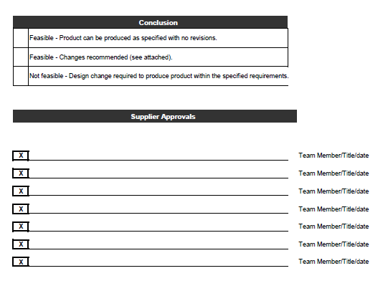
Supplier Team Feasibility
  Requires cross-functional input at the supplier level
  Supplier may be brought in for Tech. Review whether they check Feasible or Not Feasible

Slide 8
Supplier Team Feasibility
  Most Common Issue(s):
    Supplier requests print changes at PPAP submission and no exceptions were noted on Team Feasibility form
    Form filled out incorrectly
      Not signed by all team members
      Checking specs can be met but not providing evidence for each section at PPAP (blanket cert/statement is not acceptable)

Slide 9
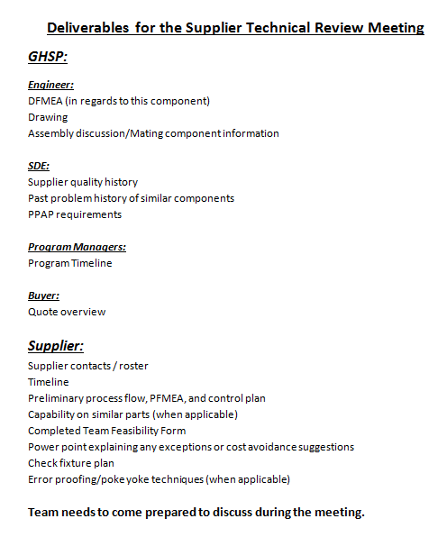
Pre-sourcing Technical Review
  Multiple suppliers are brought in to discuss product application, part design and cost savings ideas
  Next steps:
    New RFQ/print
    Clean team feasibility
    Sourcing award

Slide 10
Pre-sourcing Technical Review
Most Common Issues:
  Missing deliverables (see Tech. Review form for full list)
    Preliminary Process Flow, PFMEA, and Control Plan
    Gage/Check Fixture proposal

