Slide 1
GHSP Supplier Packaging

Slide 2
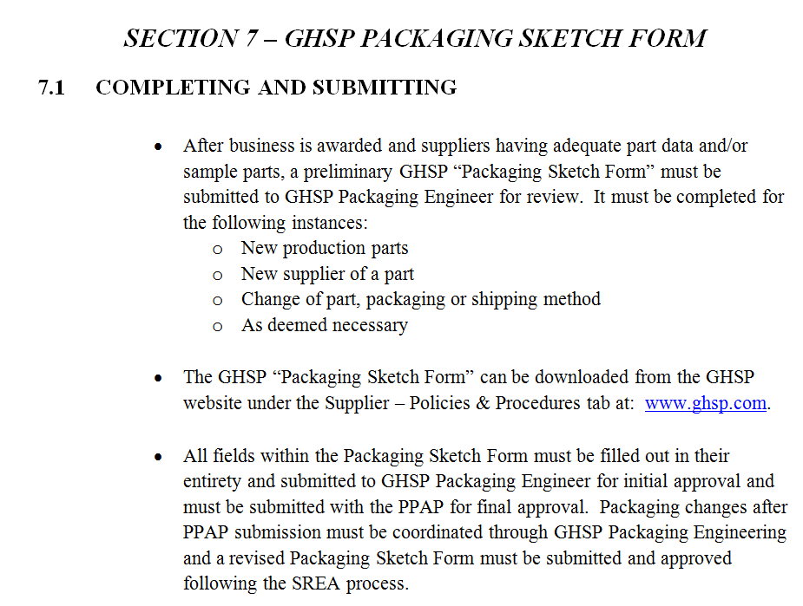
GHSP Packaging Sketch Form Submission

Slide 3
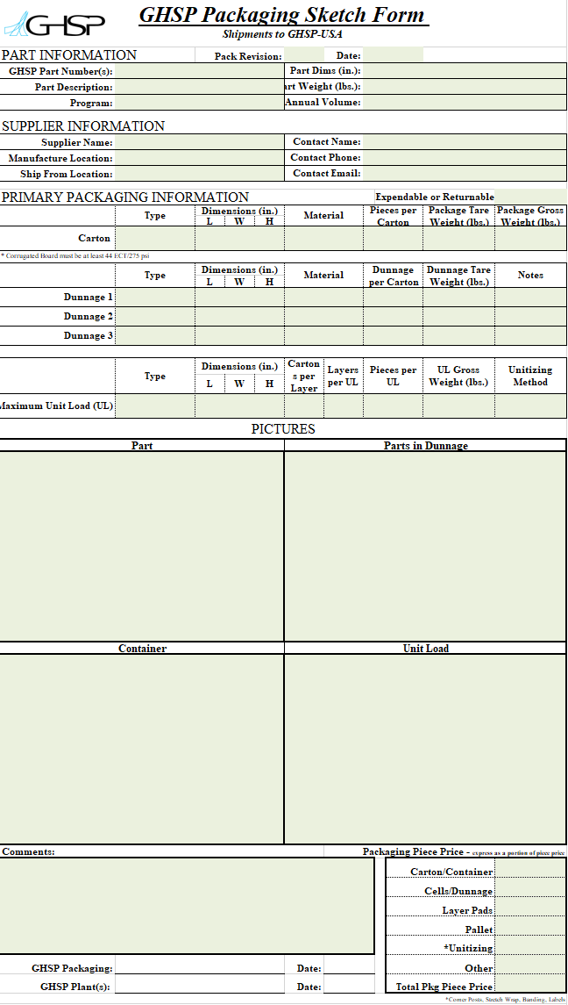
New GHSP Packaging Sketch Form
GHSP Packaging Sketch Form

Slide 4

New GHSP Supplier Packaging Requirements and Guidelines
GHSP Supplier Packaging Requirements and Guidelines

Slide 5
GHSP
Automotive Packaging 101

Slide 6
Automotive Packaging
Product Characteristics
Packaging Characteristics
Metal Parts
Electronic Components
Decorative Trim
Expendable
Returnable
Rust Inhibitor
Class “A” protection
Automation
Environmental

Slide 7
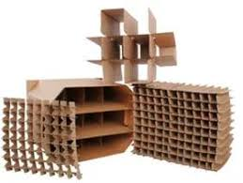
Expendable Packaging
Types of Expendable Packaging
Corrugated Board vs. “Cardboard”
Dunnage
  Partitions
  Plastic Trays/Bags
  Class A protection
  Rust Inhibitors

Slide 8
Corrugated vs. Cardboard
Corrugated Board
Cardboard
Made of 3 or more layers of liner board with a “corrugated” inner medium that is referred to as “Fluting”
Multiple Flute Sizes
Multiple Strengths
Chipboard that is formed in a single layer using fiber. Does not have “fluting”
Multiple Point Sizes
Different Finishes
Different Grades

Slide 9
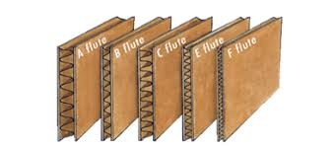
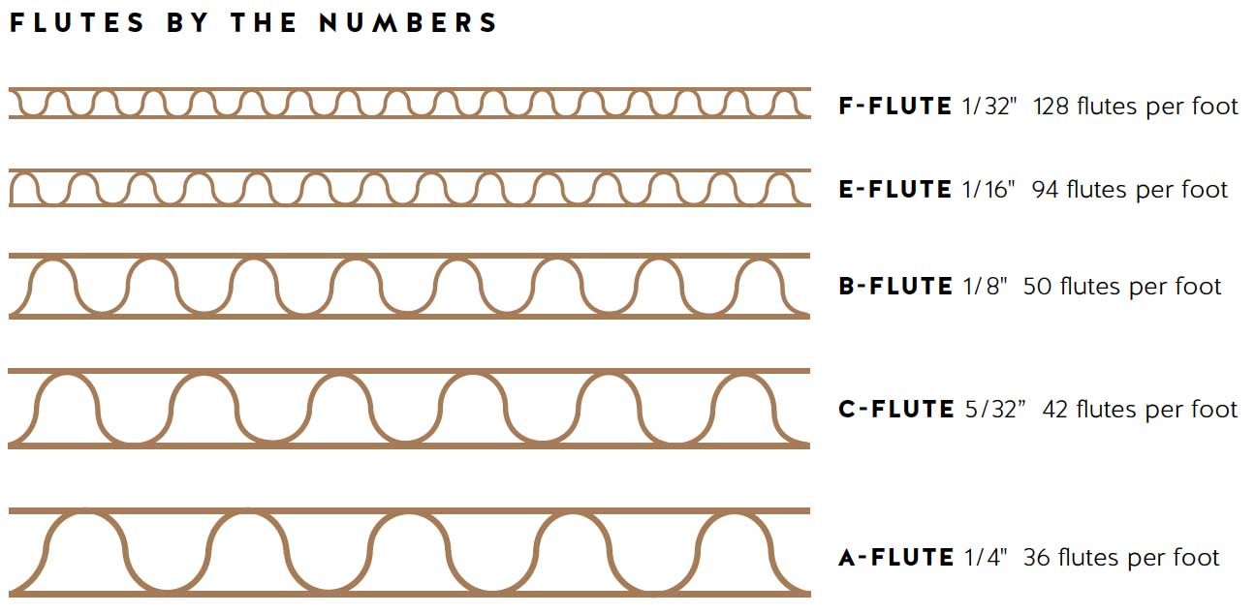
Corrugated Board
Corrugated
Most Commonly Used Flute Sizes (Automotive)
  Liner Board Select ion(lbs)
  C Flute, B-Flute, CB-Flute
  Single Wall vs. Doublewall vs. Triplewall
  Board Strength

Slide 10
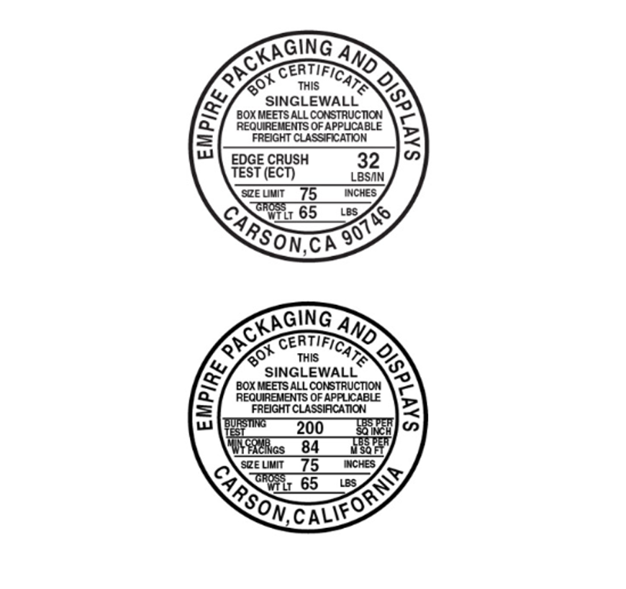
Corrugated Strength
Mullen = Burst Strength
ECT = Edge Crush Test
Mckee Formula
Certification Stamps

Slide 11



Corrugated Box Styles
RSC BOX
FOL BOX
HSC BOX

Slide 12

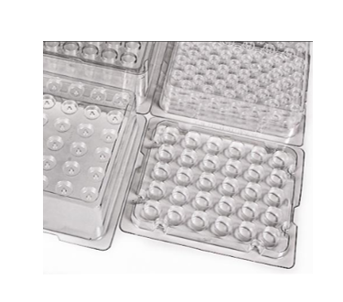

Expendable Dunnage
Types of Dunnage
Corrugated Partitions
Nomar Board/Poly Coated Chip
Thermoform/Vac-Form Trays
VCI Bags/VCI Paper/Dessicant
ESD vs. Anti-Static vs. Insulated vs. Conductive

Slide 13
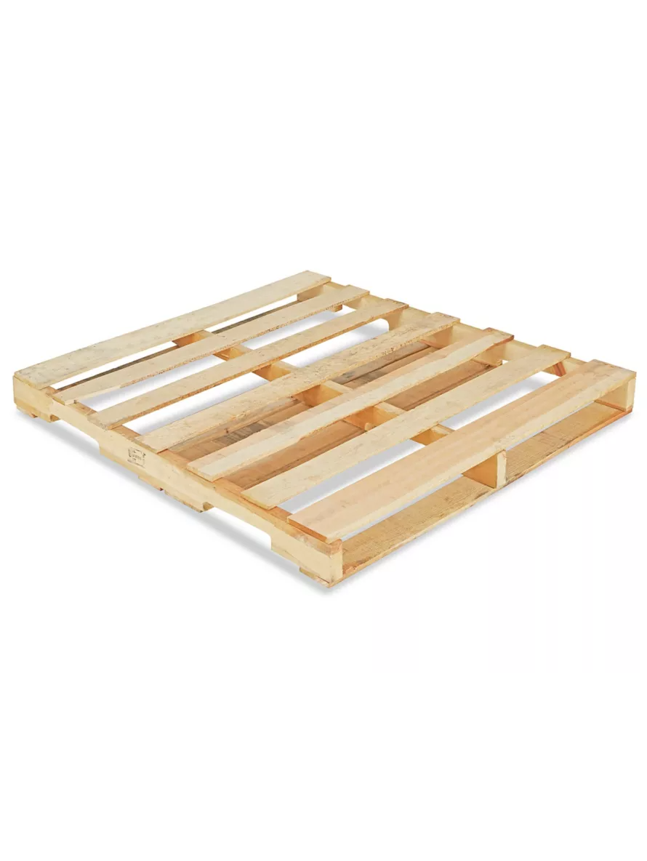
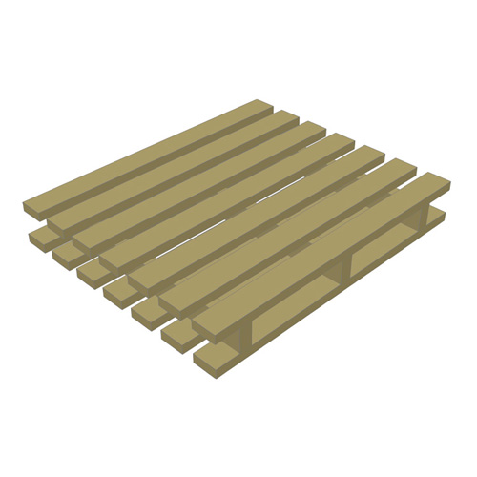
Pallets
Common Dimensions
48” x 45”
48” x 40”
32” x 30”
Materials
Hardwood
Plywood
Particle Board
Plastic One-way
Designs
2-way/4-way
Stringer/Block
Single Wing/Double Wing

Slide 14
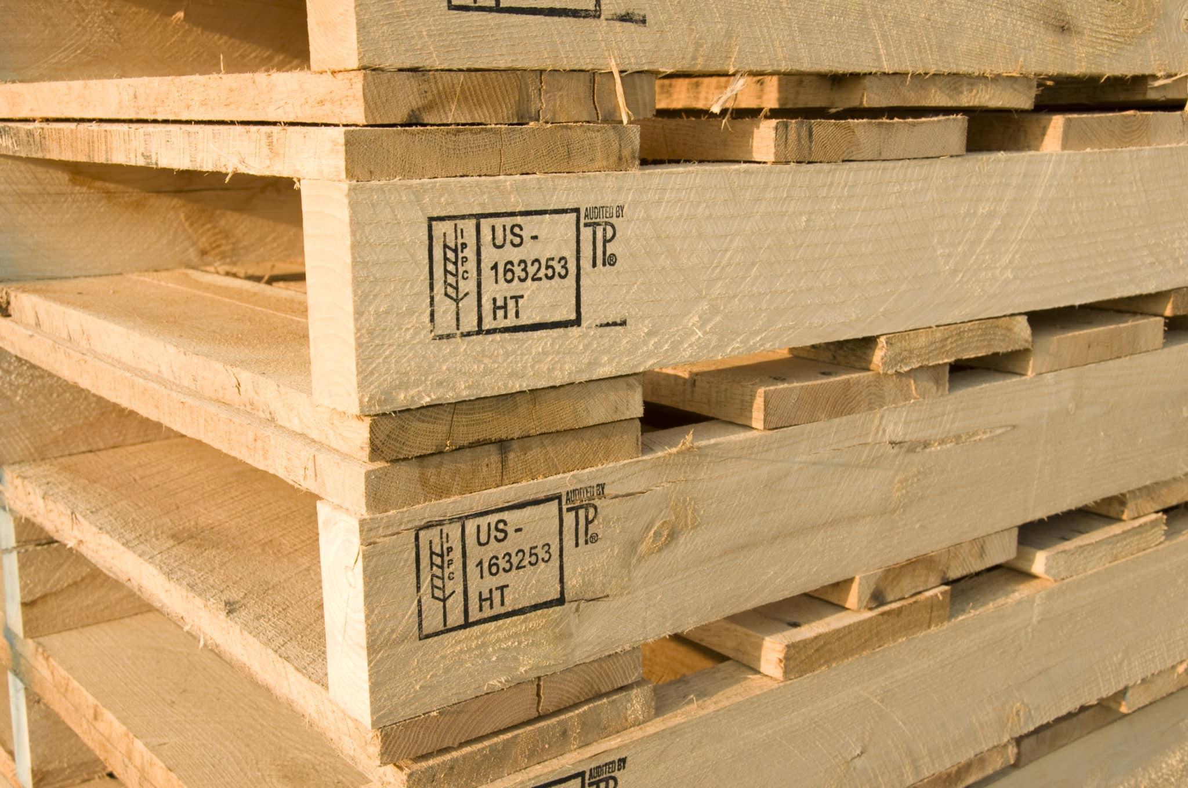

Wood Packaging Materials
Heat treated or fumigated according to ISPM 15 requirements
Visibly stamped with IPPC symbol

Slide 15
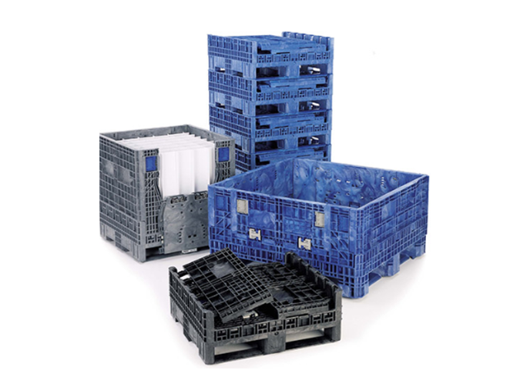
Returnable Packaging
Types of Returnable Containers
Types of Returnable Dunnage
Totes vs. Bulk Bins
Metal Racks vs. Bag Racks
P-Core/Coated P-Core
Thermoform Trays
Foam/Die Cut Foam
TPU
Curtain/SpunBound/Polyester

Slide 16
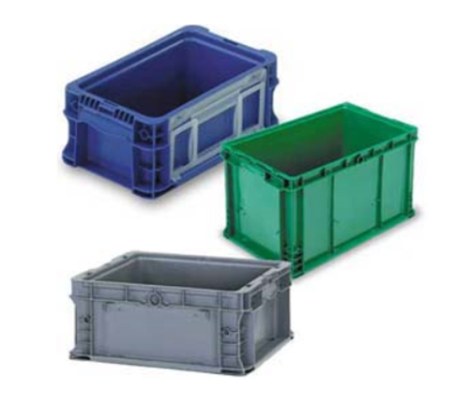
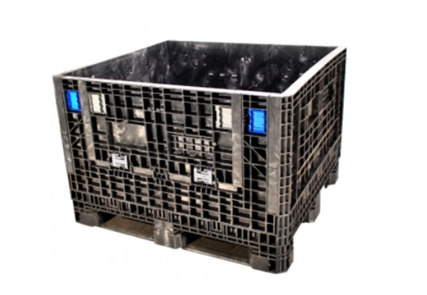
Totes vs. Bulk Bins
Totes
Bulk Bins
Hand Held
Straight Wall, Nestable, and Collapsible.
40 Standard Sizes – Straight Wall
Common Tote Sizes:
  24” x 15”
  24” x 22”
  12” x 7”
  12” x 15”
Pallet Handling/Fork Entry
Collapsible, Drop Down Door, Straight Wall
Common Footprint
  32” x 30”
  48” x 40”
  48” x 45”
  Extended Length (multiple)

Slide 17
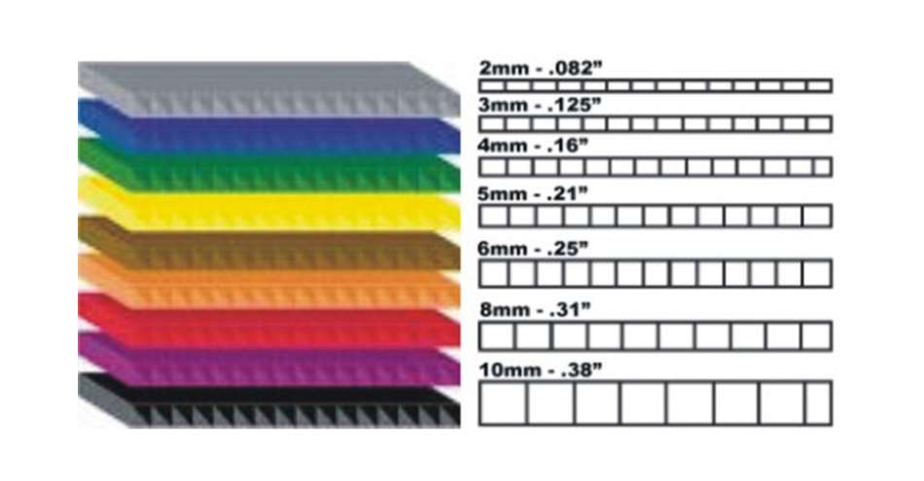
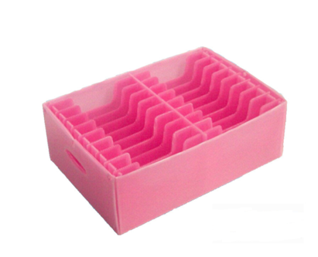
P-Core
Plastic Corrugated
Commonly Used for Returnable Partitions
Cost Effective
Similar Construction as Paper Corrugated
Multiple Strengths and Thicknesses
Special Coatings Accommodate Class A and ESD Protection

Slide 18

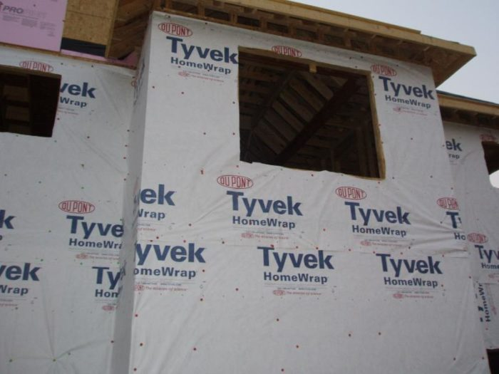
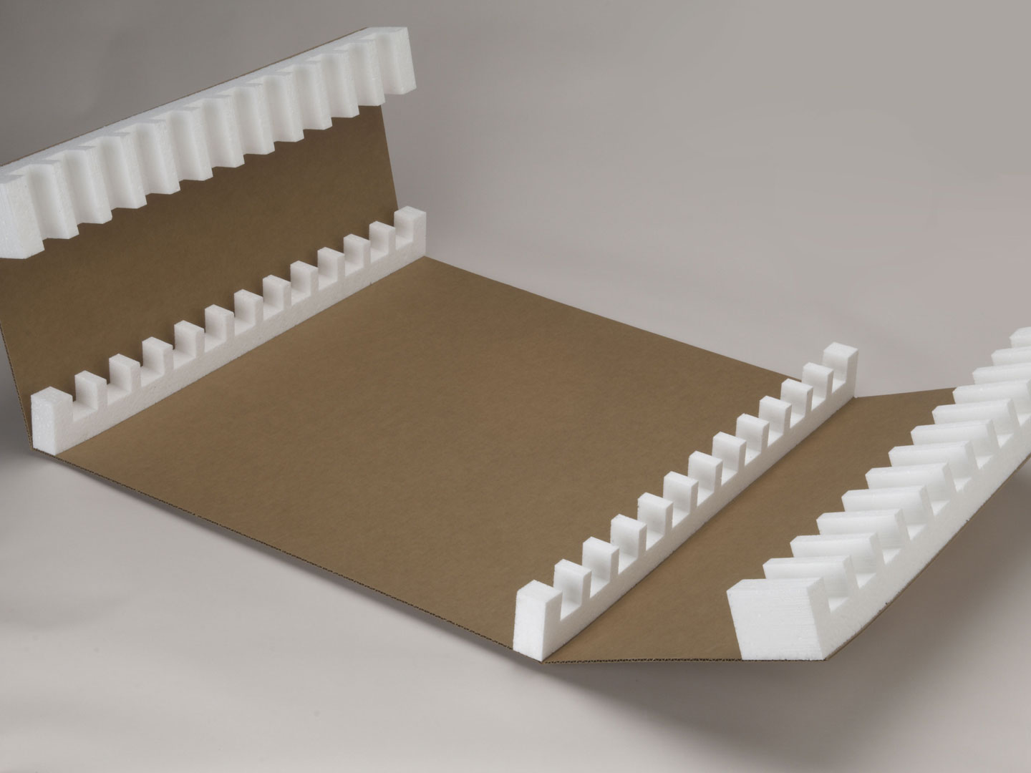
Class A Protection
Different Types
Spun Bound Cloth
Tyvek
Polyester
Beaded PE Foam

Slide 19

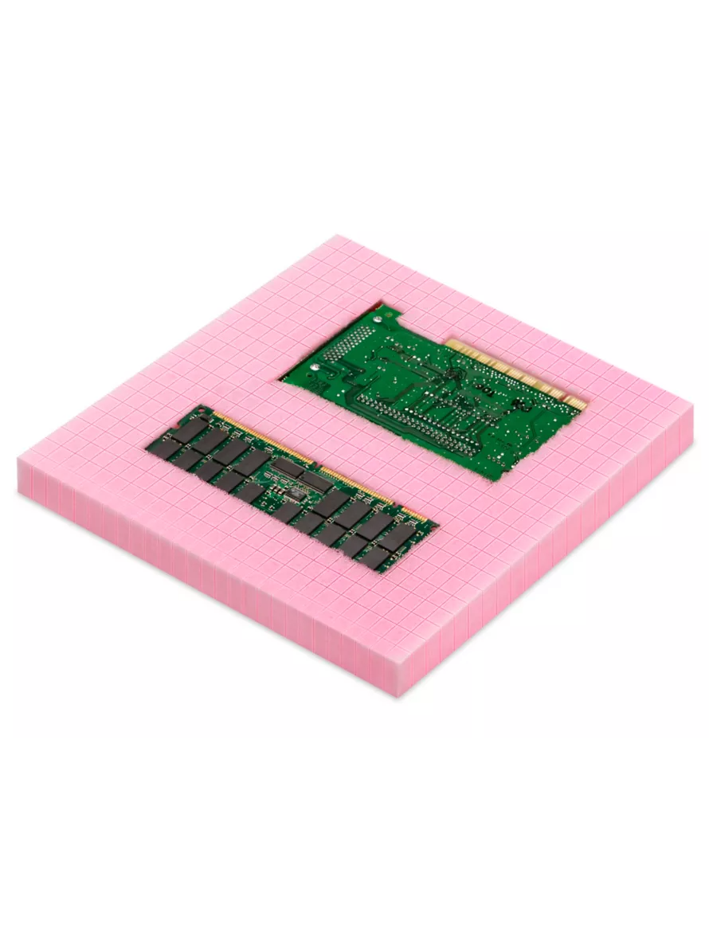
Die Cut Foam
Facilitates Unique Shapes
Protection
Low Weight
Durable

Slide 20

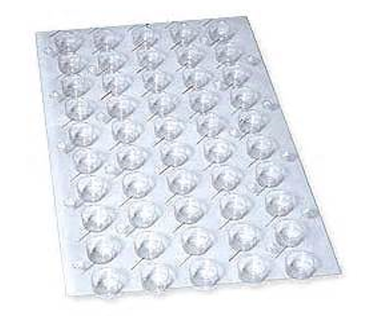
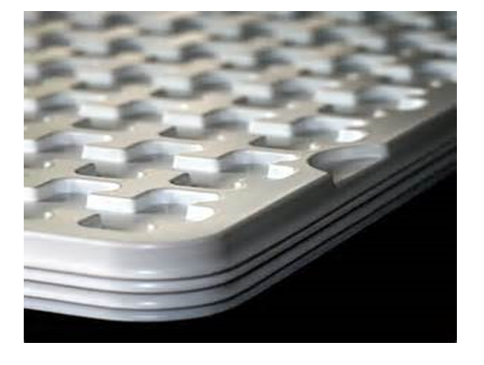
Formed Trays
Efficient (nesting/stacking)
Economical
Clean Room Friendly
Recyclable

Slide 21
Questions?

