Slide 1
Supplier Training – PTR Problem Solving

Slide 2
P T R
Problem Tracking & Resolution

Slide 3
What is a PTR??
PTRs are used by GHSP to address the following:
Customer Complaints
Internal Issues
Supplier Issues
Quality Defects
Delivery Issues
Customer Service Issues

Slide 4
What a PTR is Not!!
What a PTR is NOT!!
A way to punish suppliers
A way for GHSP to make money
To be ignored

Slide 5
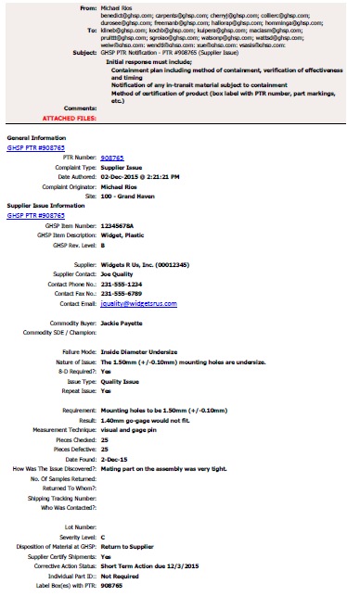
PTR: Problem Tracking and Resolution
The PTR Form
Header & General Information

Slide 6
PTR: Problem Tracking and Resolution
The PTR Form
Supplier and Issue Details

Slide 7
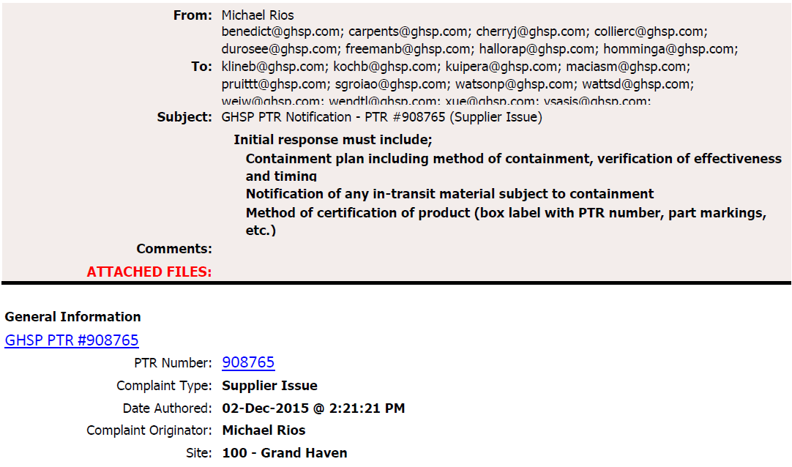
Header and General Information

Slide 8

Supplier Details

Slide 9
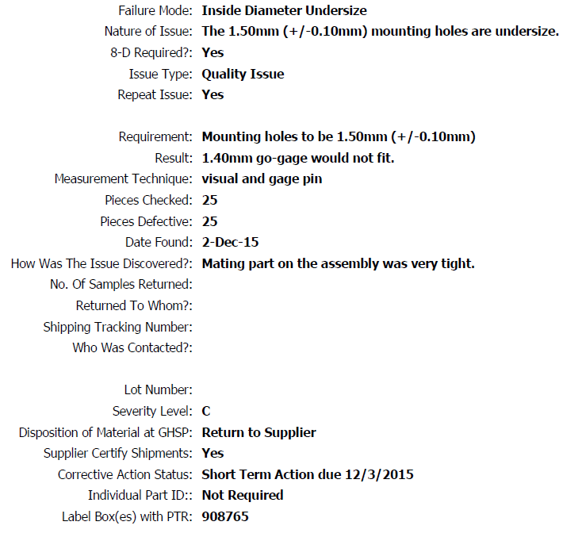
Issue Details
Types of Failure Mode include:
Dimensional issues
Excessive Flash
Appearance
No Packing Slip
Qty. of Parts Received Incorrect

Slide 10
Issue Details – cont’d
Details of the Failure Mode – allows the originator of the PTR to provide more detail of the issue

Slide 11
Issue Details – cont’d
If an 8D is required, the initial response to the PTR must include a 3D:
Team Members
Problem Statement
Details of Containment
Remember: Initial response must be submitted within 24 hours of receiving the PTR.

Slide 12
Issue Details – cont’d
Issue Types include:
Quality Issue
Delivery Service Issue
Customer Service Issue

Slide 13
Issue Details – cont’d

Slide 14
Issue Details – cont’d

Slide 15
Issue Details – cont’d

Slide 16
Issue Details – cont’d
Severity Level:
Any quality spill that affects GHSP’s performance with a customer.
One of the following:
  Repeat issue within 6 months
  Caused GHSP downtime
  Significant disruption to GHSP operations
Any incident not fitting criteria A or B at the discretion of GHSP SQE or PQE
Informational or warning only, line accumulations for charge back

Slide 17
How PTRs affect the Supplier Scorecard
How PTRs affect the Supplier Scorecard
PTR Severity | Description of Severity | Affect on Scorecard
A | Any quality spill that affects GHSP’s performance with a customer. | 10 Points deducted
B | One of the following: 1. Repeat issue within 6 months 2. Caused GHSP downtime 3. Significant disruption to GHSP operations | 5 Points deducted
C | Any incident not fitting criteria A or B at the discretion of GHSP SQE or PQE | 3 Points deducted
D | Informational or warning only | 0 Points deducted
P | Proactive notification from the supplier when GHSP has not built the defective product | 0 Points deducted

Slide 18
Issue Details – cont’d
Disposition may include:
GHSP Sort / Rework
Supplier Sort / Rework at GHSP
Return to Supplier
Scrapped at GHSP
GHSP Will Use

Slide 19
GHSP Expectations from Suppliers
Immediate communication with the PTR originator, preferably by phone.
If the originator cannot be reached, contact should be made with the PQE or SQE.
Contact must be made within 24 hours of receiving the PTR.
Early Communication
=
Higher Confidence
that the issue is taken seriously

Slide 20
GHSP Expectations from Suppliers
When required (within 24 hours):
Containment plan
Method of Containment
Verification of Containment Effectiveness
Timing of Containment Actions
Set up any sorting/rework operations at GHSP
Set up any sorting/rework operations at the supplier’s facility
Issue RMA number for the return of any suspect product
Notification of any in-transit material subject to containment
Method of certification of product (box label with PTR number, part markings, etc.)
If an 8D is required, then an initial 3D must be submitted within
24 hours

Slide 21
GHSP Contacts
Initial Response and Containment: PTR Originator
Initial 3D Submission: PTR Originator AND Plant SQE
Final 8D Submission: Plant SQE
Supplier Quality Engineers
Grand Haven: Jeff Cherry
Hart: Matt Lozen
Mexico: Chris Collier
China: Wesley Wei

Slide 22
Questions?

Slide 23
Problem Solving Process
The Discipline Approach

Slide 24
Eight Parts of an 8D
These are the same parts of the “3D” that is required to be submitted within 24 hours of receiving a PTR with the 8D requirement.
D1. Establish the team
D2. Describe the problem
D3. Contain the problem

Slide 25
The Eight Parts of an 8D
D1. Establish the team
D2. Describe the problem
D3. Contain the problem
D4. Find, define, and verify root cause(s) and escape point(s)
D5. Choose and verify permanent corrective action(s) for both root cause and escape point
D6. Implement and validate permanent corrective actions (PCAs)
D7. Prevent recurrence of problem and similar problems. Identify systemic improvement opportunities.
D8. Congratulate your team!

Slide 26
D1.) Establish the Team
Identify the Champion
  Typically the customer Quality Engineer
Select the team
  A team is a number of individuals working together as a cohesive unit toward a common goal
  It is important that the team consists of a cross-functional group including persons from manufacturing, processing, and quality.
  The team should always include operators (from each shift, if applicable).
Together Everyone Achieves More

Slide 27

D2.) Describe the Problem
The Problem Statement must be described in terms that have the same meaning to everyone involved.
Before trying to define the root cause, or jump to solutions, stop and take time to describe the problem, using as much data and facts as you can gather
Use IS-IS NOT concept with 5 Ws & 2 Hs (Who – What – Where – When – Why – How – How many
Ask: “What is Wrong with What?”
Then ask: “Do we know why this is happening?”
  If the answer is “No”, then the “What is wrong with what” is your Problem Statement.
  If the answer is “Yes”, repeat the question “What is wrong with what” until reaching the statement where the cause is unknown
“A problem well stated is a problem half solved.”
-Charles Kettering

Slide 28

D2.) Describe the Problem
Successful identification of a problem’s root cause depends upon the accuracy of the problem description!
The problem description data should provide the basis for testing the cause of the problem.
Example:
“Pin gage would not pass fully through part”
“5.00mm (+/-0.1mm) ID of P/N 12345123 mounting hole is undersize by up to 0.2mm on 19 pieces measured with pin gage.”
“A problem well stated is a problem half solved.”
-Charles Kettering

Slide 29
D3.) Contain the Problem
Interim Containment Action:
  An action that prevents the symptoms resulting from one or more problems being experienced by the customer.
Define and implement containment actions to isolate the problem from reaching the customer.
Containment actions are short term and may be costly. Examples include:
Quarantine batches of stock
Temporary inspection stages
Temporary rework (if approved)
Temporary training
Product recalls

Slide 30
D3.) Contain the Problem
Verify the effectiveness of the Interim Containment Action(s), and ensure that it does not create other problems and/or concerns.
Ensure that responsibilities for the Interim Containment Action(s) are clear.
Will the Interim Corrective Action(s) last until Permanent Containment Action(s) are implemented?
How will “OK” parts be identified?
Document the Interim Containment Action(s).

Slide 31
D3.) Contain the Problem
Interim Containment Action…
…attacks the symptom
…is closely monitored while being applied
…results are documented
…is well thought out and verified
…is replaced by Permanent Corrective Action (at D6)
…adds cost

Slide 32

D4.) Root Cause Analysis and Escape Points
Use Problem Solving Tools to identify the most likely cause of a problem
IS – IS NOT
Process Flow Diagram
Cause and Effect Diagram (Fish Bone)
PFMEA
Identify the potential escape point of a problem
Verify the root cause and escape point of a problem

Slide 33
D4.) Root Cause Analysis and Escape Points
There are three components of Root Cause Analysis
Occurrence Root Causes
Causes relating to the manufacturing process that allowed the problem to occur.
Escape Points
Causes relating to why the problem was not detected by control points, thus reaching the customer.
Systemic Root Causes
Inadequate design and/or validation of processes and/or product
Ineffective DFMEA and/or PFMEA
Lack of participation by key individuals during the advance product development/planning process

Slide 34
D4.) Root Cause Analysis and Escape Points
Terminology Related to the Root Cause and Escape Point
Possible Cause: Any cause frequently identified on the Cause & Effect diagram that describes how an effect may occur.
Most Likely Cause: A theory, based on available data, that best explains the problem description.
Root Cause: A verified cause that accounts for the problem, verified by making the problem come and go.
Escape Point: The earliest location in the process, closest to the root cause, where the problem could have been detected

Slide 35
D4.) Root Cause Analysis and Escape Points
Identify ALL possible causes
Ask “Why” as many times as necessary to drive towards root cause
Brainstorm using a Cause and Effect Diagram
Investigate what, if anything, changed in the manufacturing process
Analyze existing data such as Pareto Charts, Control Charts, Check Sheets, etc.
Identify the top few possible causes and develop a plan to investigate each cause independently.

Slide 36
D4.) Root Cause Analysis and Escape Points
Cause and Effect Diagram (Fish Bone)
Method |  |  |  | People |  |  |  | Material |  |  |  | Note:
 |  |  |  |  |  |  |  |  |  |  |  | You may change the categories as necessary to suit you problem statement
Machine |  |  |  | Environment |  |  |  | Measurement

Slide 37
D4.) Root Cause Analysis and Escape Points
Investigate possible causes
Determine what type of data should be collected to prove the cause
Conduct the study
Collect the data
Analyze the data
Outline conclusions
  Does the data establish the potential cause as being the reason for the problem?
Verify the root cause – turn it on and off

Slide 38
D5.) Choose Permanent Corrective Action
What is the significance of PCA as opposed to ICA?
ICA only protects the customer from the effects or symptoms of a problem, but they generally do not eliminate its root cause. Instead, these actions protect the customer from the symptoms of the problem while the problem remains.
PCA, on the other hand, is the best action that eliminates the root cause of a problem. The PCA removes the problem's symptoms by removing the effect on the customer.

Slide 39
D5.) Choose Permanent Corrective Action
Determine possible Permanent Corrective Action(s) based on Root Cause Verification
Ensure that PCA demonstrates the improvement is sustainable over time
Analyze the risk associated with the PCA to ensure it will not create additional problems if implemented. Sometimes choices with the greatest benefits carry the greatest risks.
Remember: Every change induces new failure modes

Slide 40
D5.) Choose Permanent Corrective Action
Key Definitions:
Verification: The method by which the root cause is confirmed.
Passive Verification: Done by observation; look for the presence of the root cause without changing anything. If you can not prove the presence of the root cause variable, then chances are that this is not the root cause.
Active Verification: The process where you seek to make the defect come and go using process variables.
Validation: Ongoing evidence, with data, that the implemented action is doing what it was intended to do without contributing to a new failure. Validation follows successful verification and will be confirmed using data.

Slide 41
D5.) Choose Permanent Corrective Action
Verify the PCA
Verification provides:
  A comparison of the effect of the problem with and without the PCA in place
  Proves, before implementation, that the PCA ensures that the Root Cause of the problem (as defined in D4) is eliminated
  Proves that the PCA will not introduce new problems

Slide 42
D6.) Implement and Validate Permanent Corrective Action
Keys to Successful PCA
Develop a detailed plan for PCA implementation
Analyze the plan to prevent implementation problems from occurring
Identify actions to take should things go wrong (contingency plan)
Next Step?
Submit SREA for implementation
Receive SREA approval
Implement the PCA!

Slide 43

D6.) Implement and Validate Permanent Corrective Action
Validate effectiveness of the PCA thru tools such as Paynter Chart and, if necessary, through trials at the customer plant
Develop an action plan with responsibility and timing
  Update affected documents, and provide evidence as requested, such as:
    DVP&R, DFMEA, PFMEA, Drawings
    Tool & Gage revisions, Control Plan, Work Instructions
    Training

Slide 44
D7.) Prevent Recurrence of Problem, and Similar Problems
It is very important to take time, as a team, to look back at the problem and ask the following questions:
Why did it happen in the first place?
What lessons can be learned?
What changes need to be made to ensure that this and similar problems never happen again?
  Identify & control process parameters that will impact the product characteristics
  Work instructions, visual aids
  Preventative maintenance program
How do we keep the process in control?

Slide 45
D7.) Identify Systemic Improvement Opportunities
Again, take the time, as a team, to look back at the problem and ask the following questions:
What was NOT done correctly during the process of developing and launching the part?
Is the DFMEA review process robust?
Are the affected disciplines involved in the development of the PFMEA and Control Plan?
Do we have the right people doing the various functions?
Is the training adequate?

Slide 46
Questions?

