Slide 1
Supplier Training – APQP/PSO

Slide 2

Purpose
To understand key concepts of the GHSP APQP and PSO process by reviewing the 16 sections.
Why do we do this???
Assure all documentation is in place and ready for PPAP
Assure that the process can run at the quoted capacity
Prepared for SOP (Start of Production)

Slide 3
Section Overview
16 Sections of the APQP/PSO
1. Plant Layout & Process Flow Diagram | 9. Parts Packaging/Shipping Specifications Available
2. Design and Process FMEA (as applies) | 10. Key Quality Systems Demonstrated
3. Product Control Plan | 11. Containment Plan Available
4. Purchased Components Readiness/Sub Supplier Part Submission Complete | 12. Preventative Maintenance Plans Established
5. Product Specifications/Drawings/Blueprints | 13. Gage & Check Fixture R&R Studies Complete
6. Tooling, Equipment, and Fixtures Identified | 14. Production Validation Complete (as applies)
7. Operators Trained and Work Instructions Available | 15. Line Speed and Capacity Verified
8. Parts Handling Plan Available | 16. PPAP Readiness

Slide 4
Section 1: Plant Layout and Process Flow Diagram
APQP Requirement
Process Flow Diagram dated and current
PSO Requirement
Review updated floor plan showing GHSP equipment
    Are inspection points identified
    Identified area for Non-Conforming Material
Flow Diagram walk showing the process meets the documented flow chart.

Slide 5
Section 2: Design and Process FMEA
APQP Requirement
DFMEA (If Supplier is Design Responsible)
Does the DFMEA include all functional and appearance specifications, CC/SC’s, etc.
Are all RPN’s calculated.
PFMEA
Assure that all functional and appearance specifications, CC/SC’s, etc.
All RPN’s are calculated
Does the PFMEA follow the Flow Diagram
Assure that all PTR’s and lessons learned are listed on the PFMEA.

Slide 6
Section 3: Production Control Plan
APQP Requirement
Production Control Plan dated and current
Does the Control Plan follow the Flow Diagram & PFMEA
Assure all SC/CC’s (Star Dimensions) and CP (Control Points) are included and controls are listed
Annual re-validation and submissions are to be listed on the control plan
PSO Requirement
Are all the elements in the control plan being followed as documented.
Are all controls (including SPC) being used and followed.
Are the controls verified on a periodic bases to ensure desired results.

Slide 7

Section 4: Purchased Component Readiness / Sub-Supplier Part Submission
APQP Requirement
Have all sub-supplier PPAP’s been received and approved. PSW’ s available for review
PSO Requirement
For components that have long lead times are there plans in place to assure adequate material in the pipe line
Is there an effective lot traceability system in place for all sub-components going into assemblies.

Slide 8
Section 5: Product Specifications Drawings/Blueprints
PSO Requirement
Assure that the supplier has the latest GHSP approved drawing on hand
Make sure that the supplier has any customer specifics on hand and that they are at the latest revision.
  These would be such items as contamination specs, material specs, GHSP Workmanship standard, etc.

Slide 9
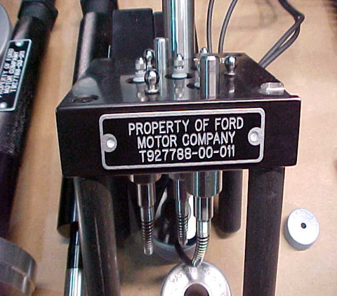
Section 6: Tooling, Equipment, and Fixtures Identified
APQP Requirement
GHSP tooling and gage sketch form
PSO Requirement
Is all the equipment and gages in place as it would be used in production.
Have customer specific requirements been met.
  Such as Ford tool tags been place on all Ford owned tooling as an example

Slide 10
Section 7: Operator Training and Work Instructions
APQP Requirement
Staffing plan for the entire cell.
  - Managers, Engineering, Quality, and operators
Training matrix for all cell operations
PSO Requirement
Are all visual aids dated, approved & current
Are inspection gages and gage instructions readily available
Have all operators been trained and ready for production

Slide 11

Section 8: Parts Handling Plan Available
APQP Requirement
GHSP Packaging Sketch Form
PSO Requirement
Storage facilities for finished goods are protected from environmental factors.
Orders in place for packaging to support on time shipments
Review the process to assure there is not the opportunity to mix parts

Slide 12
Section 9: Parts Packaging/Shipping Specifications Available
APQP Requirement
Label meets the GHSP requirements as defined in the Supplier Standards Manual
GHSP Packaging Sketch Form
PSO Requirement
Are you ready to send Advanced Shipping Notice (ASN)
For new suppliers have they been set up in SV and do they have a person dedicated to reviewing the site daily. This is where you will get your schedules.
  Also assure that there is a backup in the event that person is out.

Slide 13

Section 10: Key Quality Systems Demonstrated
PSO Requirements
General quality requirements
Compliments the TS/ISO registration
  8D process in place
  Document control
  Red Rabbit/Go NoGo masters are in place and signed off
  SPC has been established and in place

Slide 14
Section 11: Containment Plan Available
APQP Requirement
Pre Launch Control Plan
PSO Requirement
Is the Safe Launch or GP12 early containment process in place.
  Are the containment results being reviewed on a regular bases
  Is there a plan to exit containment
Is there a separate station for this process.
Are instructions available at the station
Is there a plant contingency plan written

Slide 15
Section 12: Preventative Maintenance Plans Established
APQP Requirement
Preventative Maintenance Plan for each piece of equipment and or tool
PSO Requirement
Assure that there is an adequate supply of perishable tools (such as drills, cutters, etc.)
Are all the Red Rabbits, Go NoGo parts in the preventative maintenance system to assure that they are verified.

Slide 16
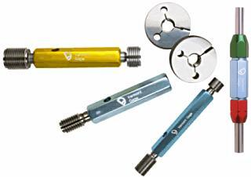
Section 13: Gage and Check Fixture R&R Studies Complete
APQP Requirement
Gage R&R studies per AIAG MSA manual
PSO Requirement
Have all functional gages been dimensionally certified
Are procedures being followed to calibrate test & measuring equipment on a regular bases

Slide 17
Section 14: Product Validation Complete (as applies)
Review any design or product validation data that is present for items that require it.
Most Validation testing is completed by GHSP within the shifter or pump

Slide 18

Section 15: Line Speed and Capacity Verified
APQP Requirement
Capacity Analysis performed on the process
PSO Requirement
Has a machine process capability study been complete on the production equipment.
Have there been contingency plans/safety stock established to support production in the event of machine breakdown or force majeure
  Will this plan accommodate GHSP schedule changes
Does the supplier know and understand the ramp-up and peak demands for the program
Does the number of acceptable parts coming of the end of line meet or exceed production requirements

Slide 19

Section 16: PPAP Readiness
Is PPAP ready to be submitted to GHSP per the deliverables set fort by SDE/SQE.
  Initial process capability performed with 125 pieces (sub groups of 5). Ppk > 1.67 (see section 7.3.3 of Global Supplier Standards Manual)
  Full dimensional layout been performed on a minimum of 5 pieces. Are all cavities represented if <= 5
  Has the supplier used common industry practices and forms as outlined in the AIAG PPAP Manual.

Slide 20
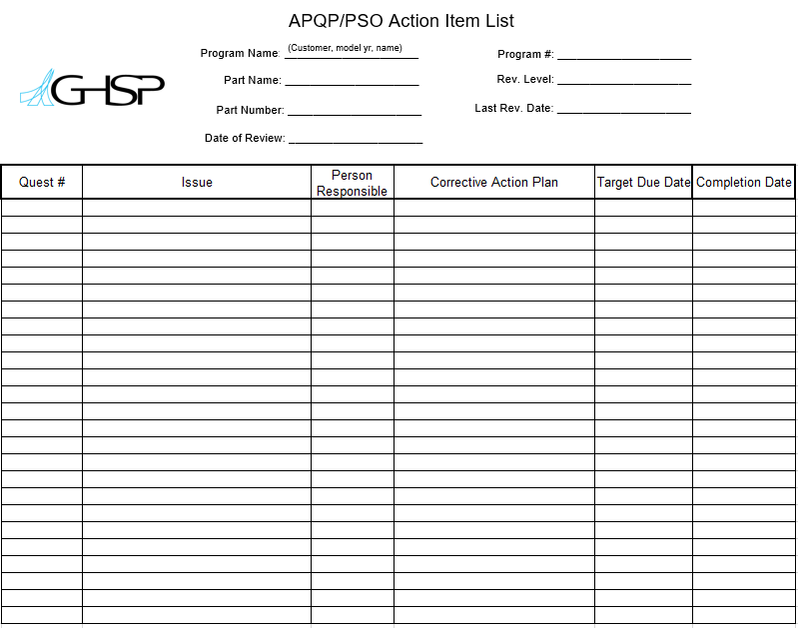
>> Pull together the open items and put together an open issues list with person responsible and an achievable due date.

Slide 21


>> The top summary page can be used to communicate the results from the supplier. This shows the red yellow green status of each element, the run results, and sign off.
All suppliers are expected to complete APQP and a self assessed PSO, critical parts to the assembly will require onsite PSO by GHSP SDE.

Slide 22
Questions?

