Slide 1
Statistical Process Control
Part II

Slide 2
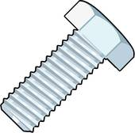
Special Cause Variation
?
If special cause variation exists in a process it results in instability over time and an inability to predict the outcome.
Prediction
Special cause variation are due to out of the ordinary events. An example of this is the bolt with a broken head. Often these events are unpredictable and results in an unsatisfactory product
Time
Size

Slide 3
The Benefits of Process Control
When a process is in control:
You can predict the process outcome in terms of performance (location) and variation (spread)
You can estimate the capability of the process in terms of the product specification
It reduces process and production variation
It reduces waste (scrap, customer satisfaction, etc.)
It reduces process cost (downtime, adjustments, etc.)
CAUTION
When a process is not in control we cannot estimate capability or the ability to meet specification!

Slide 4
Process Control vs. Capability vs. Performance
Process Control:
When a process is in control the only cause of variation present is due to common cause, regardless of product specification.
Process Capability:
When a process is in control (common cause variation). It generally represents the best performance of a stable process.
Process Performance:
The overall output of the process and how it relates to customer (internal and external) requirements, regardless of process variation within or between subgroups.

Slide 5
Process Control vs. Capability (Performance)
Statistical Control
In-Control
Out-of-Control
Case 1
(Ideal state)
Case 3
(Brink of Chaos)
Capability
(Performance)
Acceptable
Unacceptable
Case 2
(Threshold state)
Case 4
(State of Chaos)
The best condition is case 1, where the process is both in control and capable of meeting specification.
In case 2 the process is stable but has excessive common cause variation, which needs to be reduced.
In case 3 the process meets specification but is not stable due to special cause variation, which needs to be eliminated.
In case 4 the process is out of control and not capable of meeting specification. In this case common cause needs to be reduced and special causes eliminated.

Slide 6
1 – In control, capable of meeting performance
2 – In control, not capable of meeting performance
3 – Not in control, currently meeting specification
4 – Not in control, not capable of meeting performance
3
1
2
4

Slide 7
Review
The end goal is to develop a process that is in control (stable) that has minimal variation.
When reviewing data keep an eye out for special cause variation. If special cause variation is present in a process the team needs to identify root cause and implement corrective actions.

Slide 8
Control Charts
Goal
  Understand data collection
  Develop a meaningful sampling plan
  Understand common variable control charts
  Understand common discrete control charts
  Example manual control chart setup
  Control charts in Minitab
  Interpreting Results

Slide 9
Data Collection Flow
Determine the question to be answered
Determine the sampling strategy
Develop a data collection plan
Provide an easy means of storing the data
Effective data collection

Slide 10
Why are you Collecting Data
When collecting data the following questions must be answered:
  What is the intent of the data you plan to collect?
    If process monitoring is important select process input that is key to success or a product characteristic that is directly impacted. Make sure the data is meaningful.
  Will the data be representative of the population?
    Measuring 15 parts before the injection molding tool warms up probably won’t accurately reflect the product population.
  Will the data collected be actionable?

Slide 11
Sampling Strategies
Sampling Strategies
Random sampling
  Each member of the population has an equal chance of being included in the sample.
Stratified sampling
  The population is divided into subgroups and then randomly sampled
Systematic sampling
  Samples are taken at specific points in time or intervals.

Slide 12
Collection Plan
When developing a data collection plan you must consider:
What will be measured / collected?
  Product or process characteristic. Variable or attribute.
How will it be measured / collected?
  Which measurement system?
How much will be collected?
  Both frequency and sample size. Over what time period?
Who (and where) will collect it?
  Operator or Engineer? Does the part need to normalize, be kept clean, etc.?

Slide 13
Sample Size / Frequency
Overall goal is to choose a subgroup size and frequency that minimizes variation within subgroups and maximizes variation between subgroups.
Any significant variation within subgroup should be immediately investigated.
Subgroup size should be determined by process type, standard deviation of process, etc. Larger subgroup sizes makes small shifts in the process easier to detect.
Collection frequency should be determined by the process requirements. Consider difference in operators, shifts, environmental impacts, tool life, etc.

Slide 14
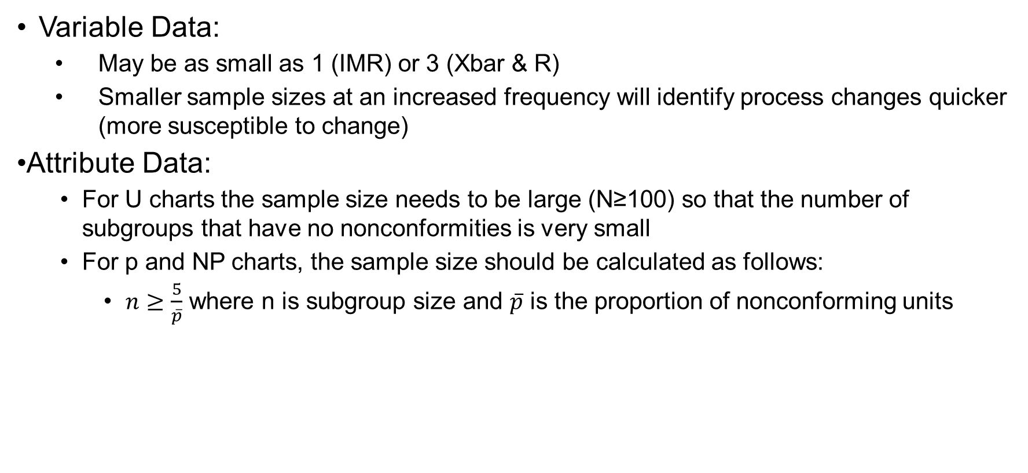
Sample Size Starting Point
Variable Data:
  May be as small as 1 (IMR) or 3 (Xbar & R)
  Smaller sample sizes at an increased frequency will identify process changes quicker (more susceptible to change)
Attribute Data:
  For U charts the sample size needs to be large (N≥100) so that the number of subgroups that have no nonconformities is very small
  For p and NP charts, the sample size should be calculated as follows:
    $n≥\frac{5}{\overline{p}}$ where n is subgroup size and $\overline{p}$ is the proportion of nonconforming units

Slide 15
What are Control Charts
A time order graphical representation of a process characteristic
They are used to:
  Determine if a process has been operating in statistical control
  Aid in maintaining statistical control
  Determine the process location and spread (common cause variation)
  Help identify special cause variation

Slide 16
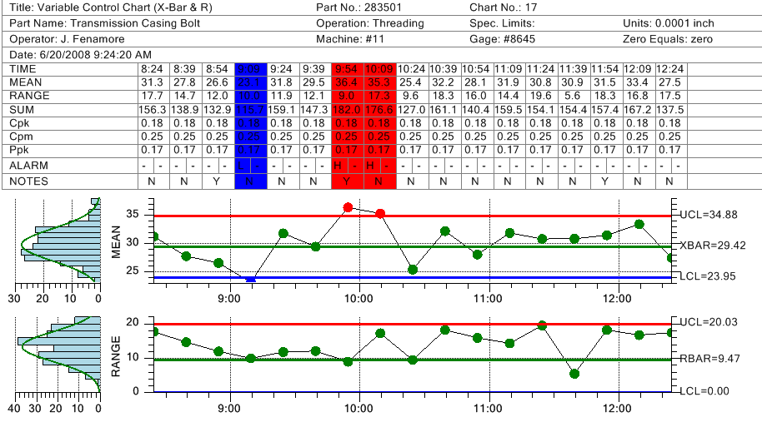
Components of a Control
Out of Control Points
Header
Event Log
Upper Control Limit (UCL)
Centerline
Lower Control Limit (LCL)
Data point

Slide 17
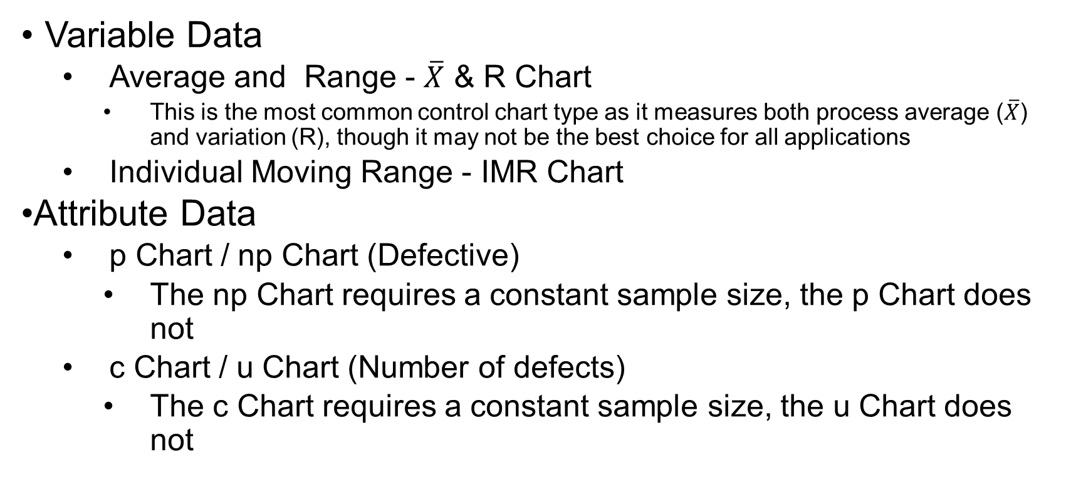
Common Control Chart Types
Variable Data
  Average and Range - $\overline{X}$ & R Chart
    This is the most common control chart type as it measures both process average ($\overline{X}$) and variation (R), though it may not be the best choice for all applications
  Individual Moving Range - IMR Chart
Attribute Data
  p Chart / np Chart (Defective)
    The np Chart requires a constant sample size, the p Chart does not
  c Chart / u Chart (Number of defects)
    The c Chart requires a constant sample size, the u Chart does not

Slide 18
GHSP Application of SPC
8
2
3
1
One subgroup
4
5
6
7
Item 1 is subgroup values- entered by inspector
Item 2 is subgroup average- calculated and plotted automatically
Item 3 is the Range biggest value minus smallest value in subgroup-calculated and plotted automatically

Slide 19
GHSP Application of SPC

Slide 20
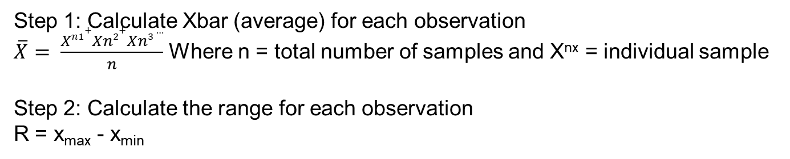
Example Control Chart
Goal: To create a sample Xbar and R chart for the data set below
Sample #1 | 0.0006 | 0.0008 | 0.0006 | 0.0002 | 0.0004 | 0.0004
Sample #2 | 0.0007 | 0.0005 | 0.0006 | 0.0007 | 0.0004 | 0.0008
Sample # 3 | 0.0001 | 0.0004 | 0.0000 | 0.0000 | 0.0006 | 0.0008
Xbar | 0.0005 | 0.0006 | 0.0004 | 0.0003 | 0.0005 | 0.002
Range | 0.0006 | 0.0004 | .00006 | 0.0007 | 0.0002 | 0.0004
Step 1: Calculate Xbar (average) for each observation
$\overline{X}= \frac{Xn1+Xn2+Xn3 …}{n}$ Where n = total number of samples and X^{nx} = individual sample
Step 2: Calculate the range for each observation
R = x_{max} - x_{min}

Slide 21
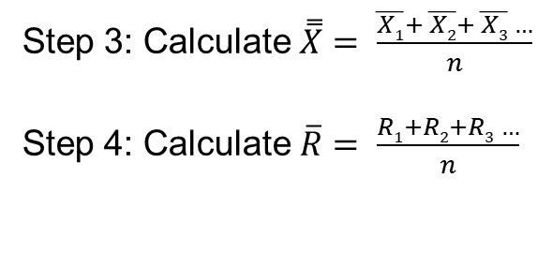
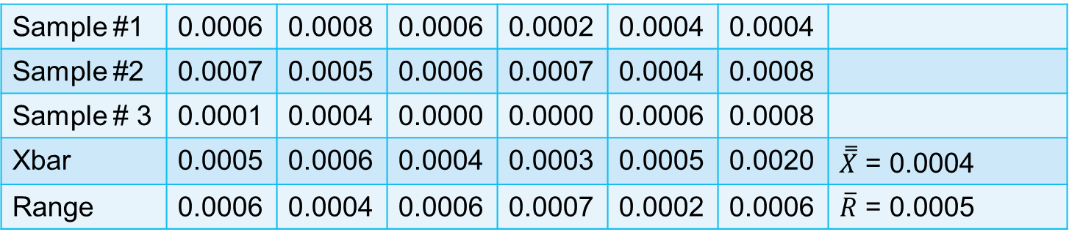
Sample #1 | 0.0006 | 0.0008 | 0.0006 | 0.0002 | 0.0004 | 0.0004
Sample #2 | 0.0007 | 0.0005 | 0.0006 | 0.0007 | 0.0004 | 0.0008
Sample # 3 | 0.0001 | 0.0004 | 0.0000 | 0.0000 | 0.0006 | 0.0008
Xbar | 0.0005 | 0.0006 | 0.0004 | 0.0003 | 0.0005 | 0.0020 | $\overset{̿}{X}$ = 0.0004
Range | 0.0006 | 0.0004 | 0.0006 | 0.0007 | 0.0002 | 0.0006 | $\overline{R}$ = 0.0005
Step 3: Calculate $\overset{̿}{X}= \frac{\overline{X1}+ \overline{X2}+ \overline{X3} …}{n}$
Step 4: Calculate $\overline{R}= \frac{R1+R2+R3 …}{n}$

Slide 22
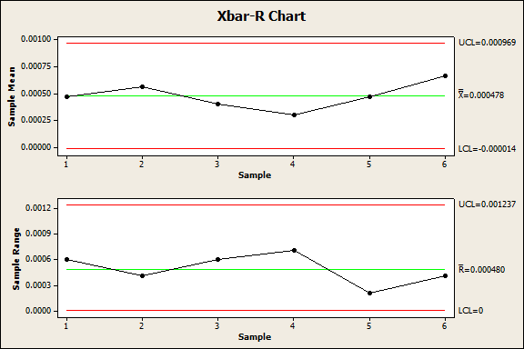
Step 6: Populate the Chart

Slide 23
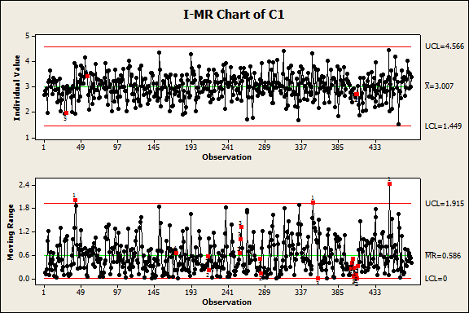
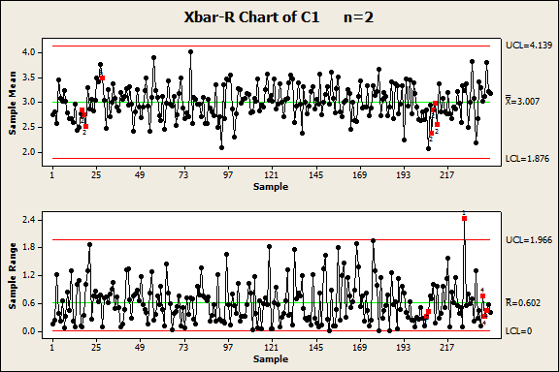
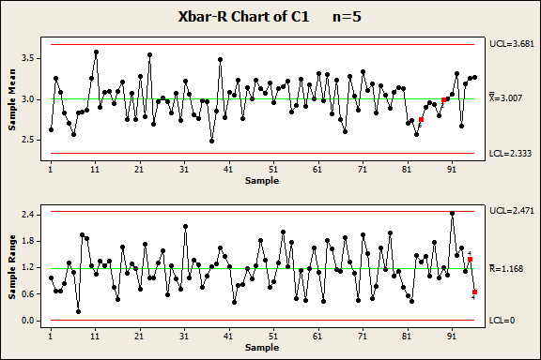
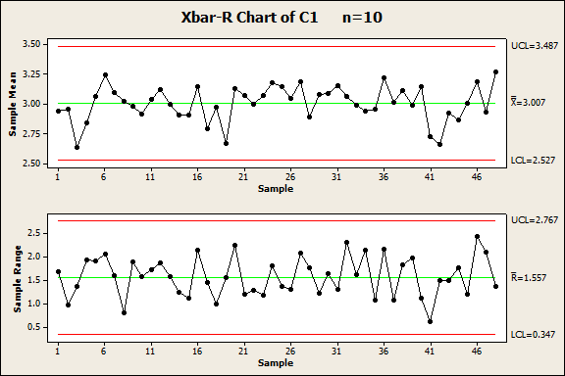
Quick Note about Control Limits
Control limit calculation directly correlates with subgroup size.

Slide 24
Xbar and R Chart in Minitab
Ensure all data is in time order
  Data may be in row or column by subgroup
  Data may all be in one column (simplest)
Go to Stat > Control Charts > Variable Charts for Subgroups > Xbar – R
Select the appropriate method the data is stored in
Select the data
  If all data is in one column select the appropriate subgroup size
Add labels as desired and click OK

Slide 25
Interpreting Results
Once your control chart is created continue collecting data as specified in your data collection plan
If an out of control condition is identified take immediate action!
  Determine root cause
  Record root cause on the chart, in the log or via another method
  Implement corrective actions to eliminate the root cause

Slide 26
Trends
Note: There are out of control conditions that may be bad for one process, but good for another.
An example of this is a run of 7 points above or below the centerline on a Xbar & R chart may indicate an out of control condition, whereas 7 points below the average on a p chart means less defects.
All trends and runs must be understood and either corrected (bad) or retained (good)
The goal is to use the fewest number of criteria to catch real signals, while avoiding false signals

Slide 27
Special Cause Criteria (AIAG/AT&T)
 | Summary of Special Cause Criteria
1 | 1 point > 3 standard deviations from the centerline
2 | 7 consecutive points on the same side of the center line (either side)
3 | 6 points in a row, all increasing or decreasing
4 | 14 points alternating up and down
5 | 2 out of 3 points > 2 standard deviations from the centerline (same side)
6 | 4 out of 5 points > 1 standard deviations from the centerline (same side)
7 | 15 points in a row within 1 standard deviation of the centerline (either side)
8 | 8 consecutive points > 1 standard deviation from the centerline (either side)

Slide 28
Special Cause Criteria (Minitab / Nelson)
 | Summary of Special Cause Criteria
1 | 1 point > 3 standard deviations from the centerline
2 | 9 consecutive points on the same side of the center line (either side)
3 | 6 points in a row, all increasing or decreasing
4 | 14 points alternating up and down
5 | 2 out of 3 points > 2 standard deviations from the centerline (same side)
6 | 4 out of 5 points > 1 standard deviations from the centerline (same side)
7 | 15 points in a row within 1 standard deviation of the centerline (either side)
8 | 8 consecutive points > 1 standard deviation from the centerline (either side)

Slide 29
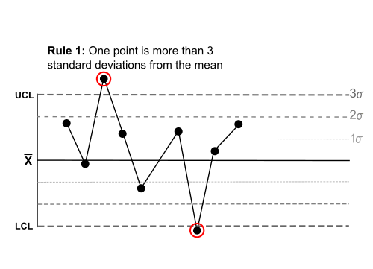
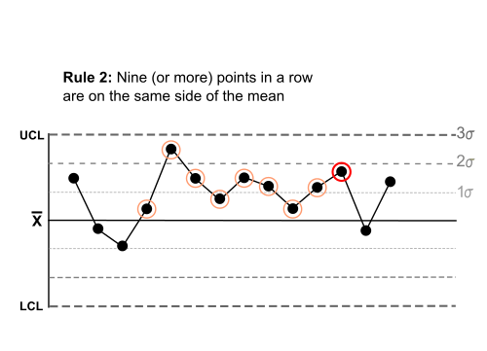
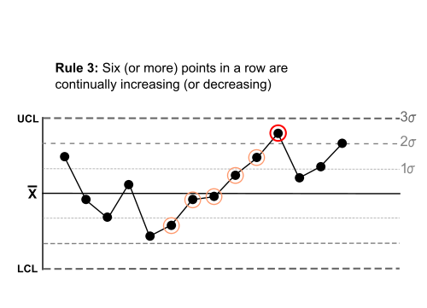
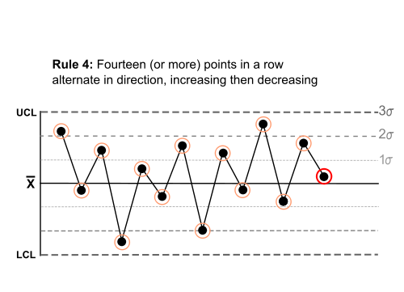
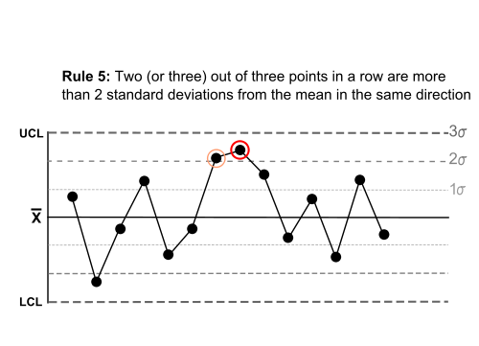
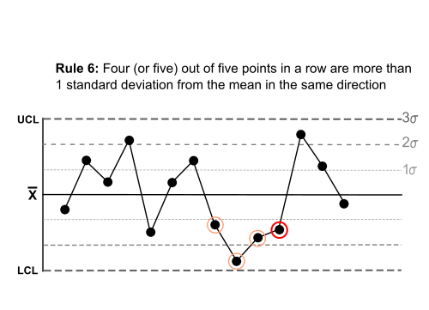
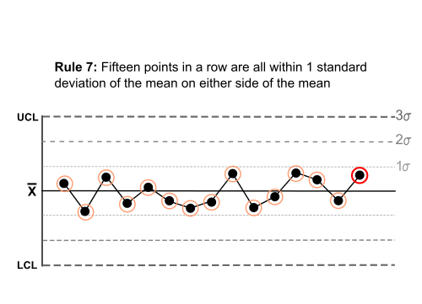
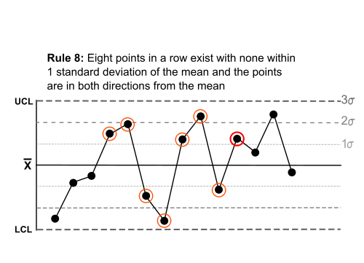
Special Cause Criteria

Slide 30
What do These Rules Test for?
Rule 1: Tests for stability. This is the strongest evidence of lack of control.
Rule 2: Tests for stability. This can be used to supplement rule 1.
Rule 3: Tests for a continuous trend up or down.
Rule 4: Tests for a systematic variable. The pattern of variation should be random, but is predictable if failing rule 4.
Rule 5: Tests for small shifts in the data.
Rule 6: Tests for small shifts in the data.
Rule 7: Tests for stratification, which can be misinterpreted as good process control.
Rule 8: Tests for mixture, which is when the data avoids the center line and lies near the control limits.

Slide 31
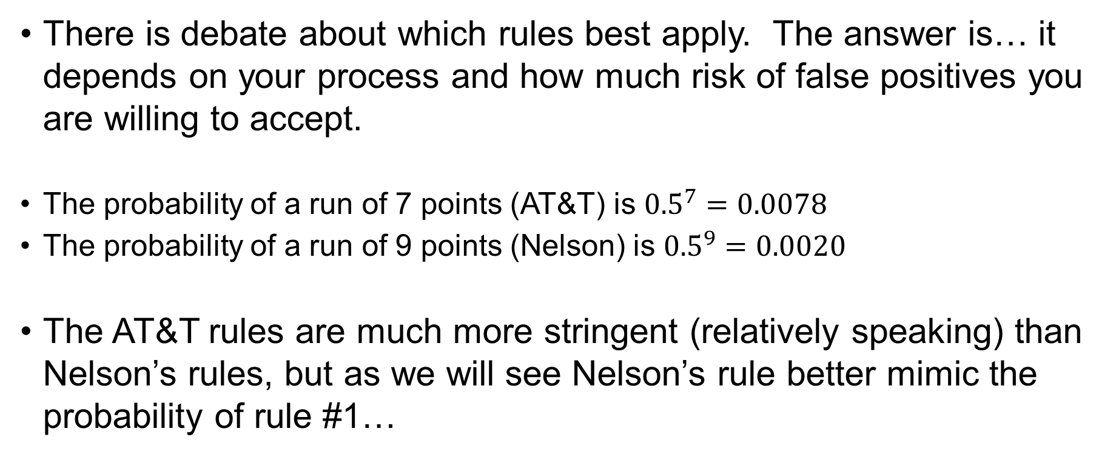
Why The Difference?
There is debate about which rules best apply. The answer is… it depends on your process and how much risk of false positives you are willing to accept.
The probability of a run of 7 points (AT&T) is ${0.5}^{7}=0.0078$
The probability of a run of 9 points (Nelson) is ${0.5}^{9}=0.0020$
The AT&T rules are much more stringent (relatively speaking) than Nelson’s rules, but as we will see Nelson’s rule better mimic the probability of rule #1…

Slide 32
How Were These Rules Established
These rules look for unnatural trends in data assuming a normal distribution. Keep in mind that the more rules applied the greater the chance for a false signal.
Let’s take a look at an example…
Rule #1 – “1 point > 3σ from the centerline”
This rule is by far the most commonly used as it represents a true ‘out of control’ condition.

Slide 33
Rule #1
A control chart of a normally distributed process shows a data point 3.1 standard deviations from the process mean. What is the probability of a point being outside of 3σ from the centerline?
3.1σ
-3σ -2σ -1σ 0 +1σ +2σ +3σ

Slide 34
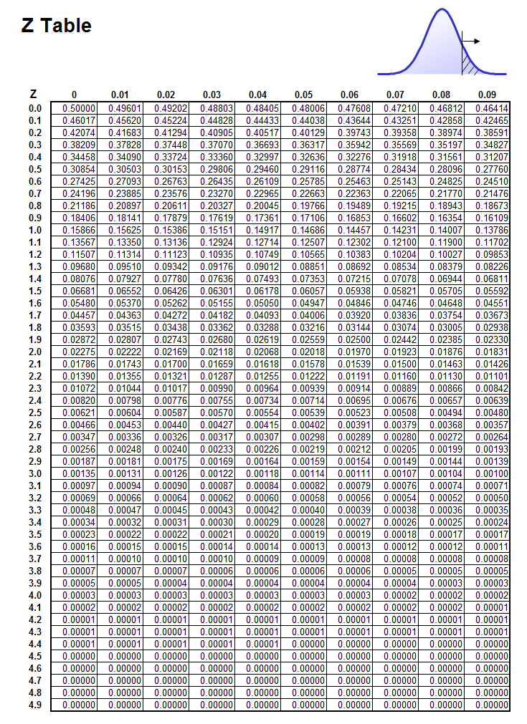
Rule #1
Looking at the z-table there is a 0.097% chance for a part to be produced at or outside of 3.1σ from the centerline on one side of the centerline.
If a part is produced at this point we had better investigate!
In general, for a normal process, the chance of a point falling outside of 3σ on either side of the center line is 0.27%.
The z-score for 3.0 is 0.00135
0.00135 x 2 = 0.0027
0.0027 x 100 = 0.27%

Slide 35
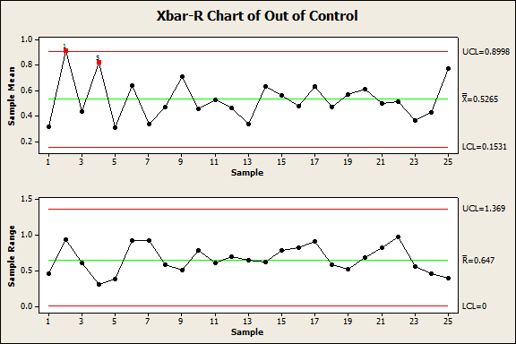
How to Determine Out of Control
Here we can see two points are highlighted.
Point #2 is outside of 3 standard deviations (test#1)
Point #4 shows 2 out of 3 points greater than 2σ from the mean (test#2)
Minitab will automatically highlight out of control points based on the 8 tests, as long as those tests are turned on when the control chart is created.

Slide 36
Rule Identification
All eight rules previously listed have visual ques.
Some of these rules are easily detected visually on a control chart, but others are not.
How can you tell if 2 of 3 parts are greater than two standard deviations from the centerline?
The answer is easy, set up a zone chart to help identify signals!

Slide 37
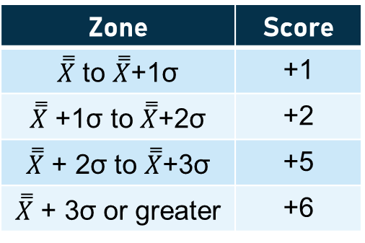
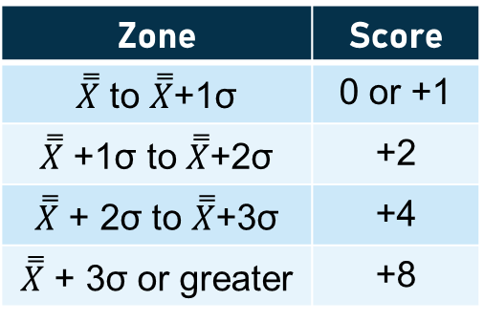
Zone Chart
Zone charts, also known as sigma charts, are divided into six shaded areas corresponding with 1, 2, and 3 standard deviation intervals from the centerline.
A value is then assigned for each zone. The typical values are as follows;
Note: Standard deviation in this case refers to the standard deviation of sample averages, not the individual values.
Zone | Score
$\overset{̿}{X}$ to $\overset{̿}{X}$+1σ | 0 or +1
$\overset{̿}{X}$ +1σ to $\overset{̿}{X}$+2σ | +2
$\overset{̿}{X}$ + 2σ to $\overset{̿}{X}$+3σ | +4
$\overset{̿}{X}$ + 3σ or greater | +8
Zone | Score
$\overset{̿}{X}$ to $\overset{̿}{X}$+1σ | +1
$\overset{̿}{X}$ +1σ to $\overset{̿}{X}$+2σ | +2
$\overset{̿}{X}$ + 2σ to $\overset{̿}{X}$+3σ | +5
$\overset{̿}{X}$ + 3σ or greater | +6
OR

Slide 38
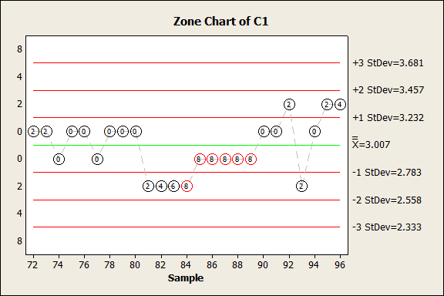
Zone Chart
Each plotted point is scored based on the zone it lands in.
Each time a point crosses the centerline the score is reset to zero.
If the cumulative score reaches 8 it is considered out of control.

Slide 39
Zone vs. Xbar
When using the 0,1,2,4,8 scoring method the zone chart is equivalent to the standard criteria 1,5 and 6 for a Xbar chart and is more stringent than criteria 8.
When using the 1,2,5,6 scoring method the zone chart is equivalent to the standard criteria 1,5 and 6 for a Xbar cart and is more stringent than criteria 7 and 8.

Slide 40
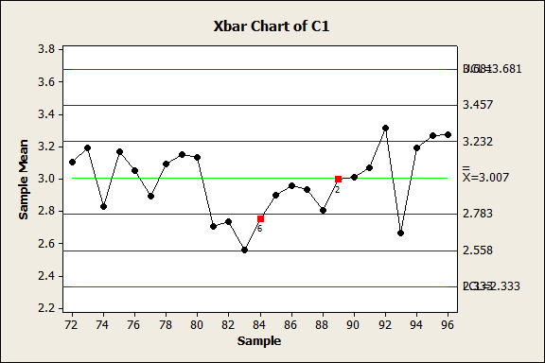
Zone vs. Xbar
Notice the same data point is flagged on both the Zone Chart and Xbar chart

Slide 41
Out of Control
There are varying degrees of out of control conditions (outliers, runs, trends, etc.) some of which include flags even if all points are within the control limits
Early in a SPC program not all conditions may be understood by those completing the real-time analysis
While each out of control condition should be understood it should also be noted that overreaction can also lead to waste

Slide 42
Possible Causes
A point outside the control limits may be due to:
  The control limit or plotted point was miscalculated
  The observation to observation spread has increased, either at one point or as part of a trend
  The measurement system has changed (new operator, method, etc.)

Slide 43
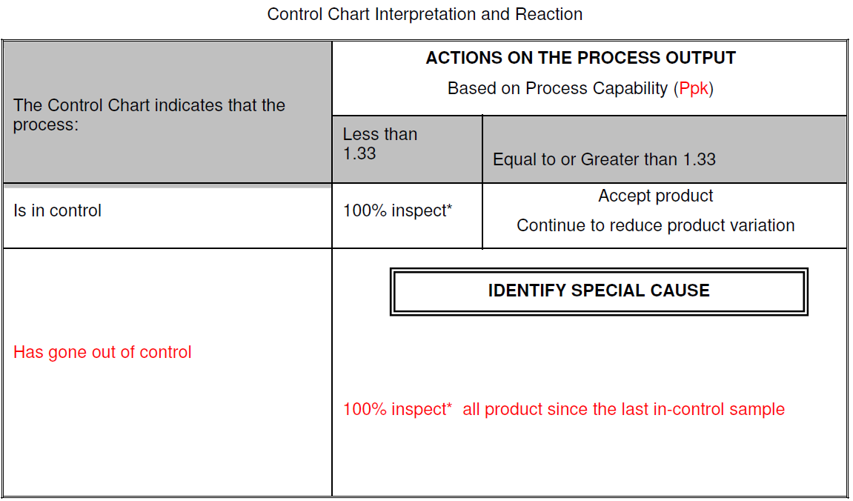
Reacting to an Out of Control Condition
There is an out of control condition! What do I do?
Ford uses the format below to help determine next steps (SC/CC Items);

Slide 44
Reacting to an Out of Control Condition
Some questions to ask:
Have control limits and plotted points been calculated correctly?
Is the measurement system working correctly?
  Are there obvious signs of wear or damage?
  Is there a different person taking the measurements?
Is the operator different? If so, have they been trained?
Has there been a process change?
Has there been a material / lot change?
Has the environment changed?
Is the production equipment adequate?
  Is it damaged?
  Is maintenance required? (Has maintenance recently been completed?)

Slide 45
Reacting to an Out of Control Condition
Regardless of the action taken the primary focus for each out of control condition is to determine the root cause and ensure actions are implemented to eliminate the special cause variation

Slide 46
GHSP Application of SPC
Statistical Process Control chart conditions that require Shark attack:
1-Check if CPK=<2 and/or PPK=<1.67
2-Check to see that No yellow color or Red color cells in the Excel sheet cells for subgroup data.
-Yellow color means it is sample is about to be outside of tolerance
-Red means outside the sample is outside of tolerance
-If Range or Average of subgroup is red that means the value is outside control limits.
3-Is it the seventh subgroup average in a row above (to the right of) the chart Xbar line (center line) or the seventh subgroup average in a row below (to the left of) the chart Xbar line (center line).
4-Is it the seventh subgroup in a row increasing (moving to the right) or the seventh subgroup in a row decreasing (moving to the left).

Slide 47
Real World Examples

Slide 48
GHSP Example

Slide 49
For out of control conditions actions must be listed in the action tab as shown below.

Slide 51
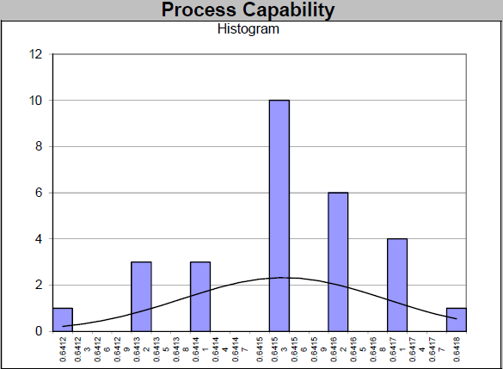
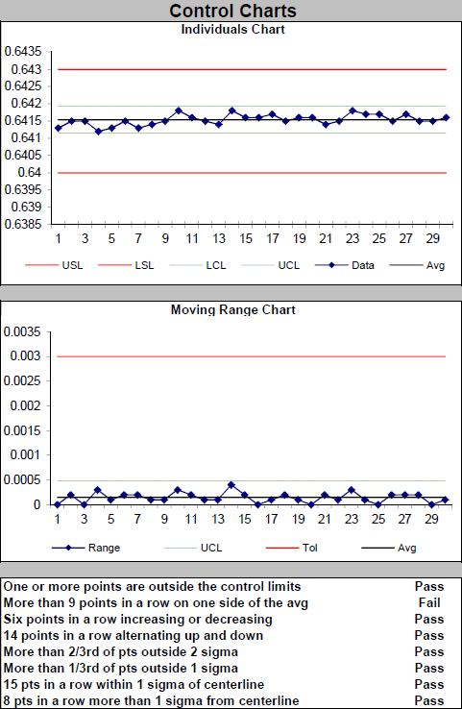
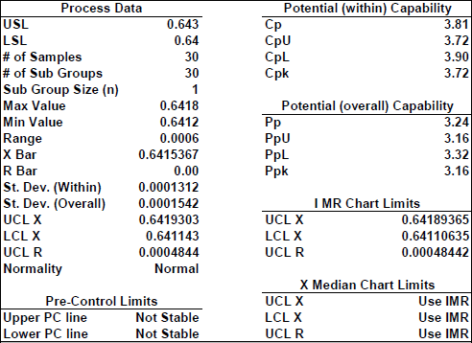
Example 2

Slide 52
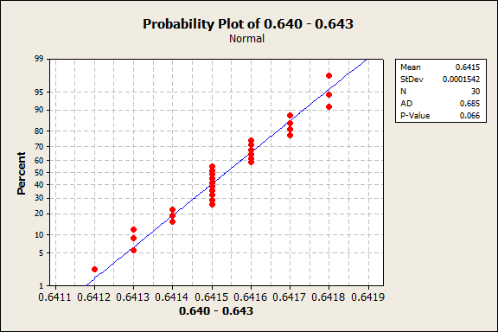
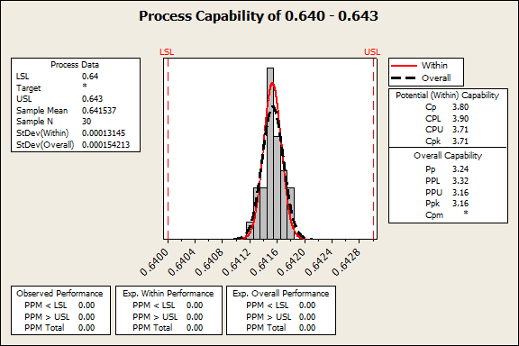
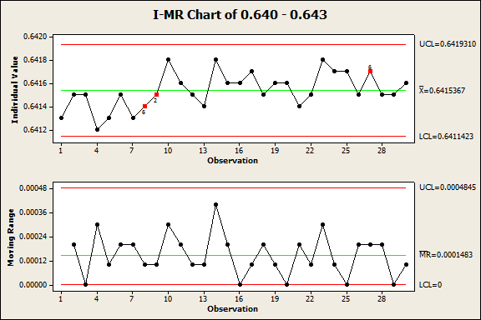
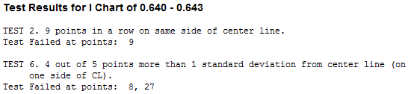
Example 2

Slide 53
Example 2 Comparison
What conclusion would you make about this capability study?

Slide 54
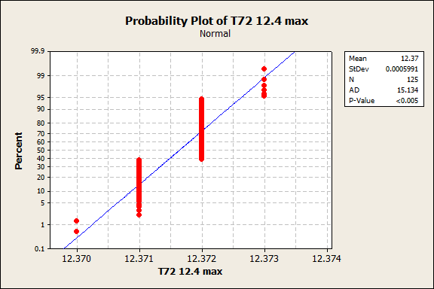
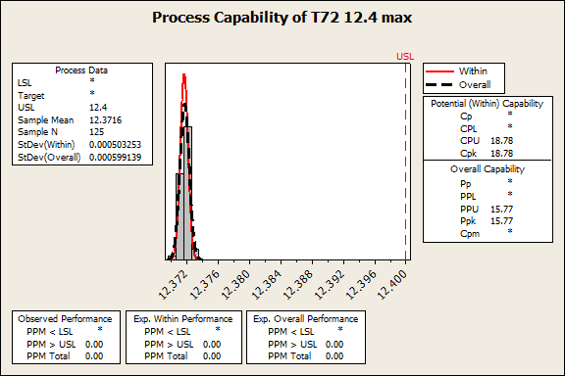
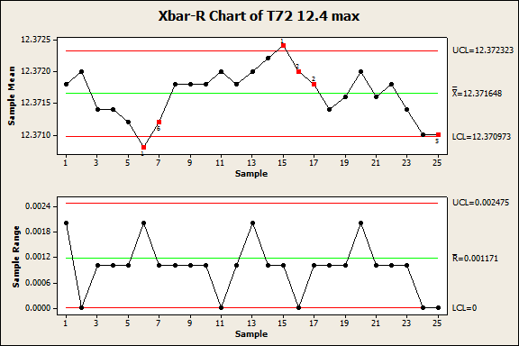
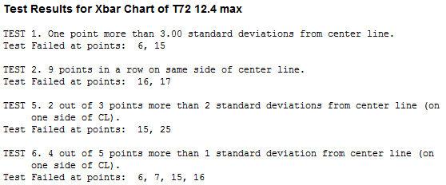
Example 3

Slide 55
Example 3
A P-value of greater than 0.05 shows normality.
This process is not normal. Why?
The measurement system is limited by resolution.
However, the total variation is 3µm. This is more than sufficient.
Is this normality study acceptable?
Yes!

Slide 56
Example 3
Is this control chart acceptable?
Let’s take a look at the gage R&R…

Slide 57
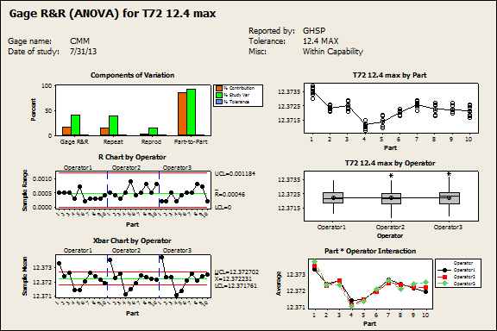
Example 3
Take a look at the control limits
Keep in mind that the points within the control
limits are effectively in the gauge’s blind spot

Slide 58
Example 3
The GRR control chart limits were 12.3727 / 12.3717
Comparing this to the control limits here the gauge used can’t effectively differentiate most of these parts from each other.
Considering this the control chart is acceptable as the variation seen here may be due to gauge error and the variation is minimal.

Slide 59
Example 3 Final Analysis
Is this capability study acceptable?
The data used for this study is not normal. However, it is limited by resolution (1µm)
The data used for this study was not in control. However, the variation was due mostly to gauge error.
The process is extremely capable.
This study is acceptable!

Slide 60
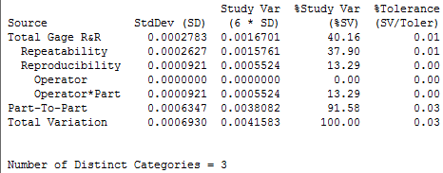
Example 3 Final Analysis
So we accept the initial process study, but talk about gauge variation.
Does this mean we need a better gauge?
Acceptable
Acceptable
Acceptable
Acceptable
Not normally
acceptable, but expected given the low part to part variation (high process capability)
Acceptable
Acceptable
Acceptable considering the high process capability
Acceptable

Slide 61
Questions

