Slide 1
Statistical Process Control (SPC)
Training Guide

Slide 2
What is data?
Data is factual information (as measurements or statistics) used as a basic for reasoning, discussion or calculation. (Merriam-Webster Dictionary, m-w.com)
What does this mean?
Data allows us to make educated decisions and take action!

Slide 3
Why is Data Important?
If we don’t collect data about a process then what?
Without data we don’t understand the process / product
So what?
Without understanding of the process / product we can’t control the outcome
Is it important to control the outcome?
When you can’t control the outcome you are dependent on chance.
You may have a good outcome, you may not.
Without data collection you may not know either way.

Slide 4
Use of Data
I’m not collecting data because its non value add.
Without data collection there is no way to identify problems, continuously improve or ensure you are meeting the voice of the customer.
I’m collecting data, but not looking at it. Is that okay?
No, the collection of data without analysis is a bigger waste than not collecting data in the first place.
What should I be doing with the data?

Slide 5
DATA
Statistics
Information that can be understood and acted on.

Slide 6
What are Statistics
A branch of mathematics dealing with the collection, analysis, interpretation and presentation of masses of numerical data (Merriam-Webster Dictionary, m-w.com)
What does this mean?
Once data is collected we can use appropriate statistical methods to describe (understand) our process / product and control (predict) the process / product outcome

Slide 7
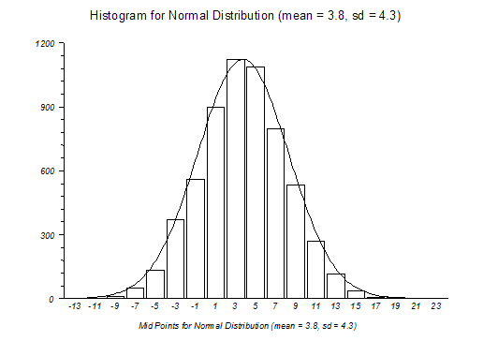
Statistics Allow us to
Describe our process / product
Control (predict) process / product outcomes
Population
(All Product)
Sample
(125 Pieces)

Slide 8
Important Notes
Statistical conclusions require useful data
We need to measure the right thing
Determining what data to collect and how to collect it are important steps in the APQP / continuous improvement process
We need to have confidence the data collected is accurate
A good measurement system is required to collect data
Be sure the measurement system analysis (MSA) is acceptable before collecting data
There is a separate training available for MSA
Reduce / Eliminate Waste
Data that doesn’t provide useful information drives waste
We want to gain the most useful information from the least amount of data possible!

Slide 9
Types of Data
Variable Data (Continuous Data)
Measurements on a continuous scale
Examples
Product Dimensions
Weight
Time
Cost
Process parameters (cutting speed, injection pressure, etc.)
Attribute Data (Discrete Data)
Data by counting
Examples
Count of defective parts from production
Number of chips on a painted part

Slide 10
Types of Attribute Data
Binomial Distribution
Pass / Fail (PPM)
Number of defective bezels
Number of defective castings
Poisson Distribution
Number of defects (DPMO)
Number of defects per bezel
Number of defects per casting

Slide 11
Which Type of Data is Better?
Variable Data
Attribute Data
Pros:
Provides useful information with smaller sample sizes
Can identify common cause concerns at low defect rates
Can be used to predict product / process outcomes (trends)
Very useful for continuous improvement activities (DOE, Regression analysis, etc.)
Cons:
Data collection can be more difficult, requiring specific gauges or measurement methods
Analysis of data requires some knowledge of statistical methods (Control charting, Regression analysis, etc.)
Pros:
Very easy to obtain
Calculations are simple
Data is usually readily available
Good for metrics reporting / management review
Good for baseline performance
Cons:
Data collection can be more difficult, requiring specific gauges or measurement methods
Analysis of data requires some knowledge of statistical methods (Control charting, Regression analysis, etc.)

Slide 12
Introduction to Statistics
Goal:
Define basic statistical tools
Define types of distributions
Understand the Central Limit Theorem
Understand normal distributions

Slide 13
Definitions
Population: A group of all possible objects
Subgroup (Sample): One or more observations used to analyze the performance of a process.
Distribution: A method of describing the output of a stable source of variation, where individual values as a group form a pattern that can be described in terms of its location, spread and shape.

Slide 14
Measures of Data Distribution
Measures of Location
Mean (Average)
The sum of all data values divided by the number of data points
Mode
The most frequently occurring number in a data set
Median (Midpoint)
Measures of Spread
Range
The difference between the largest and smallest values of a data set
Standard Deviation
The square root of the squared distances of each data point from the mean, divided by the sample size. Also known as Sigma (σ)

Slide 15
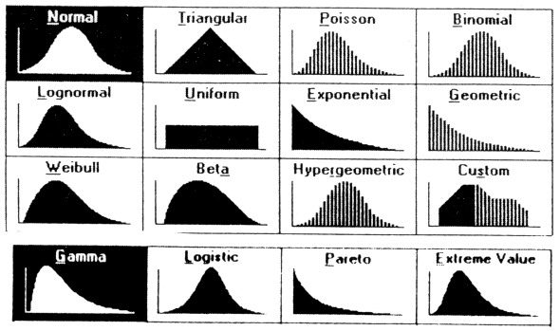
Distribution Types
Discrete
Binomial
Poisson
Continuous
Normal
Exponential
Weibull
Uniform

Slide 16
Central Limit Theorem
The Central Limit Theorem is the basis for sampling and control charting (of averages).
There are 3 properties associated with the CLT;
The distribution of the sample means will approximate a normal distribution as the sample size increases, even if the population is non-normal
The average of the sample means will be the same as the population mean
The distribution of the sample means will be narrower than the distribution of the individuals by a factor of $\frac{1}{√n}$, where n is the sample size.

Slide 17
CLT Property 1
The distribution of the sample means of any population will approximate a normal distribution as the sample size increases, even if the population is non-normal.
Because of this property control charts (for averages) is based on the normal distribution.
Population
Population
Population
Population
Distribution of sample means from any population

Slide 18
The Normal Distribution
50% 50%
µ ± 1σ = 68.3%
µ ± 2σ = 95.4%
µ ± 3σ = 99.7%
2% 14% 34% 34% 14% 2%
-3σ -2σ -1σ 0 +1σ +2σ +3σ

Slide 19
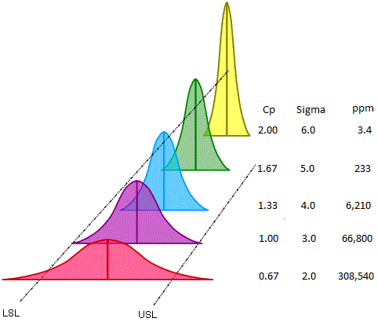
Process Capability
Process Capability

Slide 20
Process Capability
Goal
Understand process capability and specification limits
Understand the procedure of calculating process capability
Understand C_{p}, C_{pk}, P_{p} and P_{pk} indices
Estimating percentage of process beyond specification limits
Understanding non-normal data
Example capability calculation

Slide 21
Specification Limits
Individual features
(dimensions) on a product are assigned specification limits.
How do we determine a process is able to produce a part that meets specification limits?
Process Capability!
LSL
USL

Slide 22
Process Capability and Specification Limits
Process capability is the ability of a process to meet customer requirements.
LSL
USL
LSL
USL
Acceptable capability
Product outside of spec limits

Slide 23
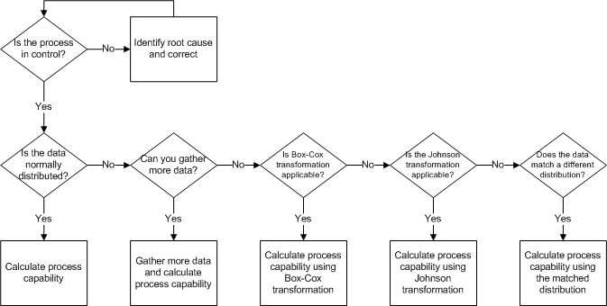
Calculating Process Capability

Slide 24
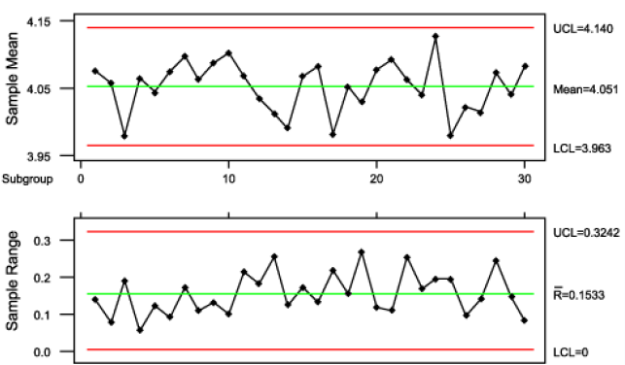
Determine Stability
All sample means and ranges and in control and do not indicate obvious trends

Slide 25
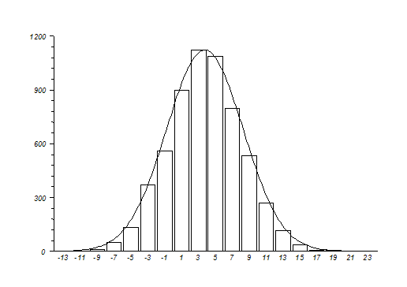
Determine Normality
Placing all data in a histogram may be used to help determine normality. If the data represents a normal curve.

Slide 26
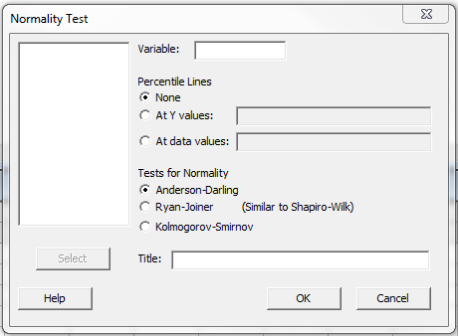
Determine Normality
A more statistical method is to use the Anderson Darling test for normality
In Minitab go to:
Stat > Basic Statistics > Normality Test
Select Anderson Darling and click ok

Slide 27
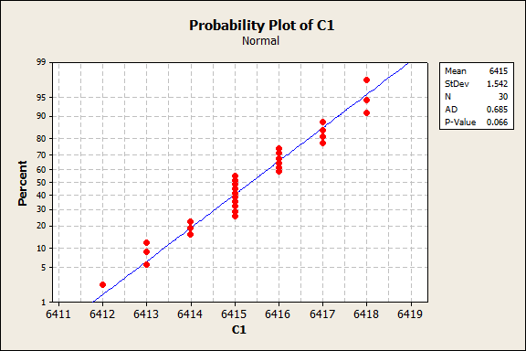
Interpreting Normality
The p-Value must be greater than or equal to 0.05 to match the normal distribution.

Slide 28
Process Indices
Indices of process variation only, in regard to specification;
C_{p} and P_{p}
Indices of process variation and centering combined, in regard to specification;
C_{pk} and P_{pk}

Slide 29
Note
Before calculating capability or performance indices we need to make sure of a couple of things!
The process needs to be stable (in control)
The process needs to be normal
A completed MSA needs to prove the measurement system is acceptable
If the above items are not met understand the results of the capability studies may be inaccurate. Also, per the AIAG PPAP manual (4th Edition) if the above items are not met corrective actions may be required prior to PPAP submittal.

Slide 30
C_{p} Overview
C_{p} = Potential Process Capability = $\frac{Tolerance}{Width of Distribution}=\frac{Voice of Customer}{Voice of Process}$
This index indicates potential process capability.
Cp is not impacted by the process location and can only be calculated for bilateral tolerance.

Slide 31
C_{p} Calculation
Subgroup Size | d₂
2 | 1.128
3 | 1.693
4 | 2.059
5 | 2.326
6 | 2.534
7 | 2.704
8 | 2.847
9 | 2.970
10 | 3.078
C_{p} = $\frac{USL −LSL}{6σc}=\frac{USL −LSL}{6\left(\frac{\overline{R}}{d2}\right)}$
Where:
USL = Upper specification limit
LSL = Lower specification limit
$\overline{R}$ = Average Range
d₂ = a constant value based on subgroup sample size

Slide 32
Interpreting C_{p}
Garage Door Width
<1
Car
1
2
Cp = Number of times the car (distribution) fits in the garage (specification limit)
LSL
USL

Slide 33
C_{pk} Overview
C_{pk} is a capability index. It takes the process location and the capability into account.
C_{pk} can be calculated for both single sided (unilateral) and two sided (bilateral) tolerances.
For bilateral tolerances C_{pk} is the minimum of CPU and CPL where:
CPU = $\frac{USL − \overset{̿}{X}}{3σc}= \frac{USL − \overset{̿}{X}}{3\left(\frac{\overline{R}}{d2}\right)}$ and CPL =$\frac{\overset{̿}{X} −LSL}{3σc}= \frac{\overset{̿}{X} −LSL}{3\left(\frac{\overline{R}}{d2}\right)}$
Where:
$\overset{̿}{X}$ = Process average
USL = Upper specification limit
LSL = Lower specification limit
$\overline{R}$ = Average Range
d₂ = a constant value based on subgroup sample size
_{Note that} $\frac{\overline{R}}{d2}$ is an estimate of the standard deviation

Slide 34
C_{pk} Example
GHSP is provided a machined casting with a hole diameter of
16.5 ± 1.0mm.
The supplier has collected 25 subgroups of 5 measurements and wants to determine the process capability.
With a subgroup size of 5 d2 is 2.326 (table to right).
If the process average ($\overset{̿}{X}$) is 16.507 and the average range ($\overline{R}$) is 0.561, then the C_{pk} is calculated as follows:
Subgroup Size | d₂
2 | 1.128
3 | 1.693
4 | 2.059
5 | 2.326
6 | 2.534
7 | 2.704
8 | 2.847
9 | 2.970
10 | 3.078
= Minimum $\left\langle \text{CPU}\text{ = }\frac{17.5 −16.507}{3\left(\frac{0.561}{2.326}\right)}\text{ , }\text{CPL}\text{ =} \frac{16.507 −15.5}{3\left(\frac{0.561}{2.326}\right)}\right\rangle$
= Minimum $\left\langle \text{CPU}\text{ = 1.372 , }\text{CPL}\text{ =}1.392 \right\rangle$
= 1.372

Slide 35
C_{p} / C_{pk} Review
C_{p} indicates how many process distribution widths can fit within specification limits. It does not consider process location. Because of this it only indicates potential process capability, not actual process capability.
C_{pk} indicates actual process capability, taking into account both process location and the width of the process distribution.

Slide 36
P_{p} Overview
This index indicates potential process performance. It compares the maximum allowable variation as indicated by tolerance to the process performance
P_{p} is not impacted by the process location and can only be calculated for bilateral tolerance.
P_{p} must be used when reporting capability for PPAP
Where:
σ = Standard deviation
USL = Upper specification limit
LSL = Lower specification limit
P_{p} = $\frac{USL −LSL}{6σp}$

Slide 37
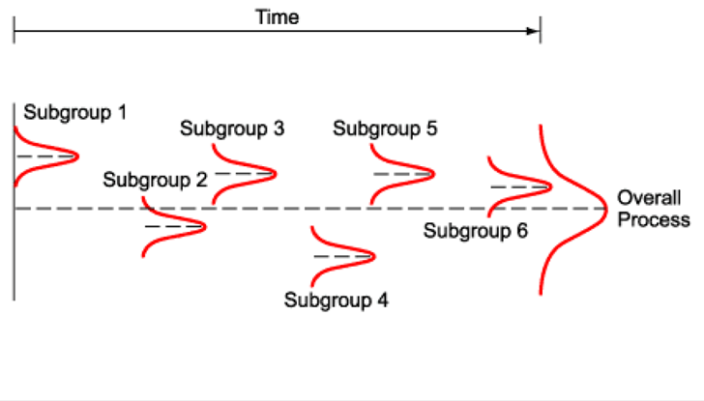
P_{p} and C_{p}
P_{p}
C_{p} takes into account within subgroup variation (average range)
P_{p} takes into account between subgroup variation

Slide 38
P_{pk} Overview
P_{pk} is a performance index. It indicates actual process performance, taking into account both process location and overall process variation.
P_{pk} shows if a process is actually meeting customer requirements.
P_{pk} can be used for both unilateral and bilateral tolerances.
P_{pk} must be used when reporting capability for PPAP

Slide 39
P_{pk} Calculation
Ppk is the minimum of PPU and PPL where:
PPU = $\frac{USL − \overset{̿}{X}}{3σp}$ and PPL =$\frac{\overset{̿}{X} −LSL}{3σp}$
Where:
$\overset{̿}{X}$ = Process average
USL = Upper specification limit
LSL = Lower specification limit
σ = Standard deviation

Slide 40
P_{p} / P_{pk} Review
P_{p} indicates how many process distribution widths can fit within specification limits. It does not consider process location. Because of this it only indicates potential process performance, not actual process performance.
P_{pk} indicates actual process performance, taking into account both process location and the width of the process distribution.

Slide 41
A Few Notes
C_{pk} will always be smaller than C_{p}, unless the process is centered. If the process is centered the two value will be the same.
P_{pk} will always be smaller than P_{p}, unless the process is centered. If the process is centered the two values will be the same.
C_{p} and P_{p} cannot be calculated for unilateral tolerances.
C_{pk} and P_{pk} can be calculated for both unilateral and bilateral tolerances.
Often, short term capability will be calculated using C_{p} and C_{pk}. This is because these indices use $\frac{\overline{R}}{d2}$ to estimate standard deviation, which is a calculation of within subgroup variation. This calculation tells us how good a process could potentially be at its best performance.
Pp and Ppk uses the actual (overall or between subgroup) standard deviation to calculate performance. As such, when reporting capability use P_{p} and P_{pk}.

Slide 42
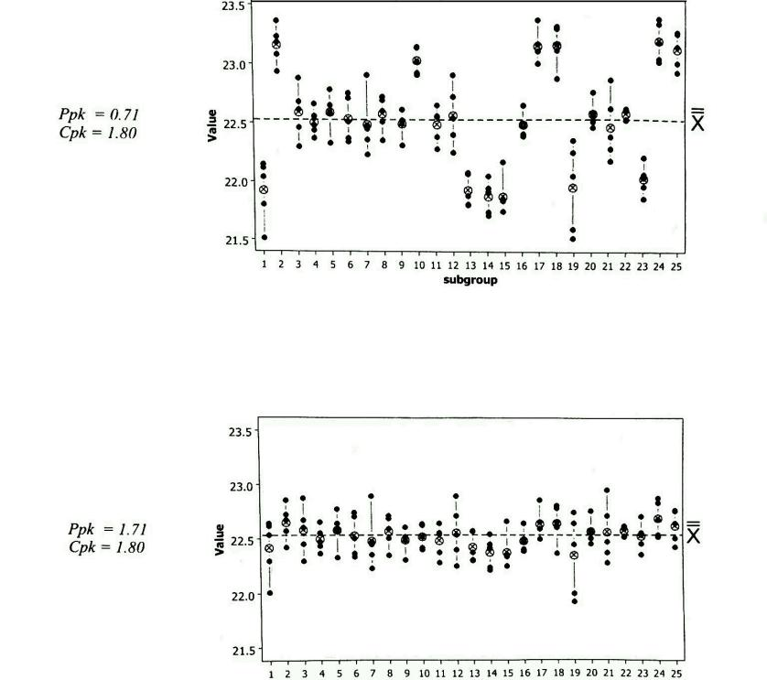
C_{pk} and P_{pk} Compared
These two data sets contain the same data.
The top data set is from an immature process that contains special cause variation.
The bottom data set has the same within group variation, but has between group variation removed.
The bottom data set shows a process that is in statistical control.
This example may be found in the AIAG SPC (Second Edition) Manual on page 136

Slide 43
Process Indices Review
Process Indices
Interpretation
Cp = 4.01, Cpk = 4.01
Pp = 4.00 , Ppk = 3.99
Cp = 0.27, Cpk = 0.26
Pp = 0.25, Ppk = 0.24
Cp = 4.01, Cpk = -2.00
Pp = 3.99, Ppk = -2.01
Cp = 4.01, Cpk = 4.00
Pp = 2.01, Ppk = 2.00
This process is stable and produces almost all parts within specification
Significant common cause variation exists
Significant special cause variation exists
Improvement can be made by centering the process

Slide 44
Estimating Percent Out of Specification
To estimate the percentage of product that falls outside of the specification limits we need to compute Z_{upper} and Z_{lower}
For this example assume an average range of 8.4 from a stable process using a sample size of 5
LSL = 160
USL = 182
167.8
178.6
189.4
Z_{lower} is the number of standard deviations between the average and the LSL
Z_{upper} is the number of standard deviations between the average and the USL

Slide 45
Estimating Percent Out of Specification
σ = $\frac{\overline{R}}{d2}$ = $\frac{8.4}{2.326}$ = 3.6
Z_{upper} = $\frac{USL − \overset{̿}{X}}{σ}$
Z_{upper} = $\frac{182.0 −178.6}{3.6}=0.94$
Z_{lower} = $\frac{\overset{̿}{X} −LSL}{σ}$
Z_{lower} = $\frac{178.6 −160.0}{3.6}=5.17$
LSL = 160
USL = 182
167.8
178.6
189.4
The LSL is 5.17σ from $\overset{̿}{X}$
The USL is 0.94σ from $\overset{̿}{X}$

Slide 46
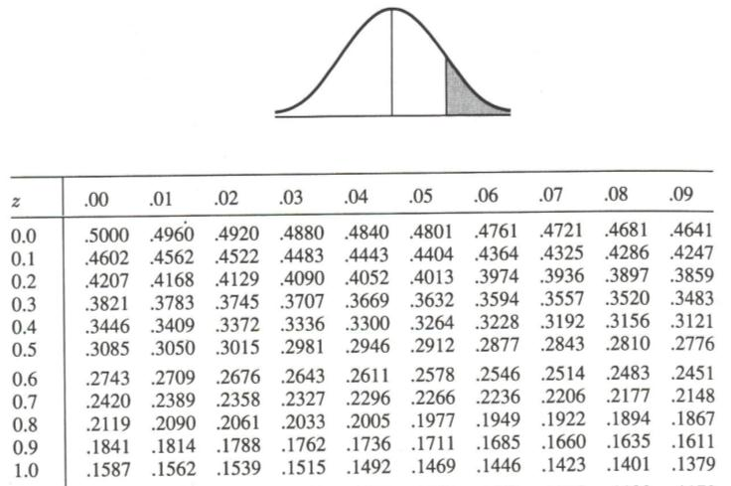
Estimating Percent out of Specification
Next, we need to reference a z table.
From the z table we find 0.94, which corresponds to a proportion of 0.1736
This convert to 17.36% defective or 173,600 PPM
LSL = 160
USL = 182
167.8
178.6
189.4
Z_{upper} = 0.94

Slide 47
Understanding Non-Normal Data
What happens when data used for capability is not normally distributed?
C_{p} and P_{p} indices are robust in their accuracy with regards to non-normal data.
C_{pk} and P_{pk} indices are not robust with regards to non-normal data.
Calculating (and making decisions based on) P_{pk} and C_{pk} indices assuming normality with non-normal data can be misleading.

Slide 48
Understanding Non-Normal Data
What do I do if my data is not normal?
Gather more data
This may or may not be an option given timing and cost.
The Central Limit Theorem (covered earlier) states that all population means resemble the normal distribution with larger sample size
Transform the data
Using either the Box-Cox or Johnson transformations we can transform non-normal data to a near normal form
This allows use to accurately calculate Cpk and Ppk indices and the proportion nonconforming
Calculate capabilities based on different distributions

Slide 49
Box-Cox Transformation
The goal of the Box-Cox transformation is to identify a Lambda value (λ).
The Lambda value will then be used in the function X^{λ} to transform the data (X) from a non-normal set into a normal data set.
The formula for this transformation is W=X^{λ} where:
-5 $≤ λ ≥$ 5
and λ = 0 for the natural log transformation
λ = 0.5 for the square root transformation

Slide 50
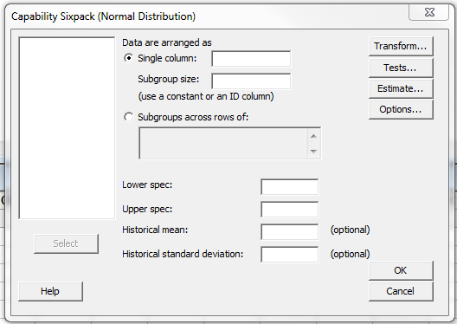
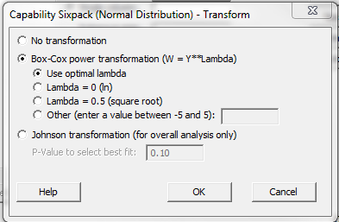
Box-Cox in Practice
The Box-Cox transformation can be used in Minitab’s capability analysis of normal data.
When running a capability study in Minitab select:
Stat > Quality Tools > Capability Sixpack > Normal
Then select “Transform” and check “Box-Cox power Transformation”

Slide 51
Johnson Transformation
The Johnson Transformation uses a system of transformations that yield approximate normality.
The Johnson Transformation covers:
Bounded data
Log normal data
Unbounded data
This system of transformations cover all possible unimodal distribution forms (skewness-kurtosis)
This transformation can also be ran in Minitab

Slide 52
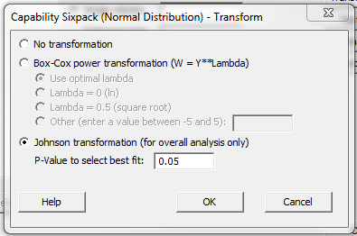
Johnson Transformation in Practice
The Johnson Transformation can be used in Minitab’s capability analysis of normal data.
When running a capability study in Minitab select:
Stat > Quality Tools > Capability Sixpack > Normal
Then select “Transform” and check “Box-Cox power Transformation”

Slide 53
Example Process Capability
Using the data below captured from an early pre-production run calculate initial process capability.
0.6413 | 0.6416
0.6415 | 0.6417
0.6415 | 0.6415
0.6412 | 0.6416
0.6413 | 0.6416
0.6415 | 0.6414
0.6413 | 0.6415
0.6414 | 0.6418
0.6415 | 0.6417
0.6418 | 0.6417
0.6416 | 0.6415
0.6415 | 0.6417
0.6414 | 0.6415
0.6418 | 0.6415
0.6416 | 0.6416
The process specification is 0.642 +0.001 / -0.002
30 data points were collected (subgroup of 1)

Slide 54
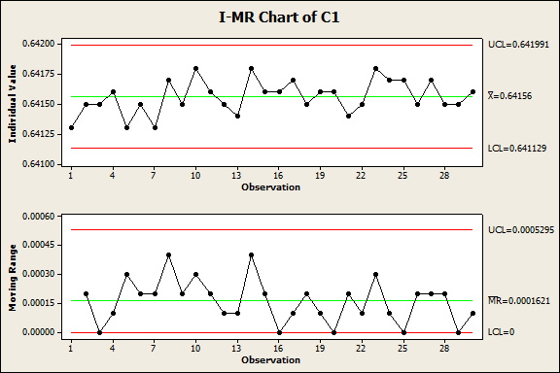
Is the Data Stable?

Slide 55
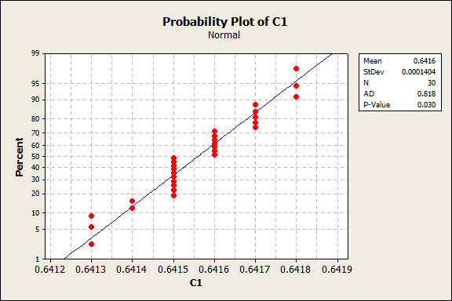
Is the Data Normal?

Slide 56
Calculate Capability

Slide 57
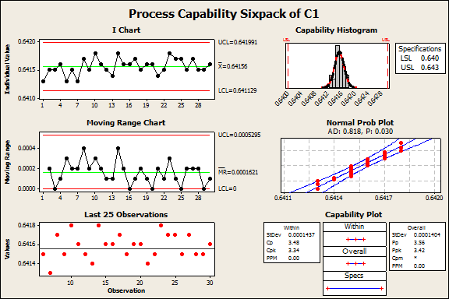
Analyze Results
Process Stable?
Yes!
Data set normal?
Yes!
Capability Acceptable?
Yes!

Slide 58
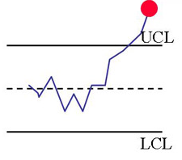
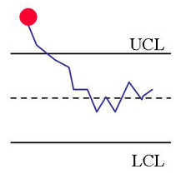
Statistical Process Control (SPC)
SPC STATISTICAL PROCESS control
The organization
Listens and reacts
-Root cause
-Learning (Understanding)
-Corrective Action
-Share knowledge
The process talks
through the
control chart
The process
responds

Slide 59
Why do we need process control?
Why prevention instead of detection?
Detection tolerates waste, Prevention avoids it.

Slide 60
Variation
There are two types of variation
Common Cause
The many factors that result in variation that is consistently acting on a process. If only common causes are present in a process it is considered stable and in control. If only common cause variation is present in a process the process outcome is predictable.
Special Cause
Also known as assignable causes, special causes are factors that result in variation that only affect some of the process output. Special cause variation results in one or more points outside of controls limits and / or non-random patterns of points within control limits. Special cause variation is not predictable and, if present in a process, results in instability and out of control conditions.

Slide 61
Common Cause Variation
If only common cause variation is present in a process it will result in an output that is stable over time and predictable
Prediction
Common cause variation can result in, for example, slight variation in the size of a bolt (exaggerated visual)
Time
Size

