Slide 1
Supplier Request for Engineering Approval Process SREA
Self paced training module

Slide 2
Training Objectives
Describe what the SREA process is and is NOT
Define when an SREA form is required
Identify the Pre-Work required to be done PRIOR to preparing the request
Describe the process flow with responsibilities (GHSP or Supplier) from start to finish
Review Strategies for gaining first time SREA approval
Provide Master “Good” Examples

Slide 3
What is and is Not an SREA?
An SREA is a process to identify, PLAN, and communicate a request to implement a PERMANENT product and/or process change that falls underneath the scope of AIAG PPAP.
The results of the planning process are identified on the SREA form along with a timing plan and validation plan (if validation testing applies)
The SREA is not applicable to temporary changes
The Supplier Deviation Process applies

Slide 4
What is the Purpose?
The SREA process is to demonstrate that you, as a supplier, proactively communicate the desire to make a change and that it shows the work plan to execute the expectations of the Production Part Approval Process (PPAP)*. The objective is to gain approval to proceed with the plan to change.
Failure to follow this process has the potential of creating a recall event (worst case) and creates chaos for GHSP and our customers.
* Refer to Section 3 –Customer Notification and Submission Requirements. AIAG PPAP Manual 4th Edition

Slide 5
When is SREA Started?
After a decision to change has been made by supplier
Before a change has been started
Before a change has been implemented or completed
When the change falls under the scope of AIAG PPAP (latest edition) or GHSP Supplier Manual publications post 4/1/2014 found on www.ghsp.com

Slide 6
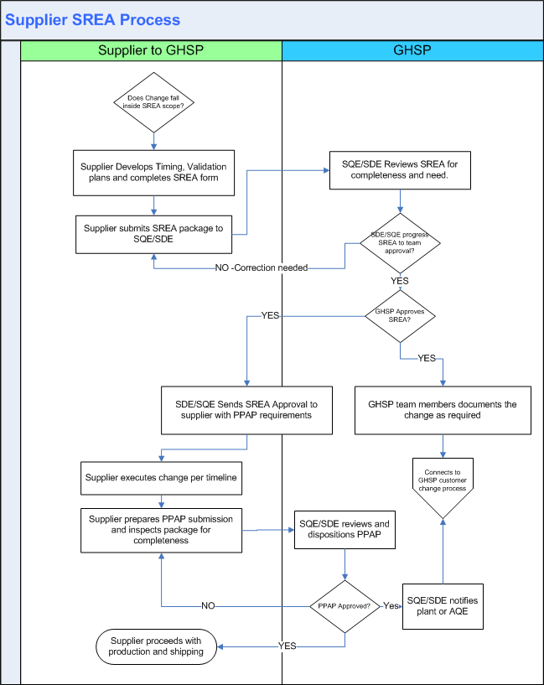
GHSP Supplier SREA Process Flow
PLAN
DO
CHECK
ACT

Slide 7
General Situations when a SREA is Required (not all inclusive)
Change in manufacturing location from one address to another.
Changing the manufacturing process sequence.
Changing the control plan, such as frequency, evaluation technique or reaction plan.
Correction of a discrepancy on a previously submitted part.
Change to design records, specifications or materials.
The above situations includes Sub-Tier N as well.
Don’t assume SREA is not needed. Verify
If in doubt, call a GHSP SDE or SQE

Slide 8
Continued General Situations when a SREA is required
SREA applicable changes include but are not limited to:
A tool change (correction) that is not part of the approved PM plan.
Replacement tooling (non-perishable).
Request to make any change that would need to be documented on the design record. Regardless of which party is design responsible.
These include :Material, Tolerance, Specifications, Special Characteristics
Any permanent change to the manufacturing process that would be documented on any element of PPAP. This includes work instructions and job set ups that were referenced on the control plan at time of PPAP approval.
Changes to work or job set up instructions that are a referred to as a control method/or reaction plan on the production control plan
Any VA/VE idea

