Slide 1
SREA Process Overview

Slide 2
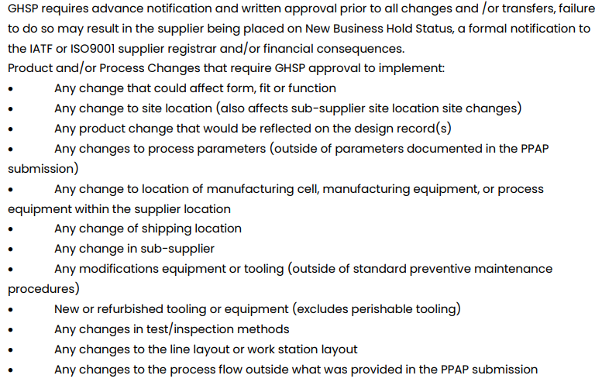
SREA Process Overview

Slide 3
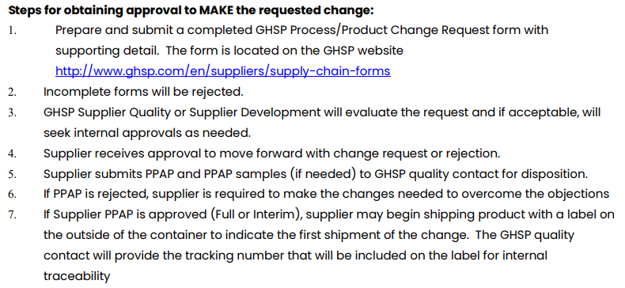
SREA Process Overview
*Note: SREA approval does not indicate an approval to ship parts. SREA approval is an approval of the plan only! PPAP approval and any functional line trials are required PRIOR to shipping production parts.

Slide 4
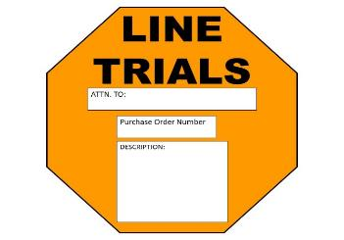
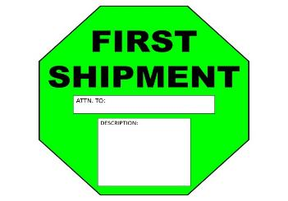
SREA/PPAP Submission
Please refer to GHSP’s Supplier Requirements Packaging Manual located at: https://www.ghsp.com/supplier-resources

Slide 5
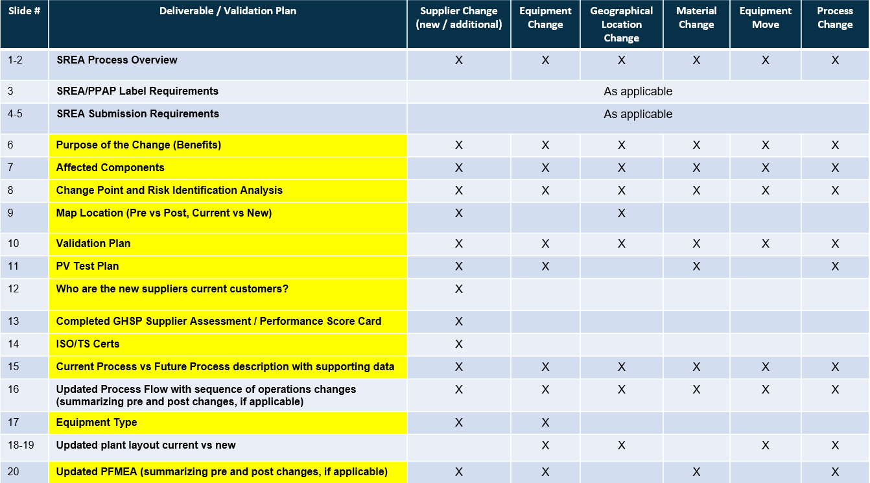
SREA Requirements
SREA submission and applicable documentation is required as per the chart indicates in slide 4 & 5. See example slides attached.
* Note: The intent is not to complete and provide data for all of these slides as part of your SREA submission. The example slides are part of your PLAN. Deliverables highlighted in yellow are expected to be included and complete with your SREA PLAN submission. The examples are not a required format of the supplier. They are examples only.

Slide 6
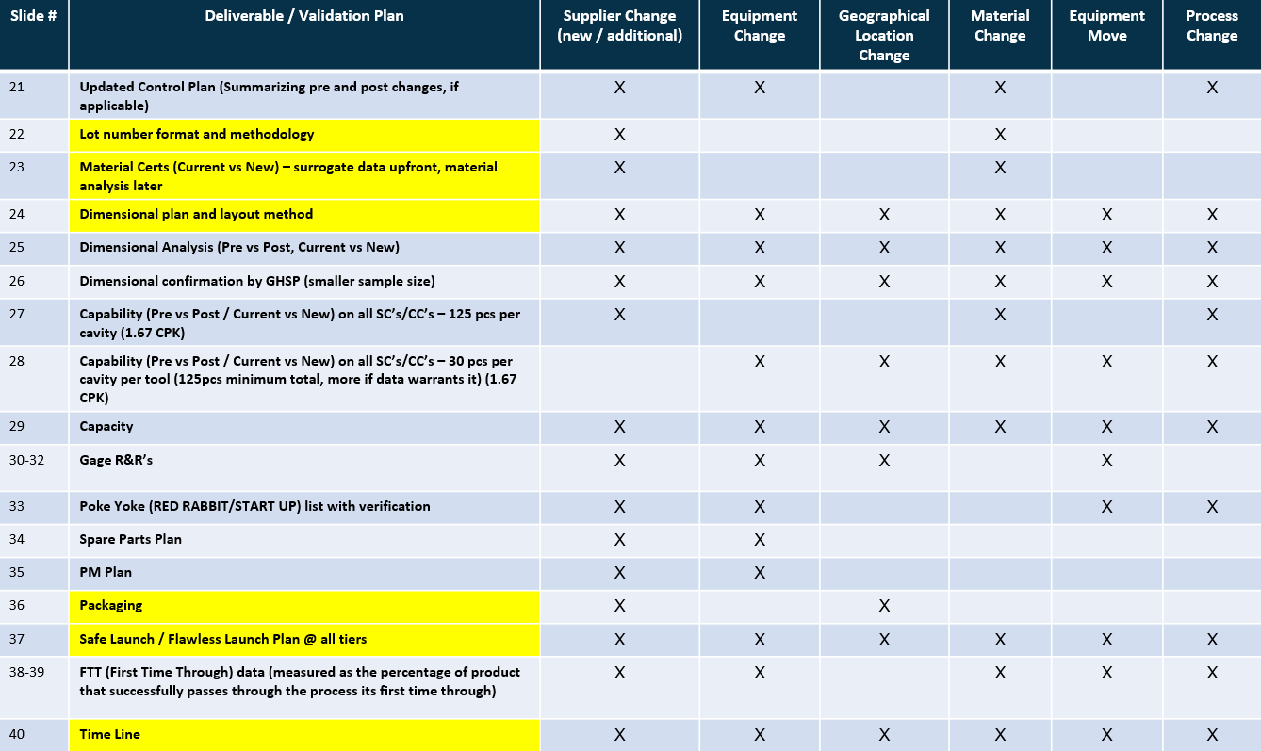
SREA Requirements Example Slides Attached

Slide 7
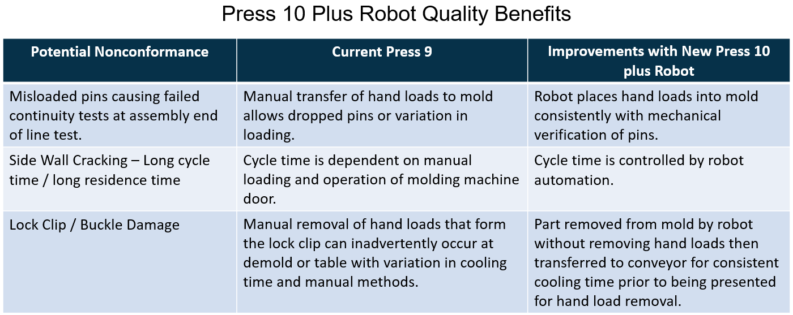
Supplier SREA Description
Purpose: Clearly explain the purpose of the proposed change. Include where possible, Who/What/Where/When/Why/How
Example
Purpose: Supplier PCB Cover move from press 9 to press 10 for process enhancement to add automation to remove manual load allowing improved process control.

Slide 8
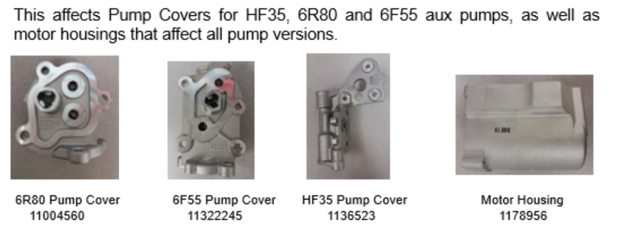
Supplier SREA Description
Example
*Pictures with descriptions are very helpful

Slide 9
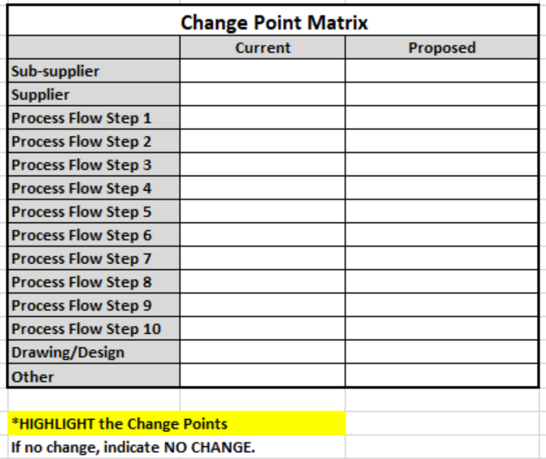
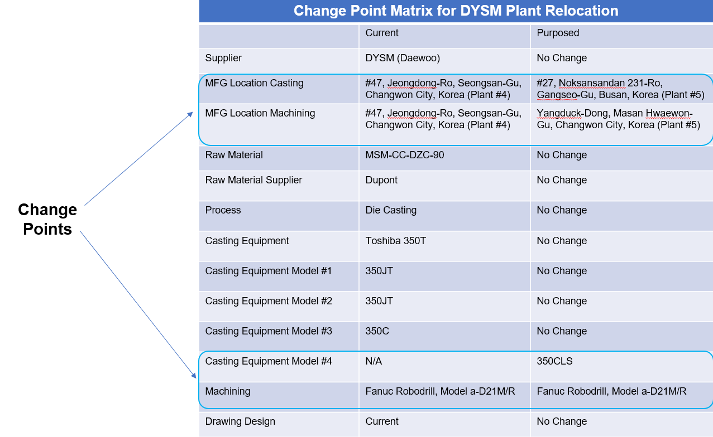
Supplier SREA Description Change Point and Risk Identification
Change Points and Risk Identification considering the 4 M’s: Material, Man, Method, Machine
Example
Complete a Change Point Matrix

Slide 10
Supplier SREA Description
Provide a Map with Distance Information
*Show old location and new location..
Current Address:
New Address:

Slide 11
Supplier SREA Description Validation Plan
*List all applicable items from the deliverables checklist (slides 3&4) with explanation
Example
Floor Layout – Supplied Pre and Post
PFMEA – PFMEA was re-evaluated due to new equipment and transportation between the casting plant and the Machining Plant and there are no new updates/.
Control Plan – Due to no new changes to the FMEA, the control plan has not changed.
PV test plan – No testing required
Process Data Comparison
Lot Control
ACME will be required to provide a full level 3 ppap to GHSP.
Full dimensional report (A-B) – pre-move vs. post-move ~ 1 pcs per cavity per tool
Capability on all SC’s. – 30 pcs
Poke Yoke verification post move with documentation – Current inspection standard and equipment settings will be applied. There are not actual poke yoke parts.
Bank Build – ACME is planning to build a bank. A bank will not be required for GHSP.
Safe Launch Plan – Details of requirements and exit criteria
Functional Trials – Supplier plan. Contact GHSP for anticipated line trial requirements at customer.
PPAP – Appropriate level for submission

Slide 12
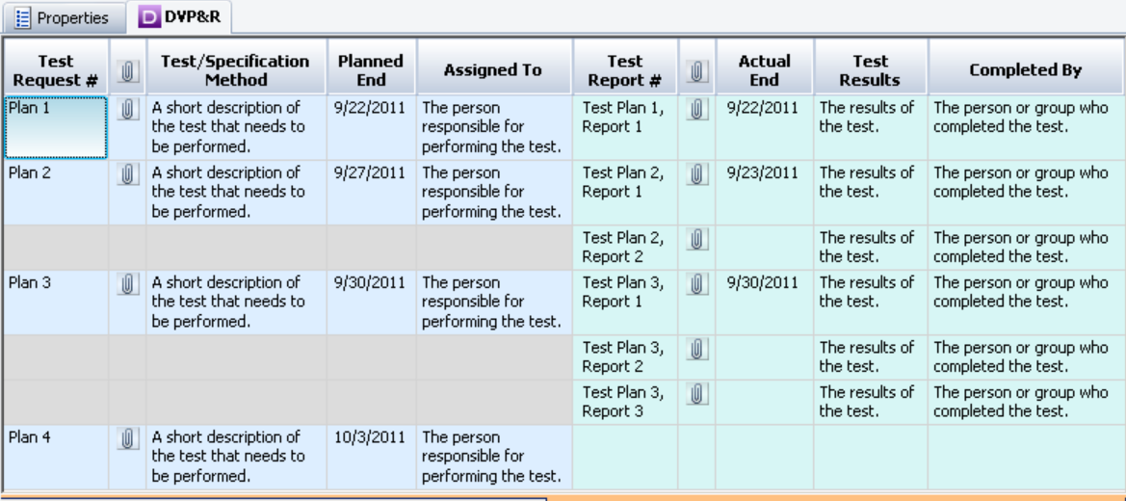
Supplier SREA Description PV Test Plan
Examples

Slide 13
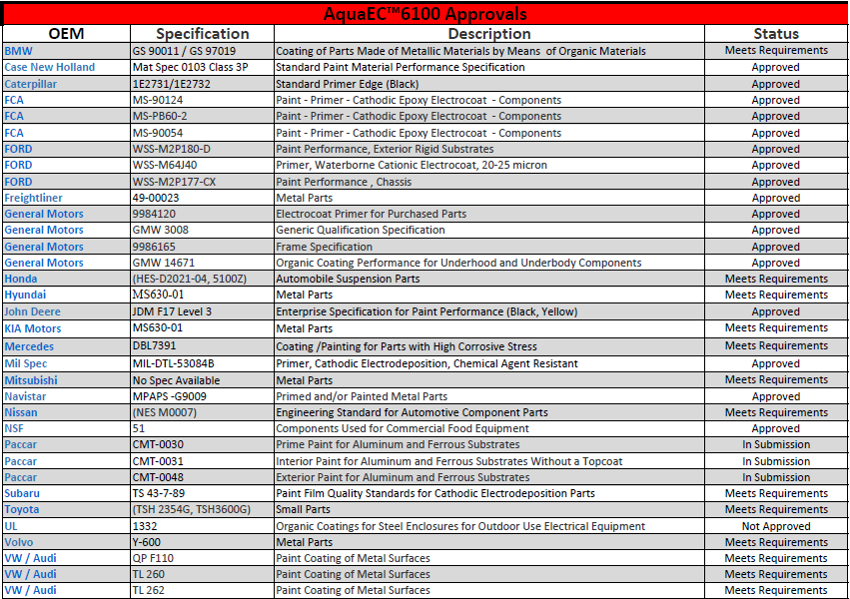
Supplier SREA Description Customer Base / Approvals
Example

Slide 14
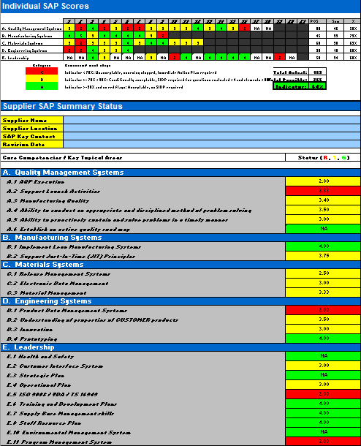
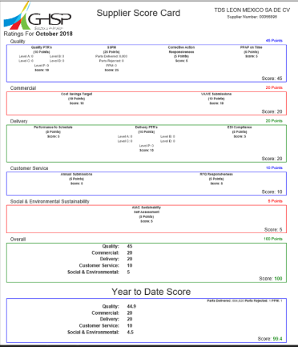
Supplier SREA Description GHSP Supplier Assessment
If applicable, ensure countermeasures, due dates, and responsibility are included for areas of concern.
Supplier assessment for new suppliers
Supplier scorecard for current suppliers

Slide 15
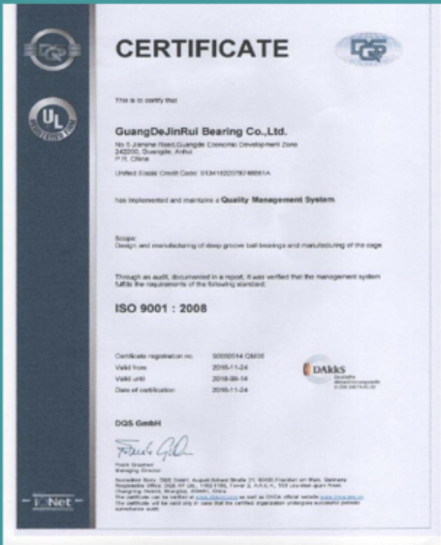
Supplier SREA Description ISO/TS Certificates

Slide 16
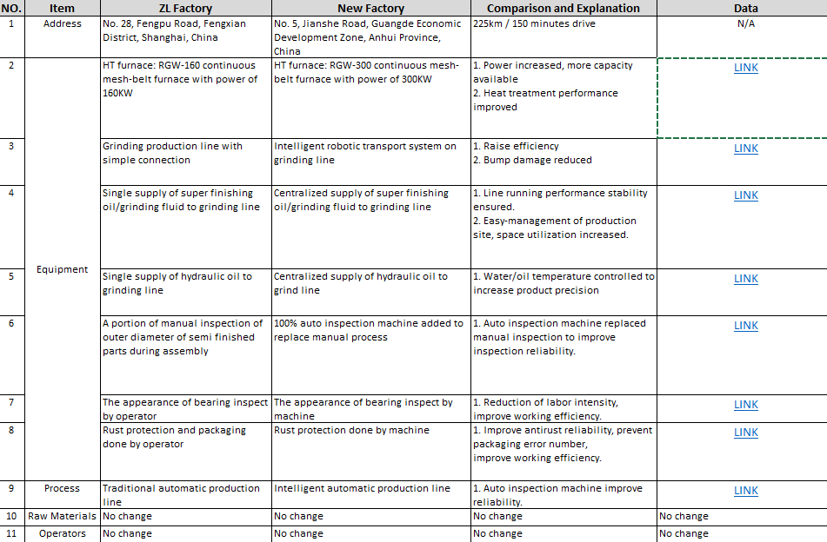
Supplier SREA Description Current Process vs Future Process with Supporting Data
CHANGE EXPLANATION
LINKS TO DATA SUPPORTING THE IMPROVEMENT
OLD PROCESS DESCRIPTION
NEW PROCESS DESCRIPTION

Slide 17
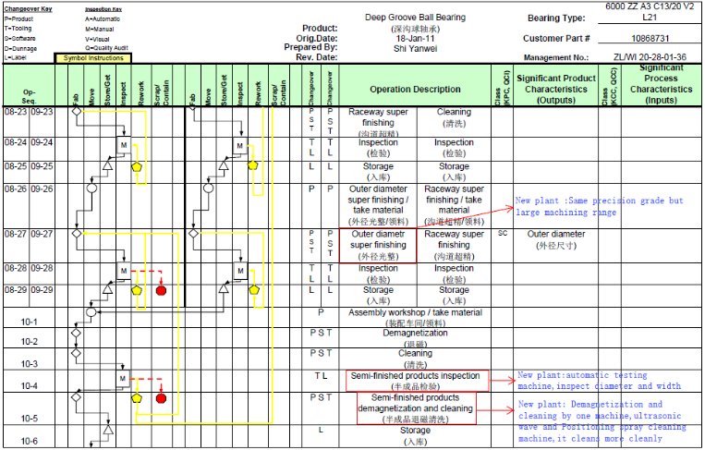
Supplier SREA Description Updated Process Flow
Updated Process Flow w/ sequence of operations changes (summarizing pre and post changes, if applicable)
Highlighting changes

Slide 18
Supplier SREA Description Equipment Type

Slide 19
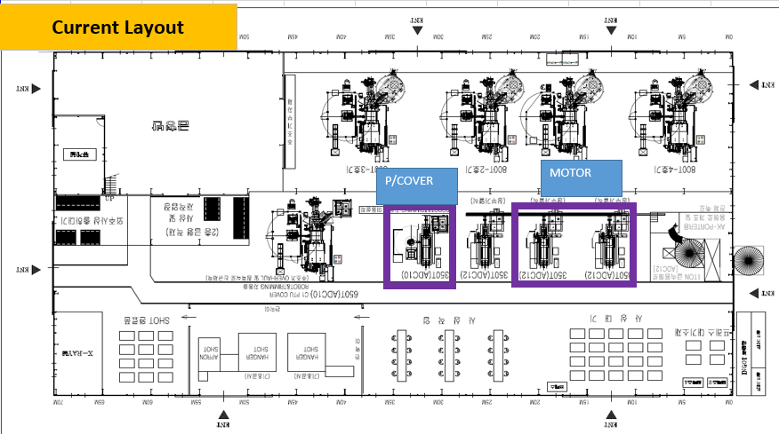
SREA Description – Current Plant Layout
Example

Slide 20
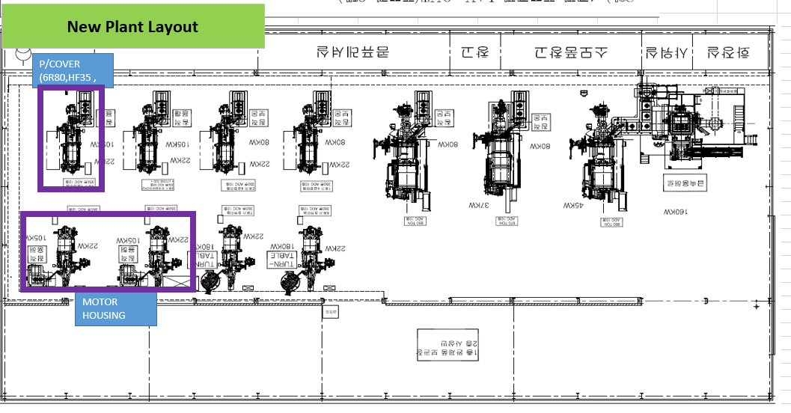
SREA Description – Future Plant Layout
Example

Slide 21
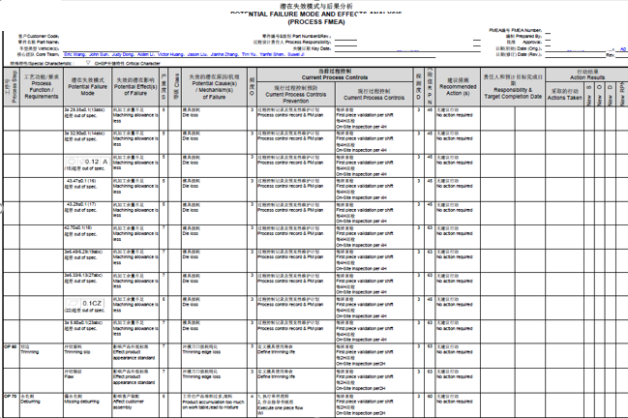
Supplier SREA Description – Updated FMEA
Updated FMEA
(summarizing pre and post changes, if applicable)
Highlight changes or make notes of updates if recommended actions section isn’t updated.

Slide 22
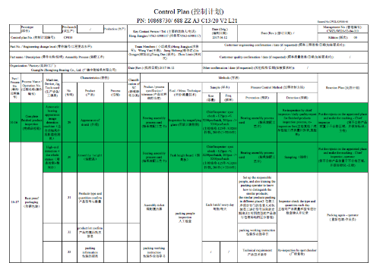
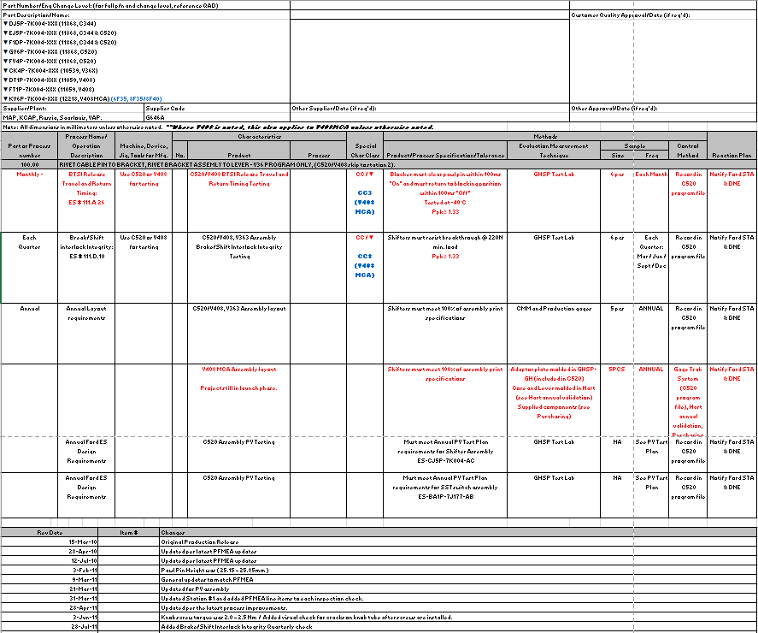
Supplier SREA Description Updated Control Plan
Updated Control Plan
(summarizing pre and post changes, if applicable)
Highlighting changes
Completing revision log

Slide 23
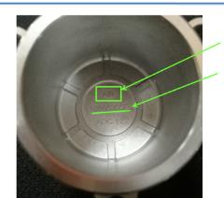
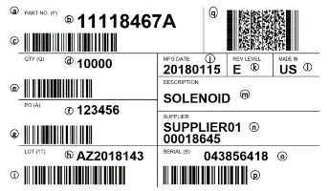
Supplier SREA Description Lot Number Format and Methodology
Examples
Supplier Code
Supplier Part #
*NOTE that lot number may not always be included on individual parts.
Be sure to include a copy of the label showing your lot # format.

Slide 24
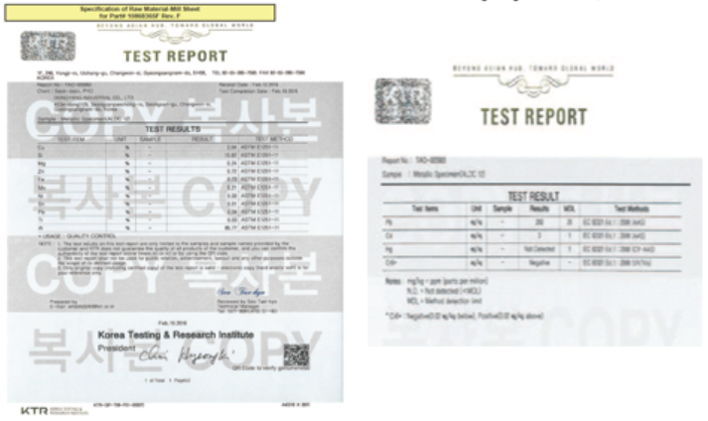
Supplier SREA Description Material Certification/Comparison
*Include the specification requirements and summarize the differences in the material reports

Slide 25
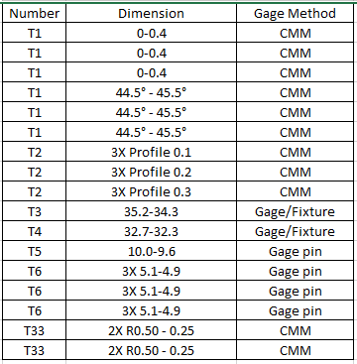
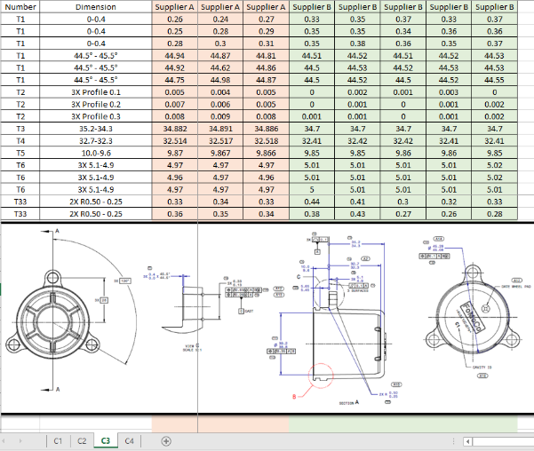
Supplier SREA Description Dimensional Plan
Plan: layout 5pcs/cavity for all dimensions.
30pcs/cavity for critical characteristics
Be sure to include the layout method.

Slide 26
Supplier SREA Description Dimensional Analysis
Compare results side by side from each supplier/process for each dimension.
Show the ballooned drawing that correlates to the dimensions.
Ensure to include each cavity.

Slide 27
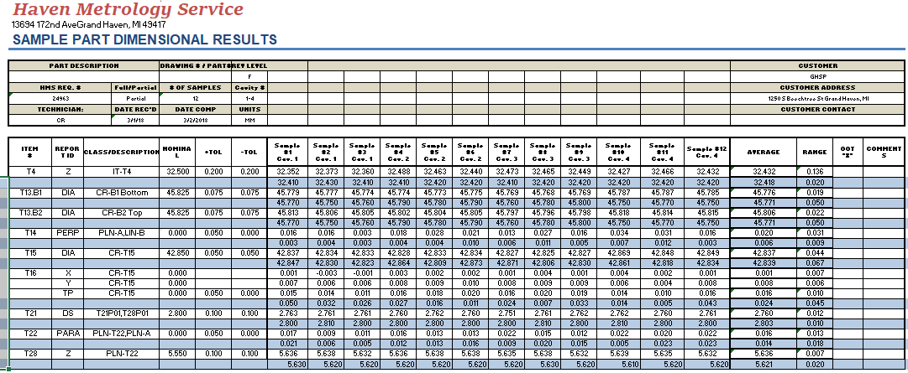
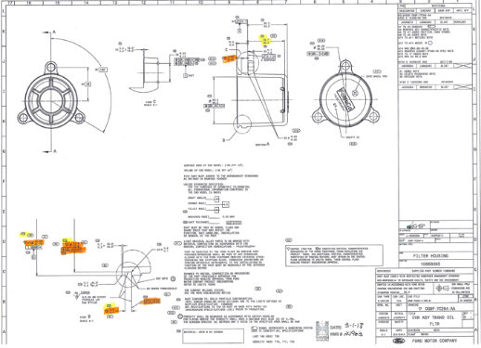
Supplier SREA Description GHSP Dimensional Analysis Verification
Depending on risk, GHSP may verify certain dimensions for comparison to supplier data.

Slide 28
Supplier SREA Description Capability Analysis
REFERENCE THE AIAG SPC MANUAL FOR FURTHER
CAPABILITY REQUIREMENTS
Note 1: If the data collected are not statistically stable, in control and normally distributed, special causes are to be eliminated and if still not normally distributed, the data should be matched to the expected distribution, such as Weibull, as appropriate, before calculation of Ppk.
For guidance on stability and control, see the Statistical Process Control (SPC) reference manual.
Note 2: The subgroup size of 5 should be considered a minimum for most situations. Where a process is highly automated and part to part (within subgroup) variation is small, larger subgroups may be necessary.
Note 3: For homogeneous processes, such as extrusion, it is recommended to measure 125 parts or samples which are evenly spaced throughout the population being evaluated.
Note 4: For bulk materials, process capability is typically not demonstrated.
Note 5: The process capability requirement for both “initial process capability” and “final process capability” demonstration is Ppk > 1.67.

Slide 29
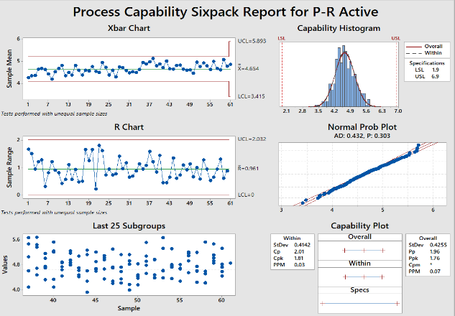
Supplier SREA Description Capability Analysis
Capability (Pre vs Post / Current vs New) on all SC's/CC’s – if there are no SC/CC’s, supplier is to choose a dimension to verify.
Must be statistically stable and in control
Data to be normal with a P value > .05
Cpk / Ppk must be 1.67 or >

Slide 30
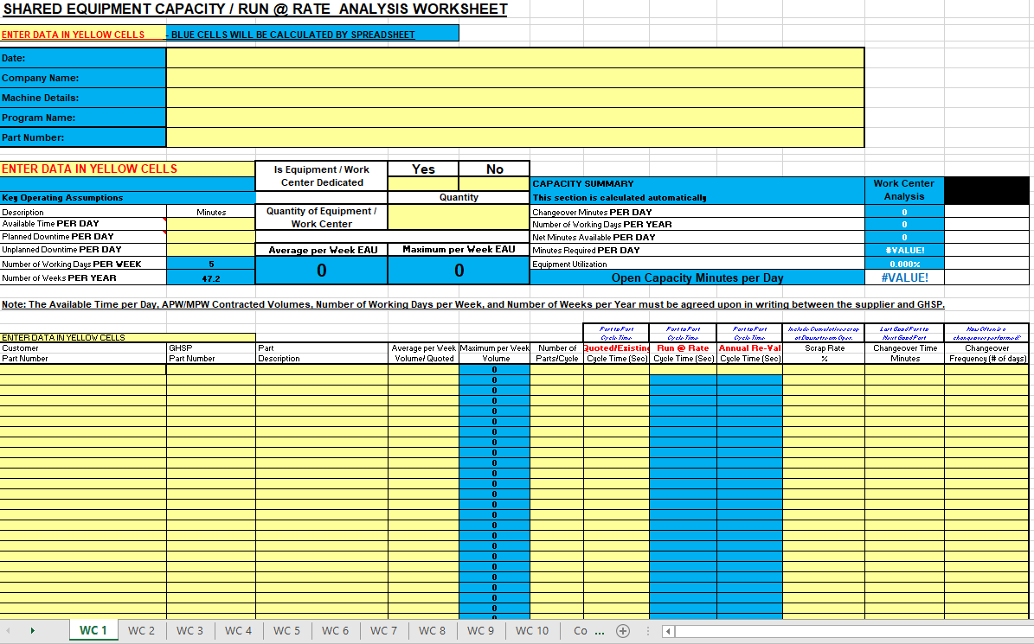
Supplier SREA Description Capacity Verification
GHSP Capacity form can be found on the GHSP website at www.GHSP.com/supplier-resources under Supply Chain Forms

Slide 31
Supplier SREA Description MSA/Gage R&R Requirements
REFERENCE THE AIAG MSA MANUAL FOR FURTHER GAGE R&R REQUIREMENTS
An ANOVA repeatability and reproducibility (R & R) study has been performed for all control
Items identified on the Control Plan. The organization shall report gauge R&R as both a
percent of study variation and a percent of tolerance.
Use the ANOVA method!
The organization shall report the number of distinct categories.
All variable gauge R&R studies should have a minimum of 5 distinct categories (See Measurement
Systems Analysis Reference Manual published by AIAG, refer to "ndc" in the index).
For additional guidance, see the Measurement Systems Analysis and Statistical Process
Control manuals from AIAG:
a) At least one half of the averages should be outside the control limits on the average chart
b) On the range charts, all values should be within the control limits
Note: in the special case where the manufacturing process is very capable, stable and in control
(e.g. Ppk > 2.5), percent tolerance is used, the number of distinct categories is not applicable,
and the values on the range chart are not always within the control limits.

Slide 32
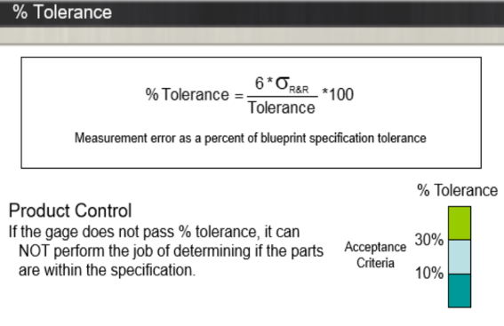
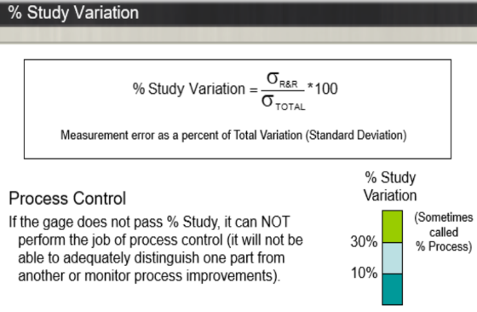
Supplier SREA Description MSA / Gage R&R Requirements

Slide 33
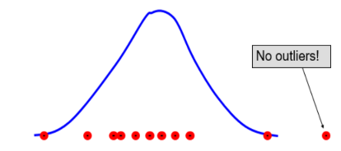
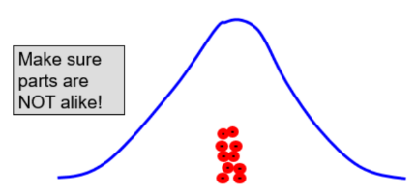
Supplier SREA Description MSA/Gage R&R Requirements

Slide 34
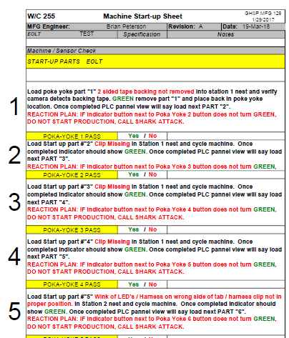
Supplier SREA Description Poke Yoke List
Example

Slide 35
Supplier SREA Description Spare Parts Plan

Slide 36
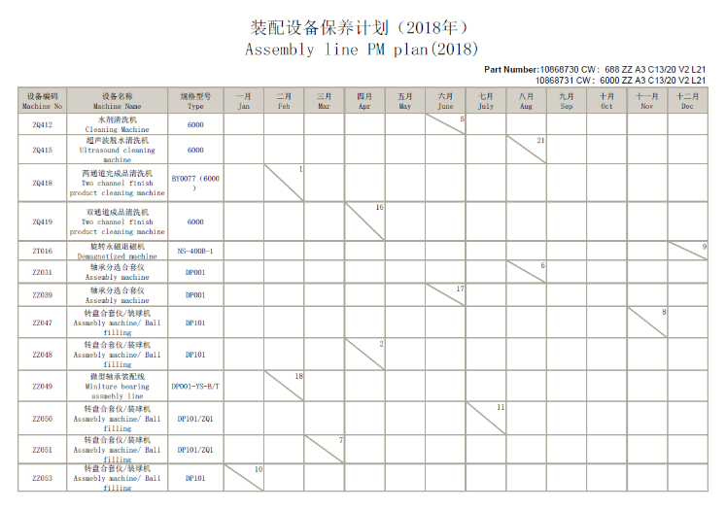
Supplier SREA Description
Example

Slide 37
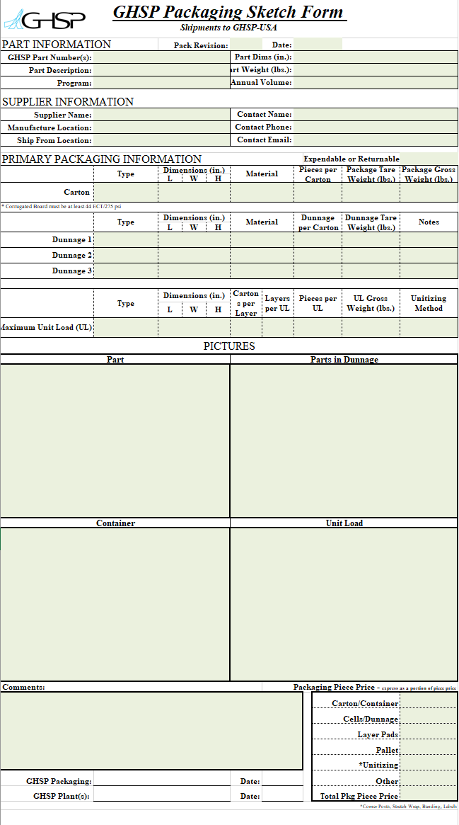
Supplier SREA Description - Packaging
Be Sure to Utilize GHSP’s Supplier Packaging and Sketch Form Located on our Website at:
https://www.ghsp.com/supplier-resources

Slide 38
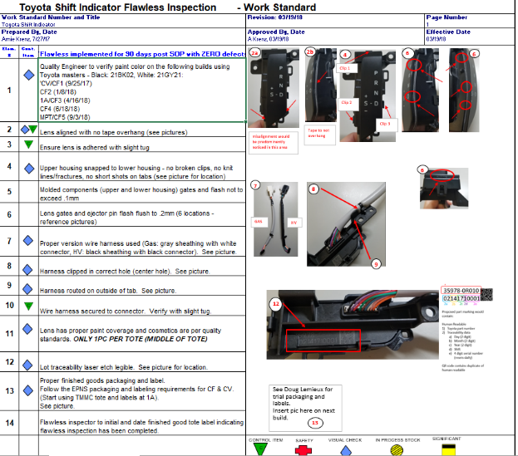
Supplier SREA Description Safe Launch/Flawless Launch Plan
Ensure to include how long and what the exit criteria is for the safe launch, i.e. “90 days post SOP with zero defects”
Your flawless plan could also be included in your control plan. If this is the method you use, ensure details are included such as frequency and exit criteria.

Slide 39
Supplier SREA Description FTT Data (First Time Through)
First time through yield or FTT
As it may sometimes be referred to is a measure of production efficiency, ability/skill, and quality. It measures how many goods are produced correctly without flaws or rework as percentage of total units produced in a production process or value stream.
The formula to calculate FTT is: (units produced – defective units)/units produced
The definition of defective units includes all units of production which are scrapped, reworked, do not meet standards, require repair, or are not saleable.
The first time through yield will help you identify efficiency and changes in performance in the production process and should be used as a signal to perform further analysis and improvements if it exhibits sudden big changes.

Slide 40
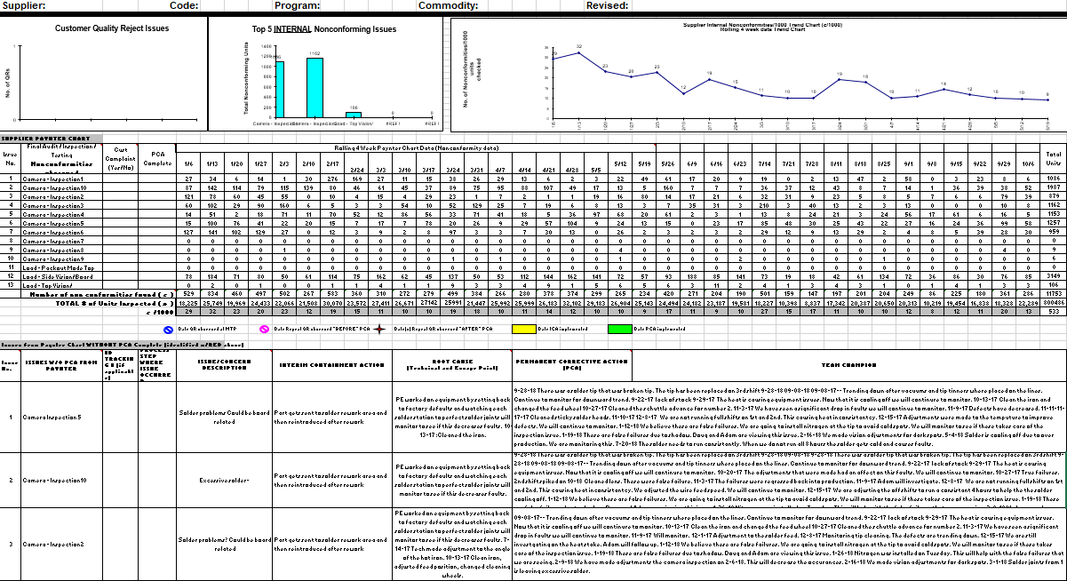
Supplier SREA Description FTT Data (First Time Through)

Slide 41
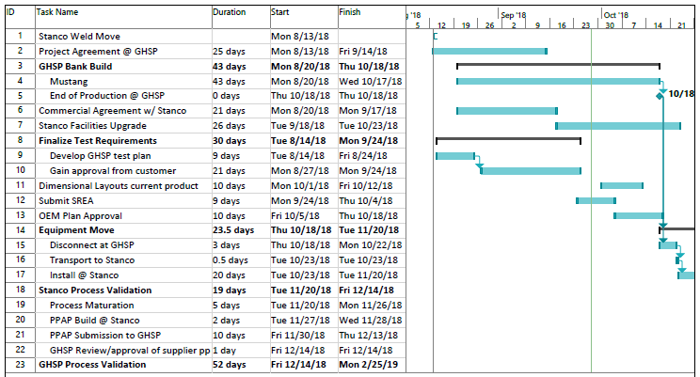
Supplier SREA Description Detailed Timing Plan
Example

Slide 42
GHSP Form Change History
Date Change
12/1/23 Updated Design
11/14/23
10/23/18 Released

