Slide 1
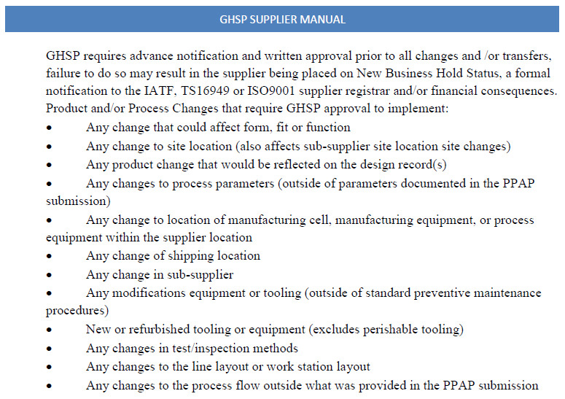
SREA Process Overview

Slide 2
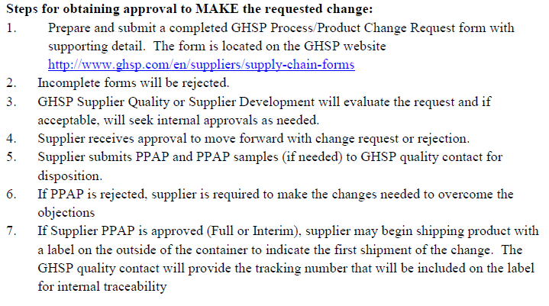
SREA Process Overview
*NOTE: SREA approval does NOT indicate an approval to ship parts. SREA approval is an approval of the PLAN only! PPAP approval and any functional line trials are required PRIOR to shipping production parts.

Slide 3
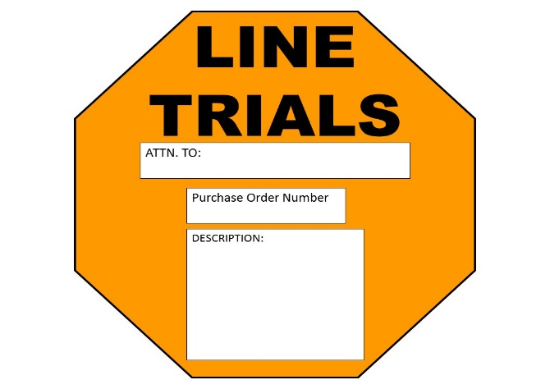
Please refer to GHSP’s Supplier Requirements Packaging Manual located at: http://www.ghsp.com/en/suppliers/packaging
SREA/PPAP SUBMISSION
Label Requirements

Slide 4
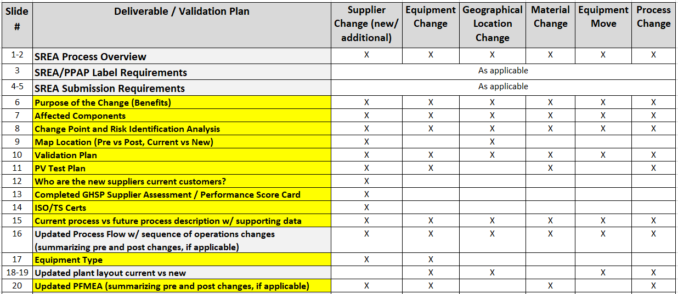
SREA REQUIREMENTS
Example slides attached
SREA submission and applicable documentation is required as per the chart indicates in slide 4 & 5. See example slides attached.
* Note: The intent is NOT to complete and provide data for all of these slides as part of your SREA submission. The example slides are part of your PLAN. Deliverables highlighted in yellow are expected to be included and complete with your SREA PLAN submission. The examples are not a required format of the supplier. They are examples only.

Slide 5
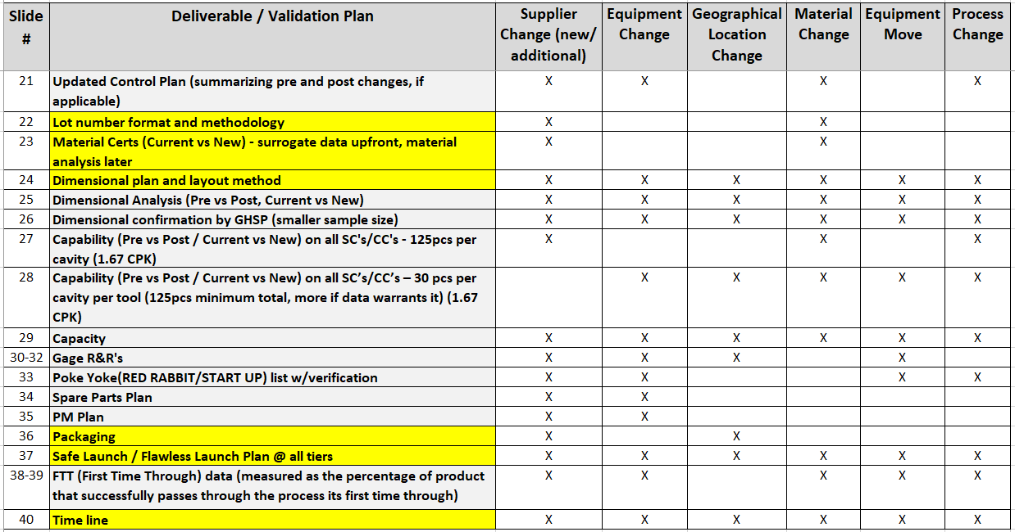
SREA REQUIREMENTS
Example slides attached

Slide 6
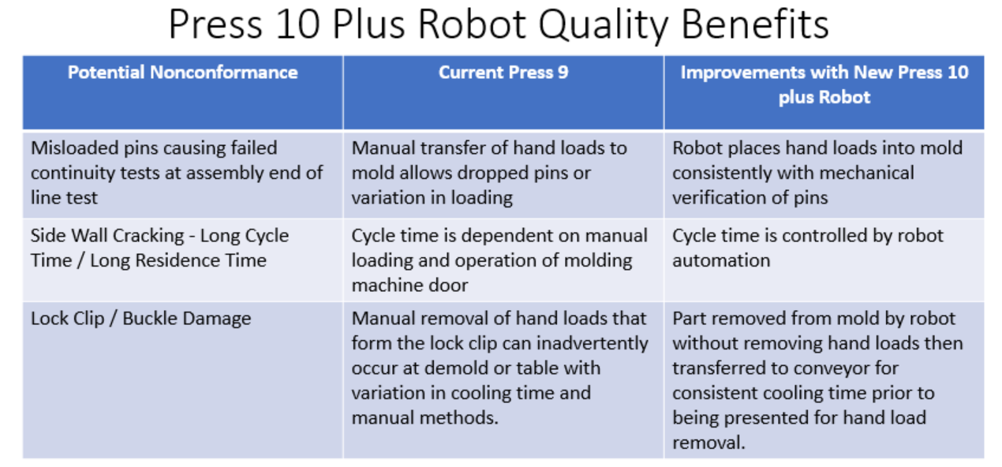
Supplier SREA Description
Purpose Statement
PURPOSE: Clearly explain the purpose of the proposed change. Include where possible, Who/What/Where/When/Why/How
Purpose: Supplier PCB Cover move from press 9 to press 10 for process enhancement to add automation to remove manual load allowing improved process control.
EXAMPLE

Slide 7
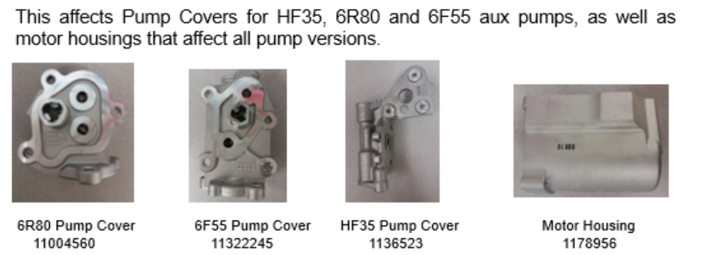
Supplier SREA Description
Affected Components
EXAMPLE
*Pictures with descriptions are very helpful

Slide 8
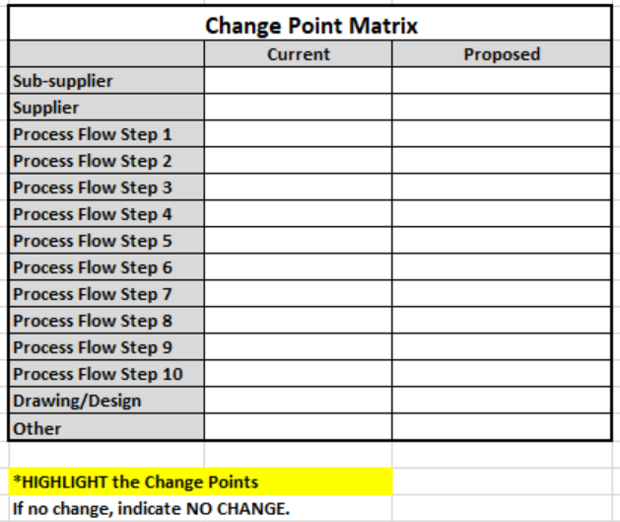
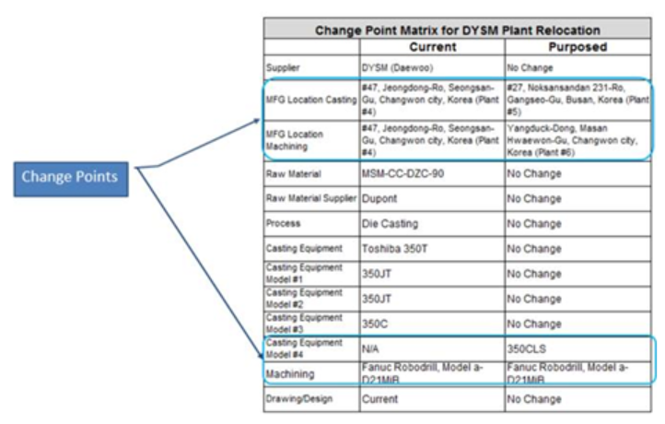
Change Points and Risk Identification considering the 4 M’s: Material, Man, Method, Machine
Supplier SREA Description
Change Point and Risk Identification
EXAMPLE
Complete a Change Point Matrix

Slide 9
Supplier SREA Description
Map Location
PROVIDE A MAP WITH DISTANCE INFORMATION
*Show old location and new location..
Current Address:
New Address:

Slide 10
Supplier SREA Description
Validation Plan
*List all applicable items from the deliverables checklist (slides 3&4) with explanation
Floor Layout – Supplied Pre and Post
PFMEA – PFMEA was re-evaluated due to new equipment and transportation between the casting plant and the Machining Plant and there are no new updates/.
Control Plan – Due to no new changes to the FMEA, the control plan has not changed.
PV test plan – No testing required
Process Data Comparison
Lot Control
ACME will be required to provide a full level 3 ppap to GHSP.
Full dimensional report (A-B) – pre-move vs. post-move ~ 1 pcs per cavity per tool
Capability on all SC’s. – 30 pcs
Poke Yoke verification post move with documentation – Current inspection standard and equipment settings will be applied. There are not actual poke yoke parts.
Bank Build – ACME is planning to build a bank. A bank will not be required for GHSP.
Safe Launch Plan – Details of requirements and exit criteria
Functional Trials – Supplier plan. Contact GHSP for anticipated line trial requirements at customer.
PPAP – Appropriate level for submission
EXAMPLE

Slide 11
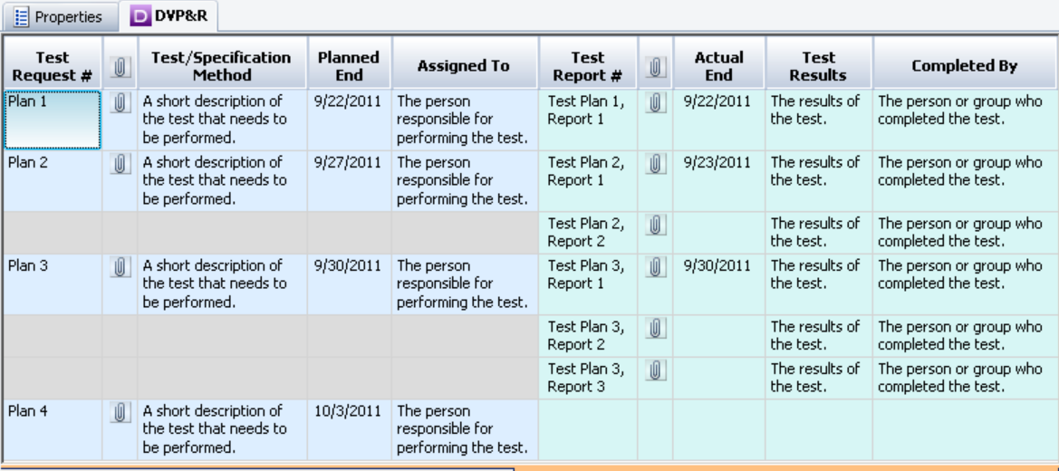
Supplier SREA Description
PV Test Plan
EXAMPLES

Slide 12
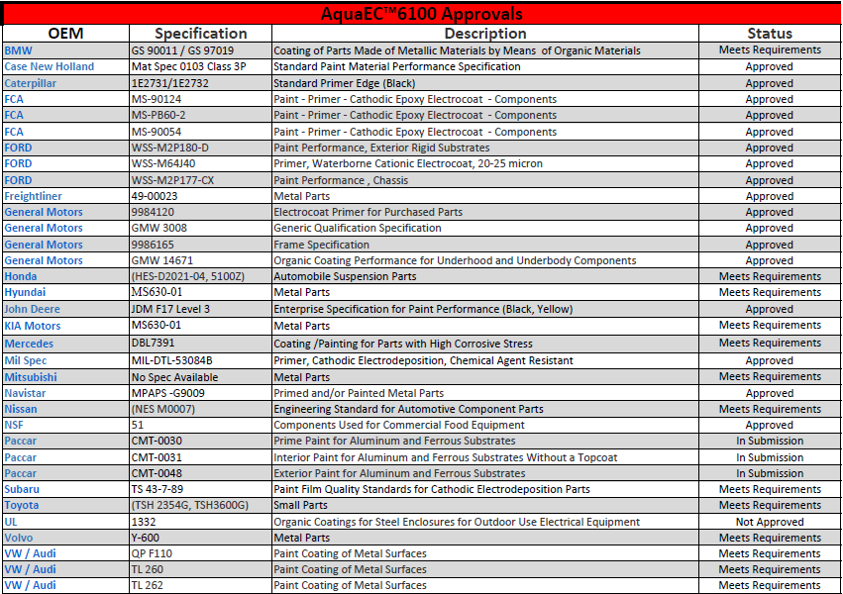
Supplier SREA Description
Customer Base / Approvals
EXAMPLE

Slide 13
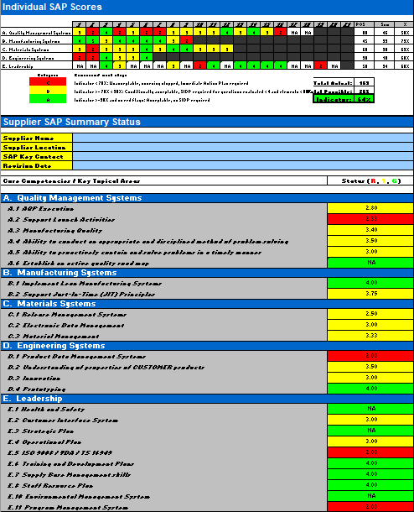
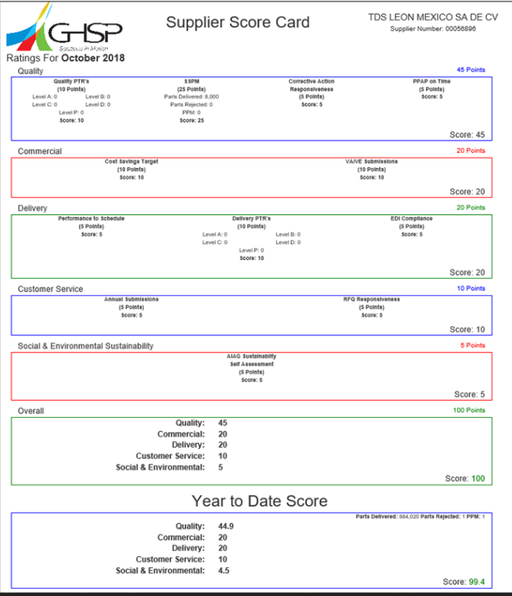
Supplier SREA Description
GHSP Supplier Assessment
If applicable, ensure countermeasures, due dates, and responsibility are included for areas of concern.
Supplier assessment for new suppliers
Supplier scorecard for current suppliers

Slide 14
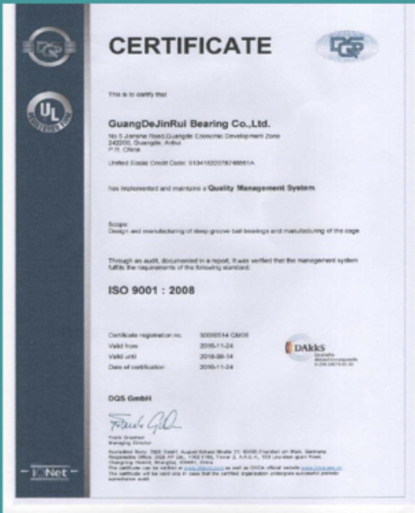
Supplier SREA Description
ISO/TS Certificates

Slide 15
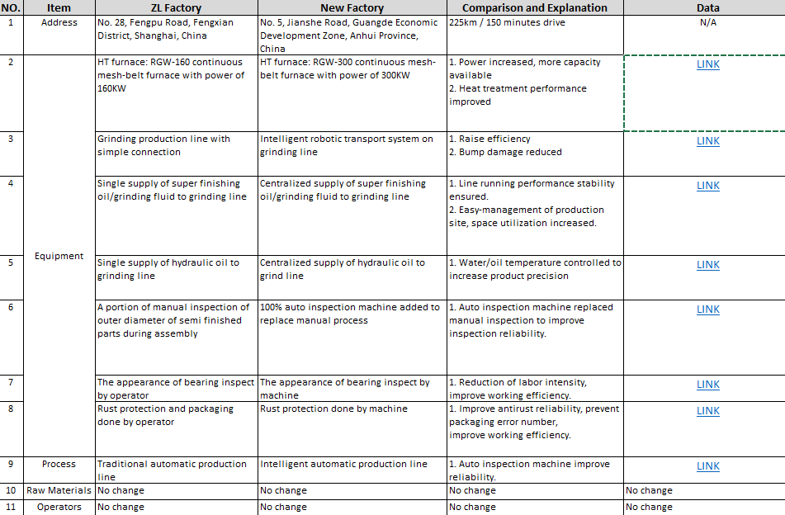
Supplier SREA Description
Current Process vs Future Process with Supporting Data
CHANGE EXPLANATION
OLD PROCESS DESCRIPTION
LINKS TO DATA SUPPORTING THE IMPROVEMENT
NEW PROCESS DESCRIPTION

Slide 16
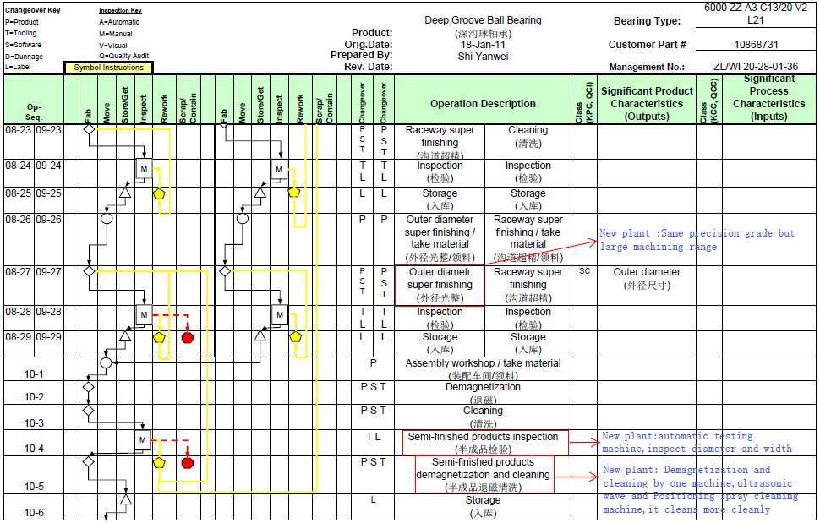
Supplier SREA Description
Updated Process Flow
Updated Process Flow w/ sequence of operations changes
(summarizing pre and post changes, if applicable)
Highlighting changes

Slide 17
Supplier SREA Description
Equipment Type

Slide 18
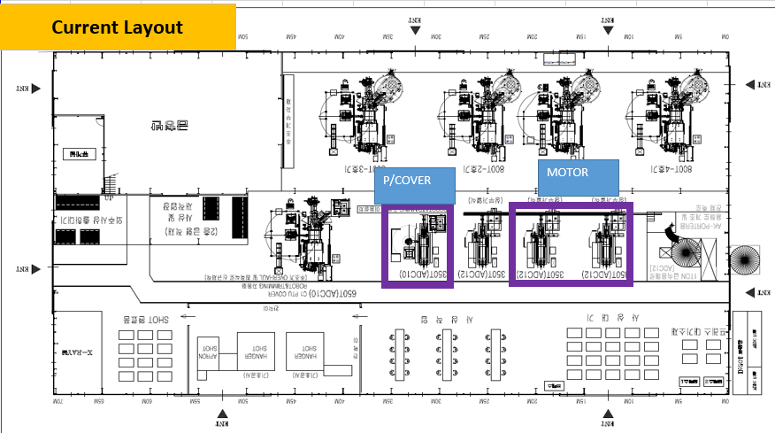
SREA Description
Current Plant Layout
EXAMPLE

Slide 19
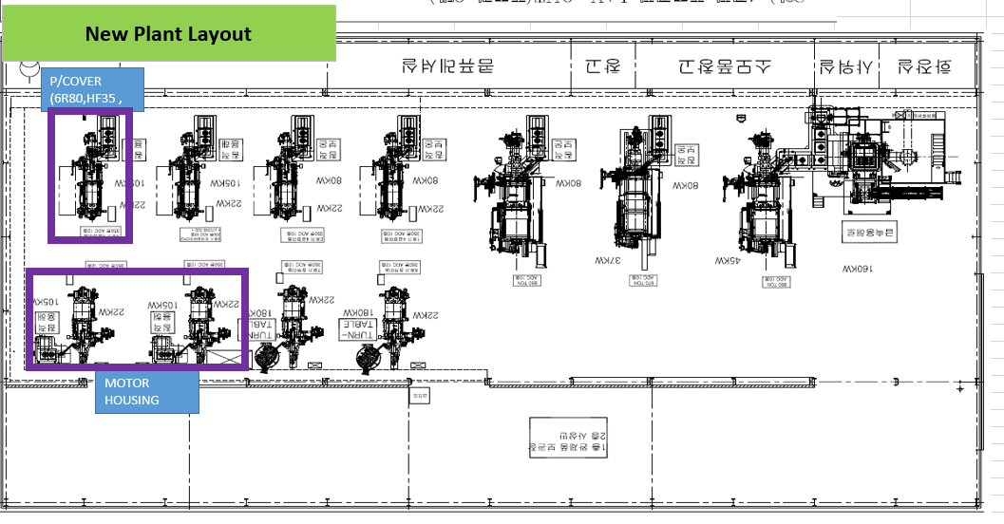
SREA Description
Future Plant Layout
EXAMPLE

Slide 20
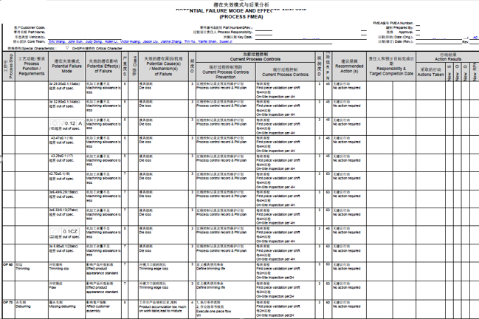
Supplier SREA Description
Updated FMEA
Updated FMEA
(summarizing pre and post changes, if applicable)
Highlight changes or make notes of updates if recommended actions section isn’t updated.
Added due to PTR# 135978

Slide 21
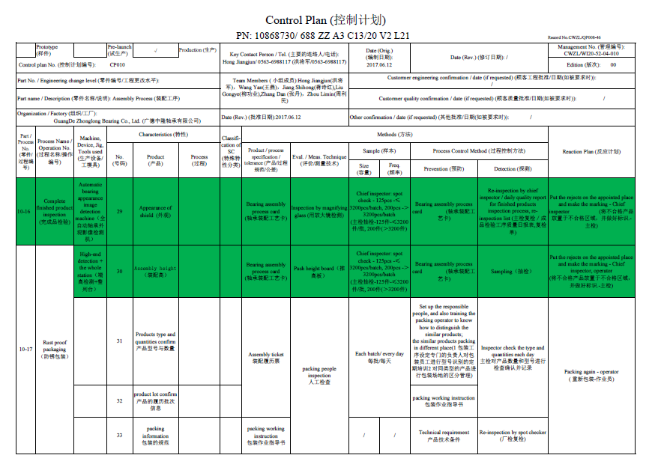
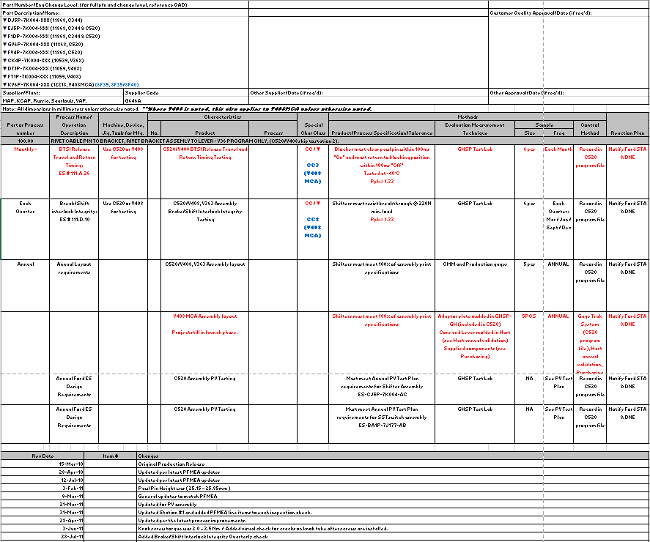
Supplier SREA Description
Updated Control Plan
Updated Control Plan
(summarizing pre and post changes, if applicable)
Highlighting changes
Completing revision log

Slide 22
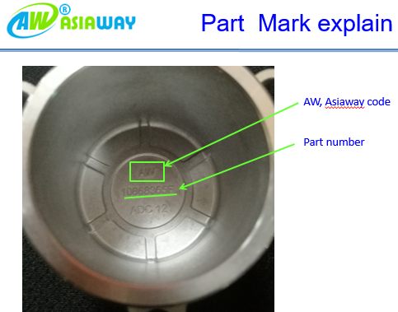
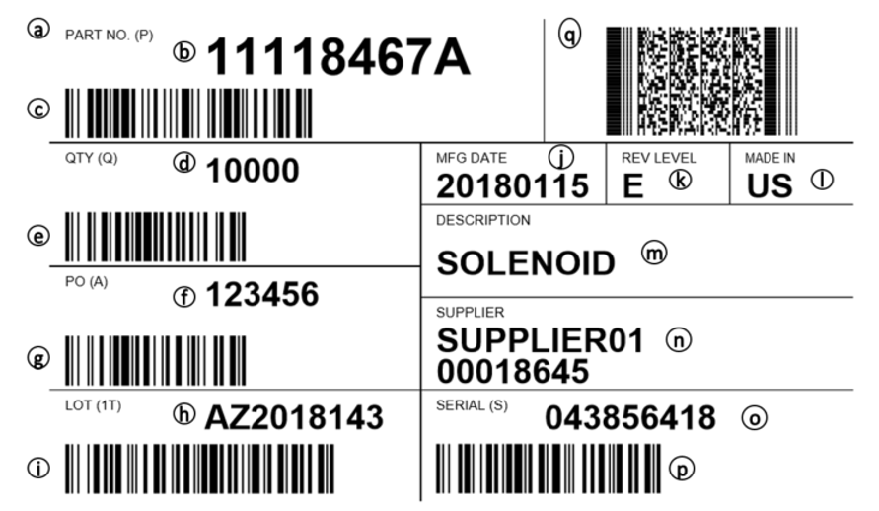
Supplier SREA Description
Lot Number Format and Methodology
EXAMPLES
Supplier Code
Supplier Part #
*NOTE that lot number may not always be included on individual parts.
Be sure to include a copy of the label showing your lot # format.

Slide 23
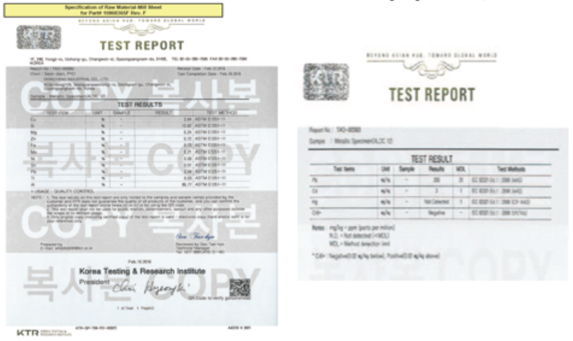
Supplier SREA Description
Material Certification / Comparison
*Include the specification requirements and summarize the differences in the material reports

Slide 24
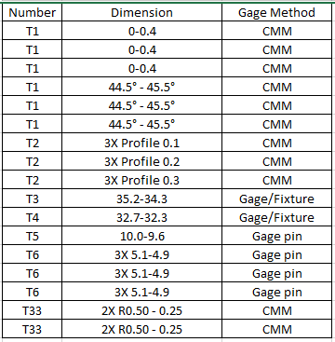
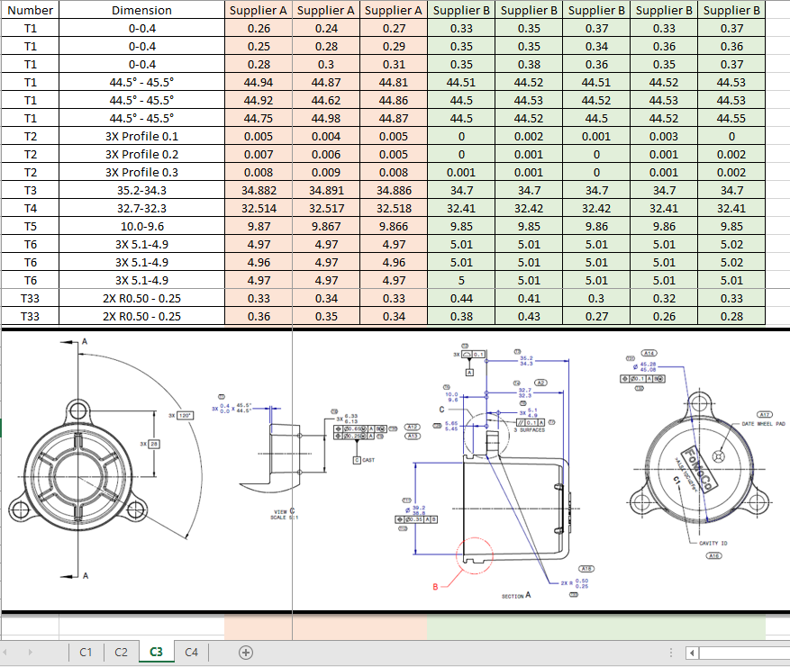
Supplier SREA Description
Dimensional Plan
Plan: layout 5pcs/cavity for all dimensions.
30pcs/cavity for critical characteristics
Be sure to include the layout method.

Slide 25
Supplier SREA Description
Dimensional Analysis
Compare results side by side from each supplier/process for each dimension.
Show the ballooned drawing that correlates to the dimensions.
Ensure to include each cavity.

Slide 26
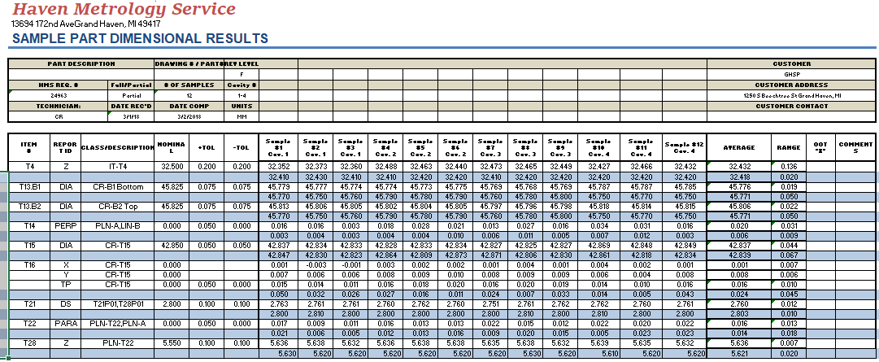
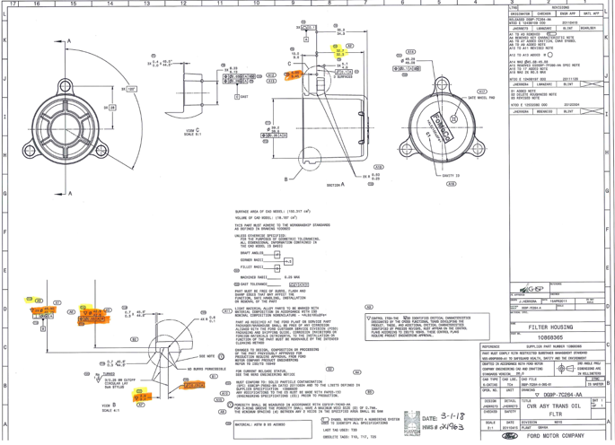
Supplier SREA Description
GHSP Dimensional Analysis Verification
Depending on risk, GHSP may verify certain dimensions for comparison to supplier data.

Slide 27
Supplier SREA Description
Capability Analysis
REFERENCE THE AIAG SPC MANUAL FOR FURTHER
CAPABILITY REQUIREMENTS
Note 1: If the data collected are not statistically stable, in control and normally distributed, special causes are to be eliminated and if still not normally distributed, the data should be matched to the expected distribution, such as Weibull, as appropriate, before calculation of Ppk.
For guidance on stability and control, see the Statistical Process Control (SPC) reference manual.
Note 2: The subgroup size of 5 should be considered a minimum for most situations. Where a process is highly automated and part to part (within subgroup) variation is small, larger subgroups may be necessary.
Note 3: For homogeneous processes, such as extrusion, it is recommended to measure 125 parts or samples which are evenly spaced throughout the population being evaluated.
Note 4: For bulk materials, process capability is typically not demonstrated.
Note 5: The process capability requirement for both “initial process capability” and “final process capability” demonstration is Ppk > 1.67.

Slide 28
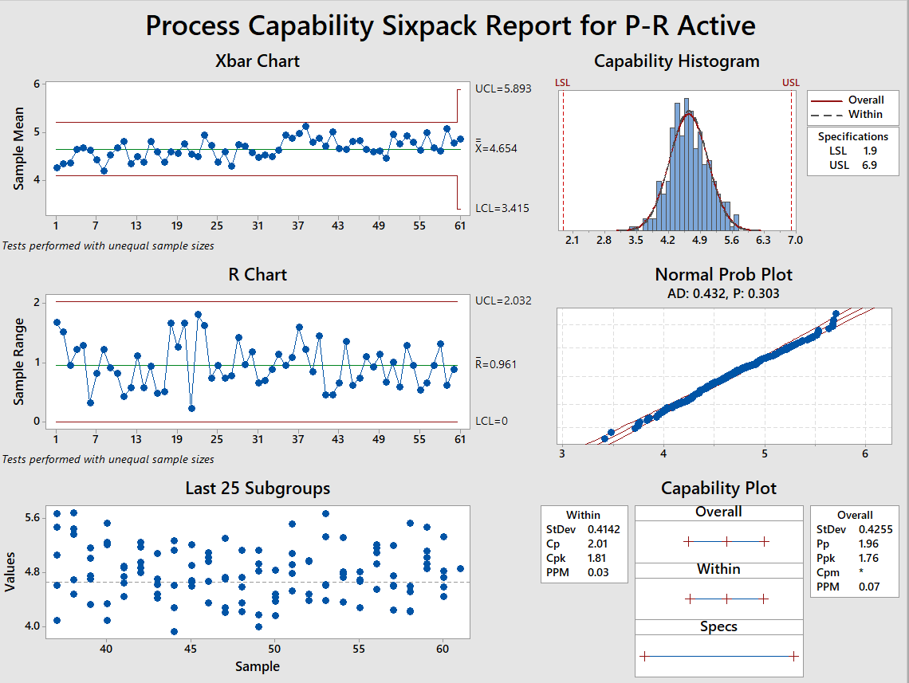
Capability (Pre vs Post / Current vs New) on all SC's/CC’s – if there are no SC/CC’s, supplier is to choose a dimension to verify.
Supplier SREA Description
Capability Analysis
Must be statistically stable and in control
Data to be normal with a P value > .05
Cpk / Ppk must be 1.67 or >

Slide 29
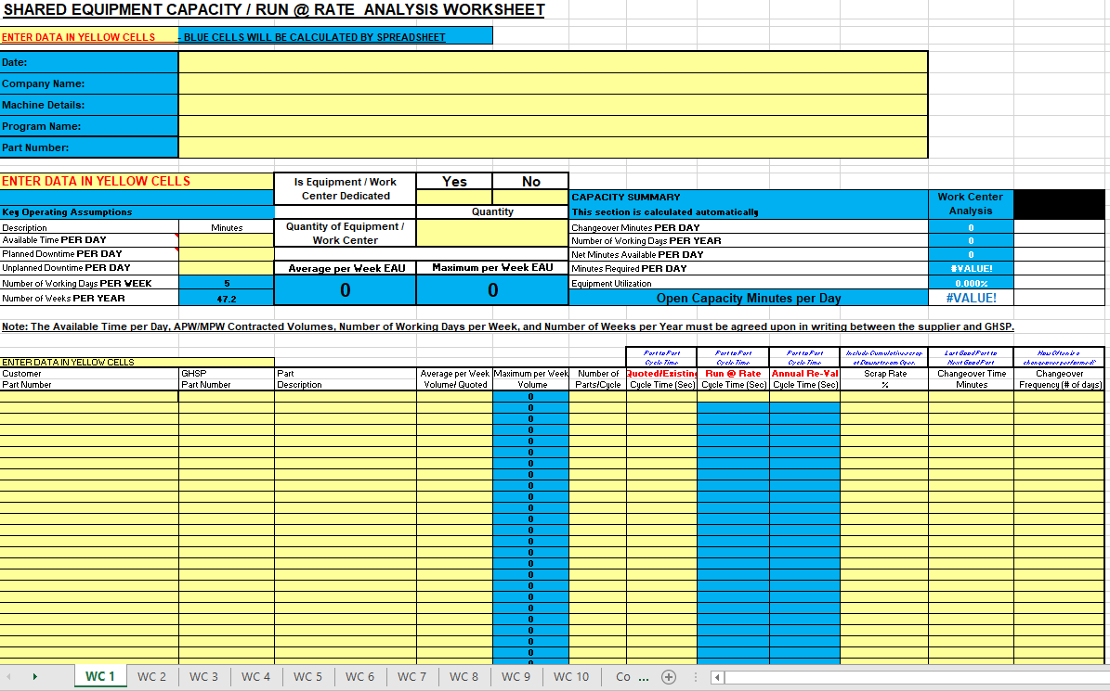
Supplier SREA Description
Capacity Verification
GHSP Capacity form can be found on the GHSP website at www.GHSP.com under Supply Chain Forms

Slide 30
REFERENCE THE AIAG MSA MANUAL FOR FURTHER GAGE R&R REQUIREMENTS
Supplier SREA Description
MSA / Gage R&R Requirements
An ANOVA repeatability and reproducibility (R & R) study has been performed for all control
items identified on the Control Plan. The organization shall report gauge R&R as both a
percent of study variation and a percent of tolerance.
Use the ANOVA method!
The organization shall report the number of distinct categories.
All variable gauge R&R studies should have a minimum of 5 distinct categories (See Measurement
Systems Analysis Reference Manual published by AIAG, refer to "ndc" in the index).
For additional guidance, see the Measurement Systems Analysis and Statistical Process
Control manuals from AIAG:
a) At least one half of the averages should be outside the control limits on the average chart
b) On the range charts, all values should be within the control limits
Note: in the special case where the manufacturing process is very capable, stable and in control
(e.g. Ppk > 2.5), percent tolerance is used, the number of distinct categories is not applicable,
and the values on the range chart are not always within the control limits.

Slide 31
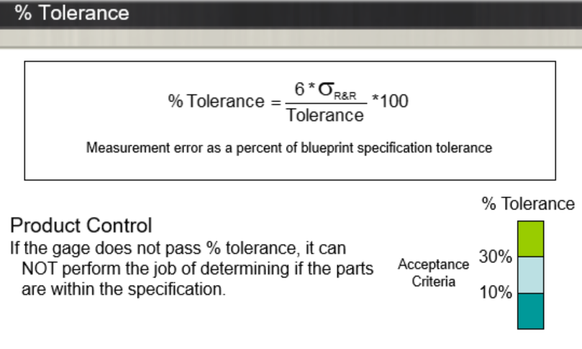
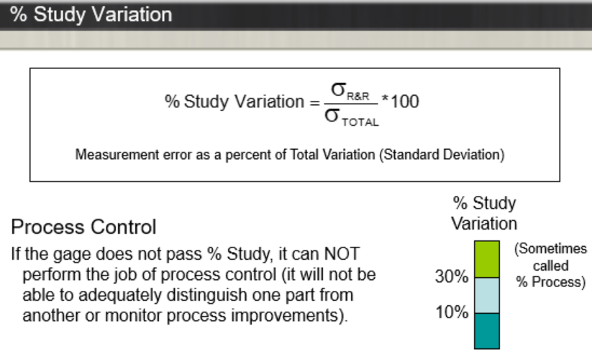
Supplier SREA Description
MSA / Gage R&R Requirements

Slide 32
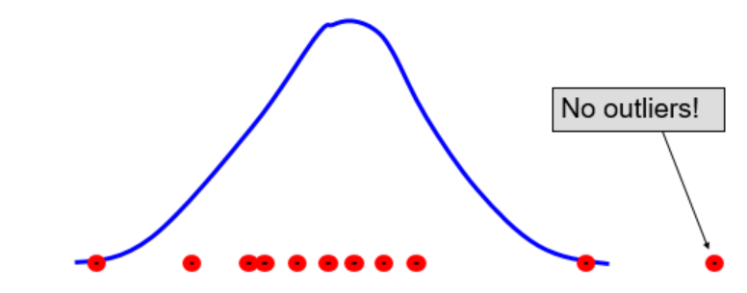
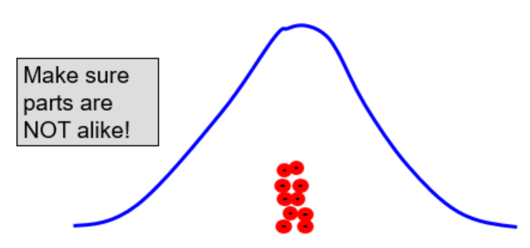
Supplier SREA Description
MSA / Gage R&R Requirements

Slide 33
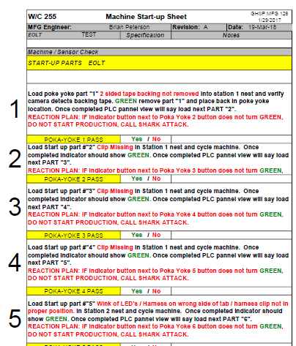
Supplier SREA Description
Poke Yoke List
EXAMPLE

Slide 34
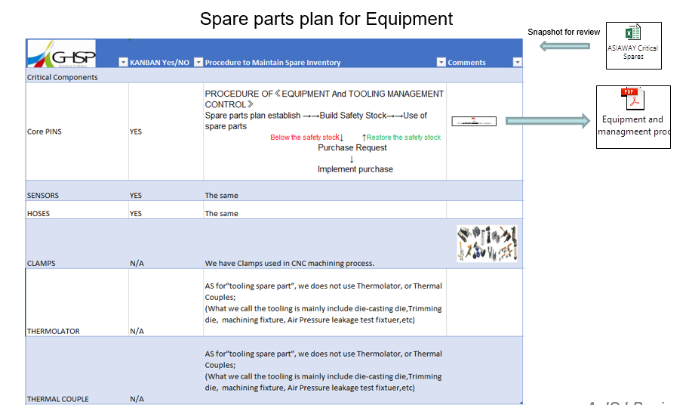
Supplier SREA Description
Spare Parts Plan
EXAMPLE

Slide 35
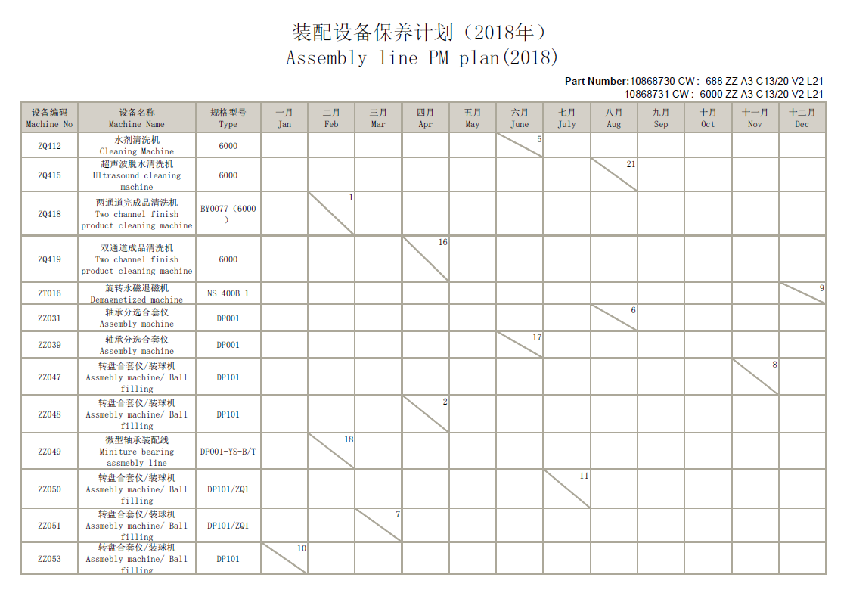
Supplier SREA Description
PM Plan
EXAMPLE

Slide 36
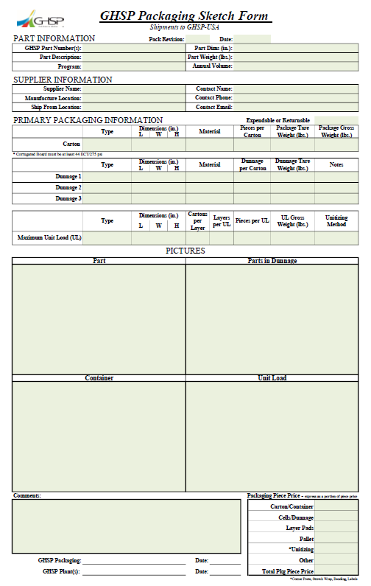
Supplier SREA Description
Packaging
BE SURE TO UTILIZE GHSP’S SUPPLIER PACKAGING AND SKETCH FORM LOCATED ON OUR WEBSITE AT:
http://www.ghsp.com/en/suppliers/packaging

Slide 37
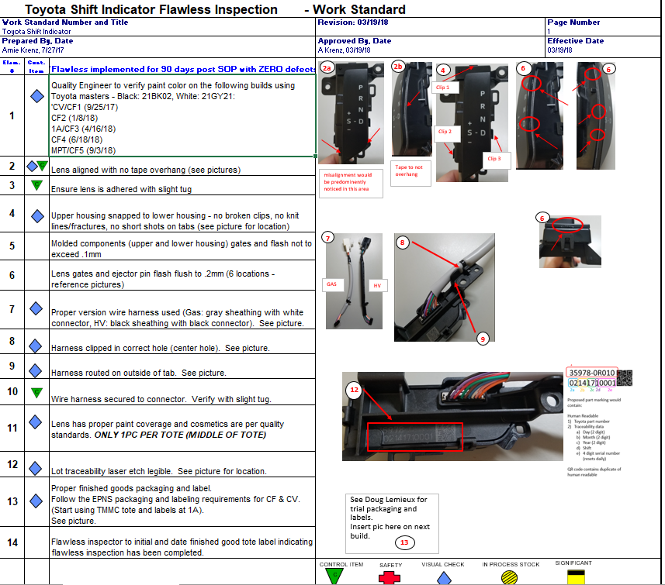
Supplier SREA Description
Safe Launch / Flawless Launch Plan
Ensure to include how long and what the exit criteria is for the safe launch, i.e. “90 days post SOP with zero defects”
EXAMPLE
Your flawless plan could also be included in your control plan. If this is the method you use, ensure details are included such as frequency and exit criteria.

Slide 38
Supplier SREA Description
FTT Data (First Time Through)
First time through yield or FTT
As it may sometimes be referred to is a measure of production efficiency, ability/skill, and quality. It measures how many goods are produced correctly without flaws or rework as percentage of total units produced in a production process or value stream.
The formula to calculate FTT is: (units produced – defective units)/units produced
The definition of defective units includes all units of production which are scrapped, reworked, do not meet standards, require repair, or are not saleable.
The first time through yield will help you identify efficiency and changes in performance in the production process and should be used as a signal to perform further analysis and improvements if it exhibits sudden big changes.

Slide 39
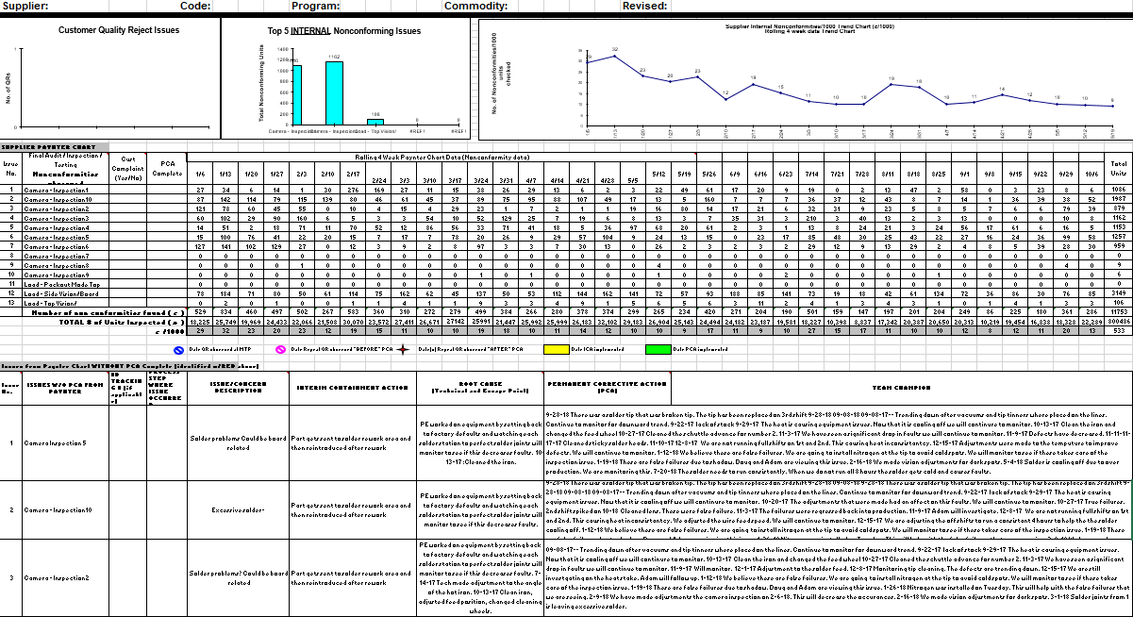
Supplier SREA Description
FTT Data (First Time Through)
EXAMPLE

Slide 40
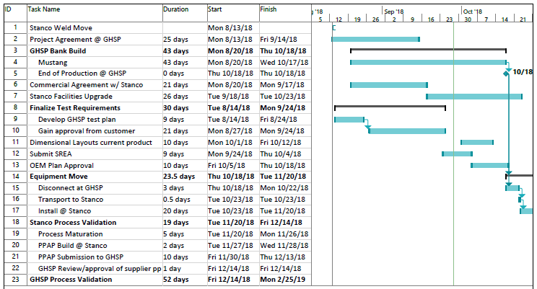
Supplier SREA Description
Detailed Timing Plan
EXAMPLE

Slide 41
GHSP Form Change History
Date Change
10/23/18 Released

