Slide 1
QAD Supplier Portal –
Printing Releases

Slide 2
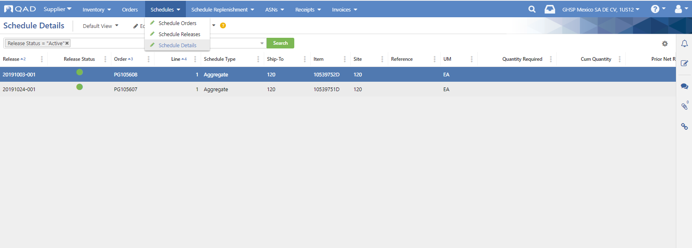
Once logged in, go to the Schedules drop down menu and choose Schedule Details
Then click on the Drill-Down Links icon on the right

Slide 3
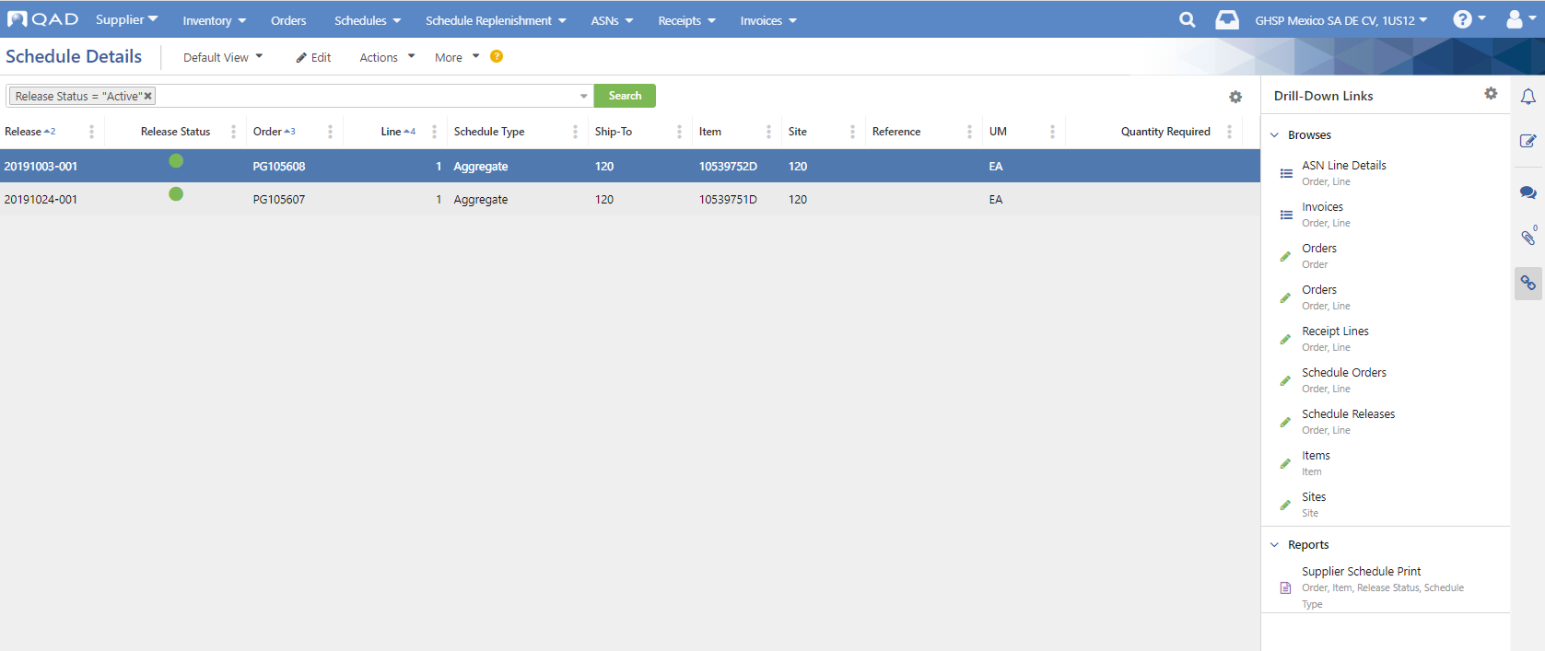
Click on Supplier Schedule Print

Slide 4
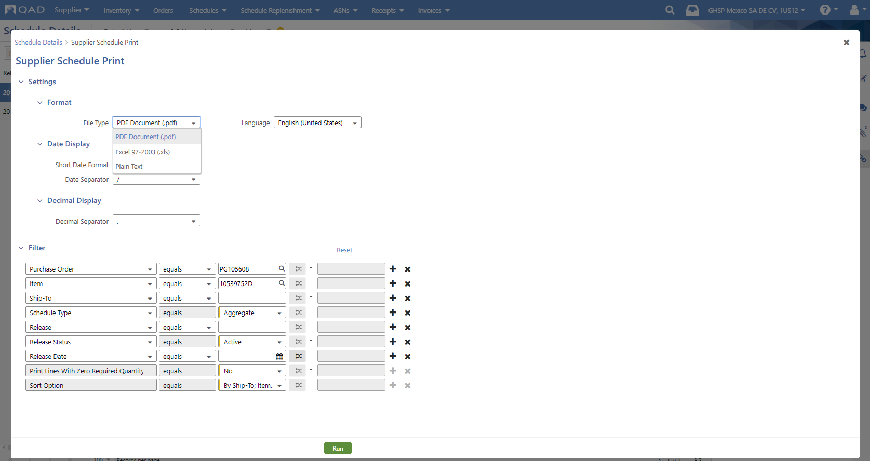
Click on Settings to choose the File Type. Default is .pdf

Slide 5
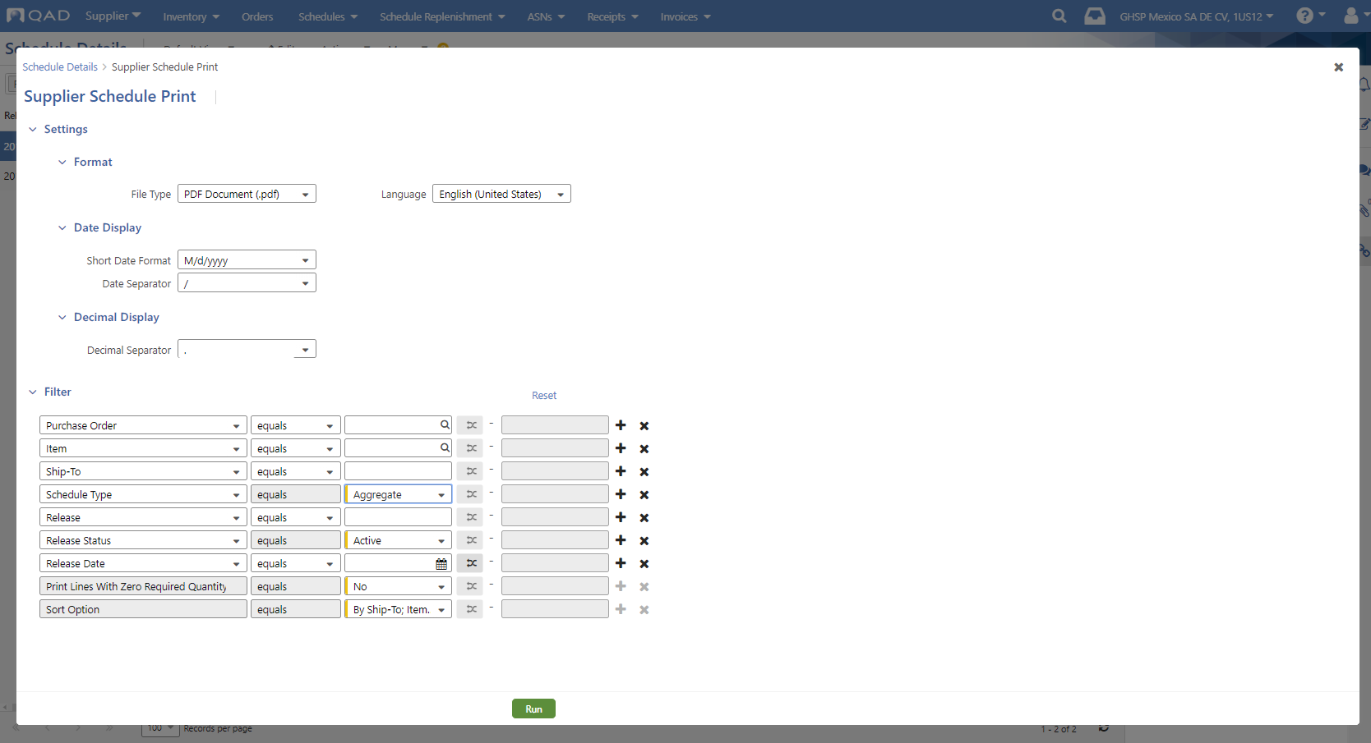
In the Filter section, click “X” to delete these filter options noted with
and change the Schedule Type to Aggregate

Slide 6
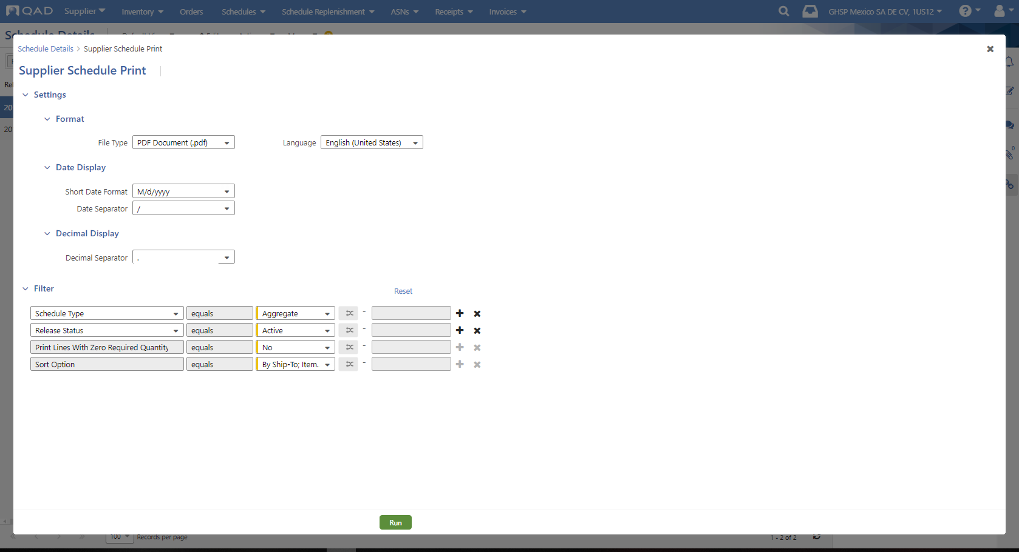
Once it looks like this, click Run.

