Slide 1
QAD Supplier Portal: Supplier Schedules

Slide 2
Course Overview
Supplier Portal — Supplier Schedules
Summarizes supplier schedules as a general concept
Introduces the Schedules view and its features
Lists important Schedules view columns
Exercise on schedules in the context of QAD Supplier Portal
Notes:
This course starts with an overview of supplier schedules as a general concept. We will then move to talk about the Schedules view in QAD Supplier Portal and its most important columns. Finally, we will complete an exercise on supplier schedules in the context of QAD Supplier Portal.

Slide 3
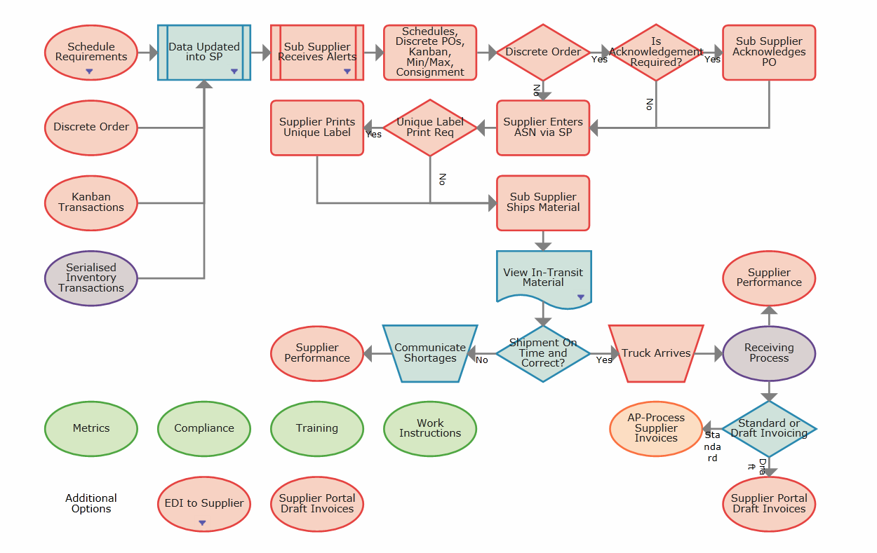
Supplier Portal — Supplier Schedules
Notes:
The highlighted node indicates that schedule, discrete PO, kanban, min-max and consignment data is all visible in QAD SP once loaded.

Slide 4
Supplier Schedules
Supplier Portal — Supplier Schedules
Cumulative, schedule-driven POs
Used by companies with long-term supplier contracts with weekly or daily deliveries
For example, in the automotive industry
Schedules specify delivery dates
May or may not include blanket contracts for service components
Notes:
Supplier schedules are period-oriented schedules that are generated on a daily, weekly, or monthly basis. Schedules contain the basic data for ASNs, receipts, and invoices.
Supplier schedules are cumulative, schedule-driven purchase orders with multiple line items from which releases of requirements and due dates are issued. They are typically used by companies with long-term supplier contracts that require regular weekly or daily deliveries. The schedules specify, for the near term, dates and even hours of deliveries. Schedules also inform MRP and the supplier about long-term plans, and are used extensively in the automotive industry.

Slide 5
Supplier Schedules — Continued
Supplier Portal — Supplier Schedules
Customers can use the Schedules view to indicate forecasted requirements
Schedules in Supplier Portal originate in QAD ERP or in another ERP
Schedules from QAD ERP are automatically loaded to Supplier Portal by a poller
Planning, Shipping, and Aggregate types
Notes:
It is important to note that, even when using another replenishment strategy, customers often use the Schedules view to indicate forecasted requirements. In these cases, the supplier then uses the Schedules screen to view forecasts for planning purposes.
For schedule-driven replenishment operations, QAD Supplier Portal offers customers and suppliers a potential saving on EDI costs. If a supplier does not have EDI, all required date is available in the Schedules view. Suppliers can see current required shipment releases, together with projections of future requirements, all on one screen. With just a mouse-click, a supplier can download the entire schedule into a spreadsheet – a format they can easily input into their planning system.
The schedules displayed in the view originate from QAD ERP or from another ERP product. If you are using QAD ERP, a poller automatically transfers data between QAD ERP and QAD Supplier Portal.

Slide 6





Delivery without ASN
Supplier
Shipped
QAD Supplier
Portal
AS + CI PO receipt
AVL
Schedule Update from MRP
Supplier Scheduled Releases
EDI
Active
Supplier Scheduled Release Management Flow
6
Notes:
This flow starts with the Purchase Material Planners who schedule or run on demand the schedule update from MRP to generate new supplier scheduled releases. When the new releases are created, Planners review all active shipping and planning scheduled releases from the supplier scheduled releases browse and manage them with the Manage Scheduled Releases bulk action. When the supplier scheduled releases are active, they become available in QAD Supplier Portal or are communicated to suppliers via EDI or are printed.
Finally, when the orders are processed, shipped, and delivered; Material Handlers can record the receipt of materials.

Slide 7
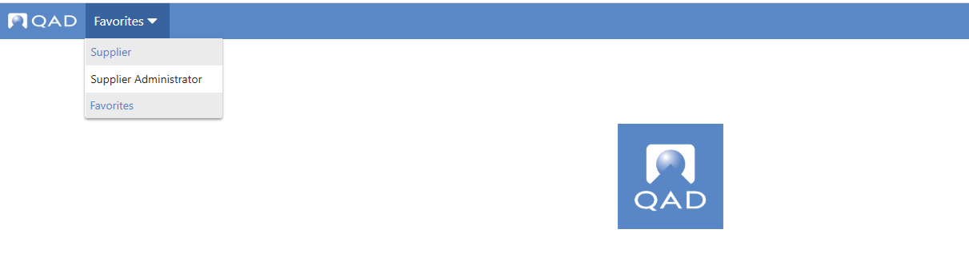
Accessing the Schedules View
Supplier Portal — Supplier Schedules
Use drop-down to select “Supplier”
Notes:
To open the Schedules view, choose the link from the top of the page.

Slide 8
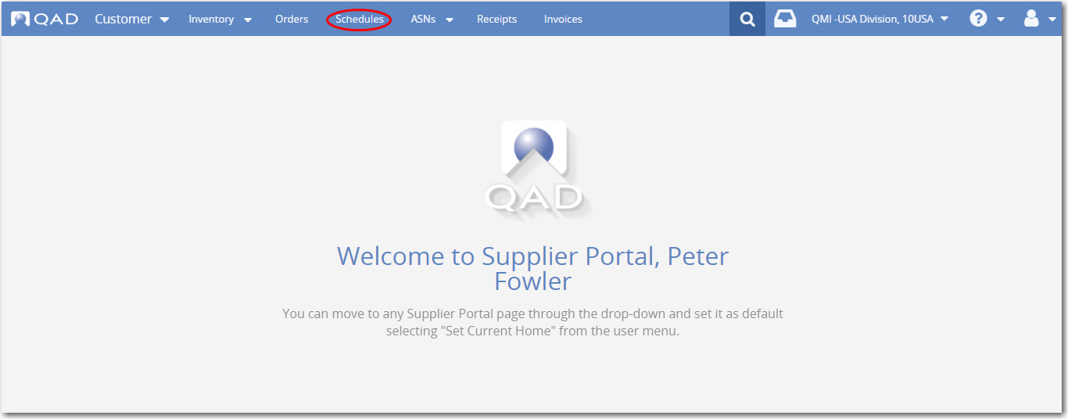
Accessing the Schedules View
Supplier Portal — Supplier Schedules
Notes:
To open the Schedules view, choose the link from the top of the page.

Slide 9
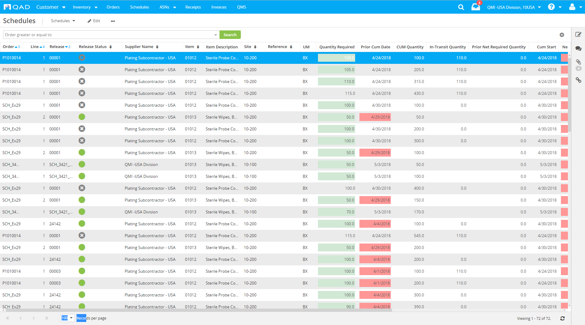
Schedules View
Supplier Portal — Supplier Schedules
Supplier release details provided
with ship schedule, cumulative or net releases
Notes:
The main Schedules screen displays the customer’s releases, along with all relevant details. The screen includes an option that lets you create an ASN against a schedule. On the right, drill-downs open more details. Color-coding advises you of firm orders (vs planned orders) and quantities that are past due.
Even when using another replenishment strategy, customers often use the Schedules view to indicate forecasted requirements.
It is interesting to note that every line you see on the Schedules screen provides all the information related to a schedule. This means that the lines include the Schedule Order (contract) information plus the Schedule Release information and all the details related to dates.
Finally, the In-Transit column contains the in-transit quantities for each release (that is, the item-place), providing you with comprehensive information to better control your supply chain.

Slide 10
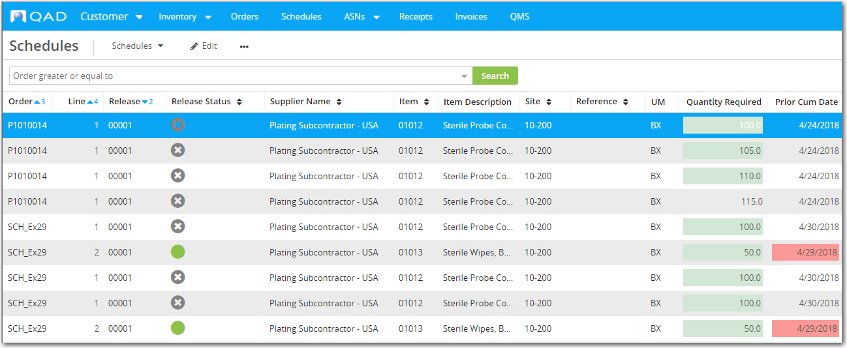

Schedules View, Visual Indicators
Supplier Portal — Supplier Schedules
A green cell indicates Firm required quantities, if Firm schedules are used.
Icons show the release status
Notes:
The Schedules view includes visual indicators to highlight fields that require particular attention.
The Release Status column displays different icons, depending on the status of the line. A blank green circle indicates that the line is active. A grey circle with an X indicates that the line is inactive.
In the Quantity Required field, a green cell indicates Firm required quantities.
In the Prior Net Required Quantity and Net Required Quantity fields, a red cell indicates that Prior Net Req Qty or Net Required Quantity is greater than zero, indicating that items are missing.

Slide 11
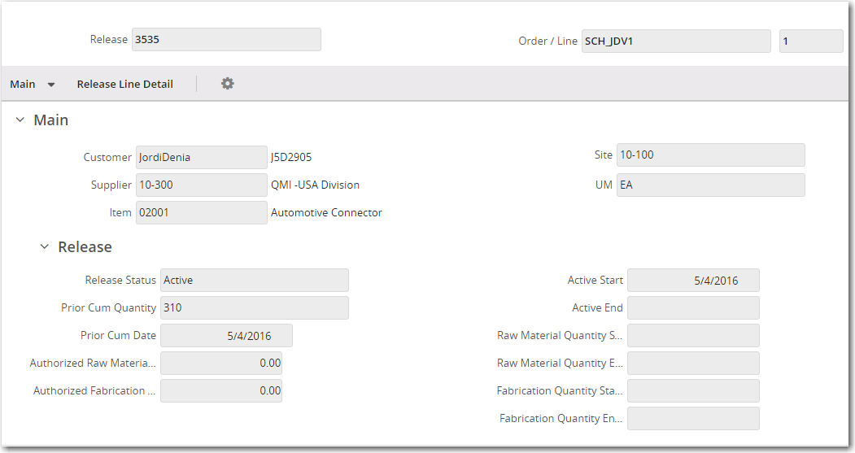
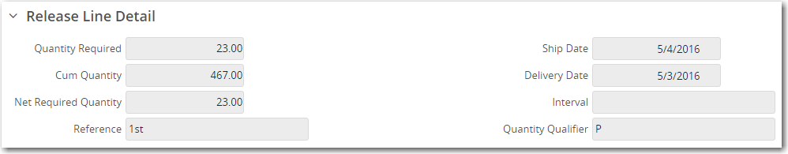
Schedules Detailed View
Supplier Portal — Supplier Schedules
Accessed by double-clicking a schedule line
Detailed data, organized by panels
Notes:
In a form, view more detailed data grouped by panels. The form displays when you double-click on a row (a record) in an editable view grid. A form includes a summary panel, navigation bar, main panel, and then various detail panels and sub-panels.
A release is a set of item quantities and requirement dates identified by a release ID number, which is then sent to your supplier.

Slide 12
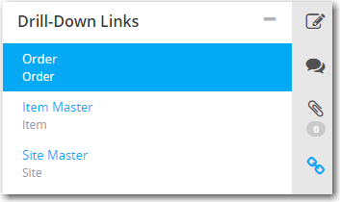
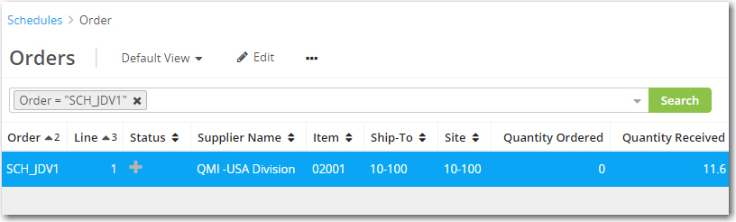
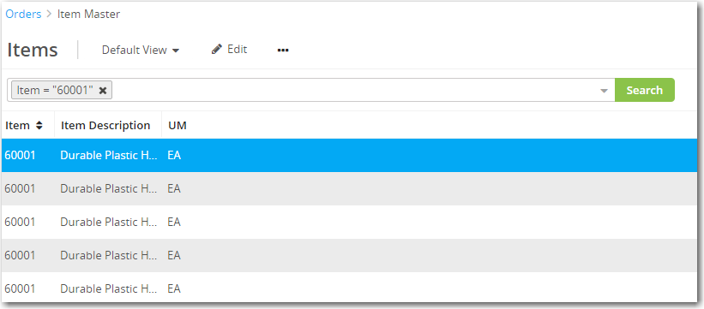
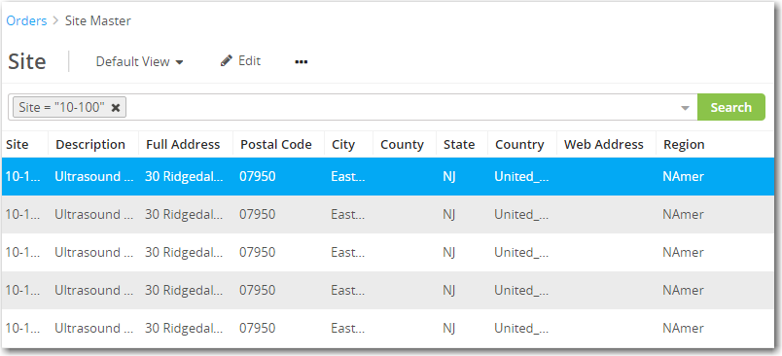
Schedules View, Drill-Down Links
Supplier Portal — Supplier Schedules
Double-click the row that you want to view in more detail.
Notes:
The Schedules view in QAD Supplier Portal includes drill-down links. By selecting the drill-down view you want and then clicking on the Link icon located on the right of the view, you can quickly access browses related to data in the currently selected record. For example, you can quickly open the Item Master browse for the ordered item.

Slide 13
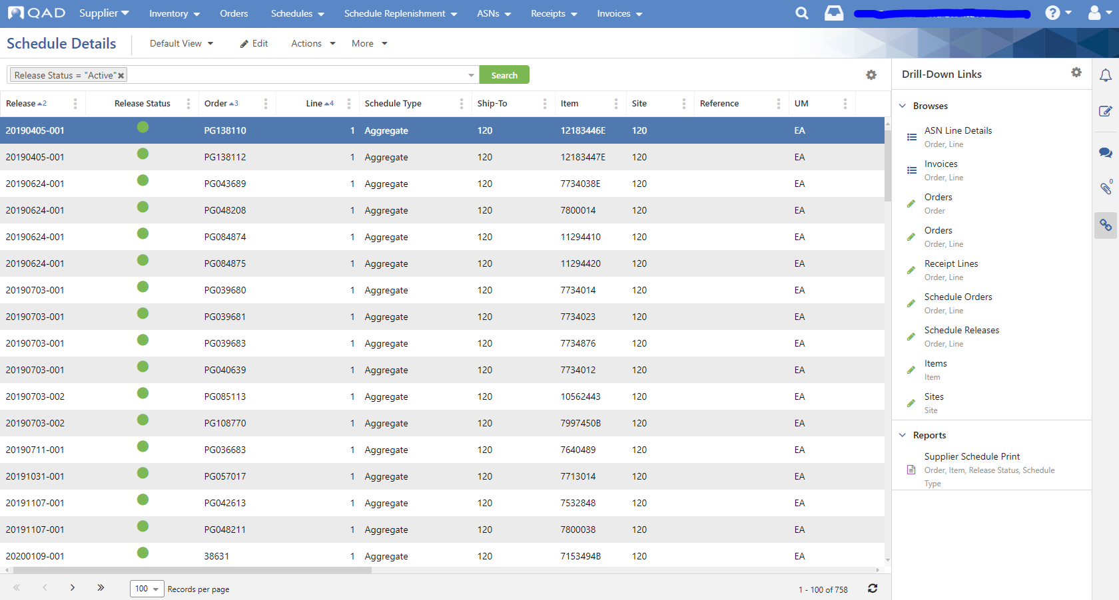
Schedules View, Printing
Supplier Portal — Supplier Schedules
Click on Drill Down links then Supplier Schedule Print. Set and filter for the desired information and print type.
Notes:
The Schedules view in QAD Supplier Portal includes drill-down links. By selecting the drill-down view you want and then clicking on the Link icon located on the right of the view, you can quickly access browses related to data in the currently selected record. For example, you can quickly open the Item Master browse for the ordered item.

Slide 14
Key Settings for the Schedules View
Supplier Portal — Supplier Schedules
Policies in Supplier Portal non-CI Web UI
Maintained in Admin >> Company >> Company Maintenance >> Policies
Update Cumulative Receipt Quantity Method Policy
Recalculate Ship Date Policy

Slide 15
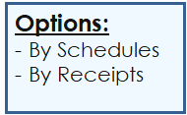
Update Cum Receipt Qty Method
Supplier Portal — Supplier Schedules
Specifies how the Cum Receipt Qty value is determined -- from receipts or from schedules.
GHSP default setting is “By Schedules”
Notes:
Specifies how the Cum Receipt Qty value is determined -- from receipts or from schedules. Cum Receipt Qty is used to calculate the Arrears and Overshipments values displayed in Schedule Replenishment. The By Schedules (default) setting is recommended for most customers, especially those who use a QAD ERP application (MFG/PRO, Standard Edition, Enterprise Edition).

Slide 16

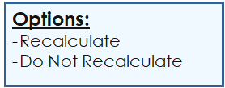
Recalculate Ship Date Policy
Supplier Portal — Supplier Schedules
Specifies if the Ship Date field imported from ERP should be recalculated based on the associated Transportation Days field.
GHSP default setting is “Recalculate”
Notes:
Specifies if the Ship Date field imported from the ERP system
should be recalculated on Schedules view based on the associated Transportation Days field.
The default setting is for recalculation to be enabled. If recalculation is disabled, the Ship Date field is not recalculated.

Slide 17
Choosing Columns for the Schedules View
Supplier Portal — Supplier Schedules
Primarily, the columns you require depend on your particular business processes
Often, customers recommend how they want suppliers to set up the Schedules view
In Schedule Details, filter for Release then either Ship Date or Delivery Date columns (depending on the type of release customer plant provides) to view upcoming shipment requirements
Notes:
How do you decide which columns are the most useful and configure the Schedules screen to display them? Primarily, the columns you require depend on your particular business processes and, often, a customer has recommendations on how they would like the supplier to set up the Schedules screen.

Slide 18
Schedules as Replenishment Strategy
Supplier Portal — Supplier Schedules
If schedules are your primary replenishment strategy, the important columns are:
Order | Schedule Type
Line | Required Quantity
Release | Net Required Quantity
Delivery Date Ship Date | Item
Notes:
If you are using schedules as your primary replenishment strategy, some of the important columns to display are:
Order
Line
Release
Delivery Date
Ship Date
Schedule Type
Required Quantity
Net Required Quantity
Item
Of course, it is important to display any other columns that help you to understand and to manage your inventory system. Remember that you can adjust the column widths by simply placing your mouse on the dividing line of the heading and moving it left or right.

Slide 19
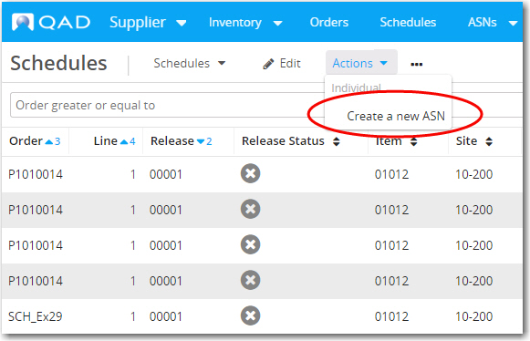
Schedules View, Creating ASNs
Supplier Portal — Supplier Schedules
Suppliers: The Create a new ASN option becomes visible under Actions whenever there is a quantity available to ship
When you select Create a new ASN option, you open the ASN Maintenance screen, where you can create the shipment.
Notes:
In the Schedules view, the ASN creation option is visible under Actions whenever there is a quantity available to ship (according to the order).
When you select Create a new ASN option, you open the ASN Maintenance screen, where you can create the shipment.
This course includes a separate module on ASNs.

Slide 20
Advanced Training Topics
Supplier Portal — Supplier Schedules
Shipping Forecasts
Produced by suppliers to provide information and visibility about their planned shipping schedules
QAD SP stores two types of related information:
Supplier schedules (demand provided by customers)
Shipping forecasts (supply provided by suppliers)
Notes:
The advanced training topics will be developed in late 2019 or in early 2020.

Slide 21
Advanced Training Topics — Continued
Supplier Portal — Supplier Schedules
Schedule Replenishment
Displays the next scheduled deliveries, arrears, overshipments, and replenishment quantities for all schedule-controlled items
The replenishment quantity automatically refreshes when receipts, ASNs, or schedules are created or updated

