Slide 1
QAD Supplier Portal: Web UI Overview

Slide 2
Course Overview
Supplier Portal — Web UI Overview
Highlights SP functions available in the Web UI
Describes the main UI features that help provide a unique user experience

Slide 3
Current Features Available in SP Web UI
Supplier Portal — Web UI Overview
Purchase Orders
Supplier Schedules
ASNs
  Label Printing
Receipts
Invoices
Kanban
Min/Max
User-Defined Fields (UDFs), read only
Consolidated Accounts
Notes:
The SP Web UI features listed above are now available in the new Web UI.

Slide 4
Browser Support
Supplier Portal — Web UI Overview
Important
The QAD SP UI is only supported on current versions of the Chrome and Safari web browsers.
Although you can use other web browsers, you may experience differing levels of performance and user experience.

Slide 5
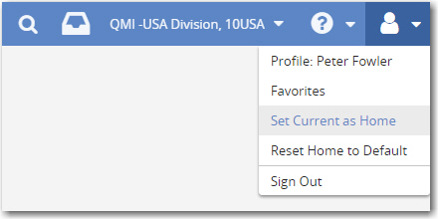
Setting Your Home Page
Supplier Portal — Web UI Overview
First page you see after login is your home page
To set a page as your home page, choose Set Current as Home from the user options drop-down
Notes:
After you sign in, the first page you see is your home page. If this is the first time you have signed in, you will see the default home page. You can set any page to be your home page by choosing Set Current as Home from the user options drop-down.

Slide 6
Menu Bar
Supplier Portal — Web UI Overview
The SP menu bar starts with the QAD icon, located in the upper left
Click the QAD icon to go to your home page
Notes:
The SP menu bar starts with the QAD icon, located in the upper left. Click the QAD icon to go to your home page
When you are working in the UI going through various menus and want to go back to your home page, click the QAD icon.
When you log in, log out and then log in again, the page that opens is the last menu that you were in. Click the QAD icon to bring you back to your home page.

Slide 7
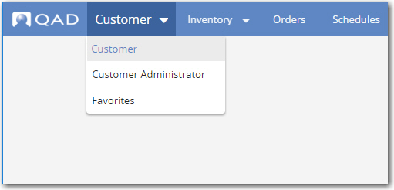
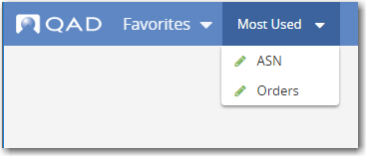
Menu Bar — Roles and Favorites
Supplier Portal — Web UI Overview
Choose your role from the drop-down list of your available roles
Choose Favorites to have the menu bar display all your favorite menu items
Menu bar with Favorites and Most Used
Notes:
Next to the QAD icon, Role and Favorites menu selection.
Choose a role from the drop-down menu listing the roles available to you. Choose Favorites, located at the bottom of the drop-down menu, to have the menu bar display all your favorite menu items.

Slide 8
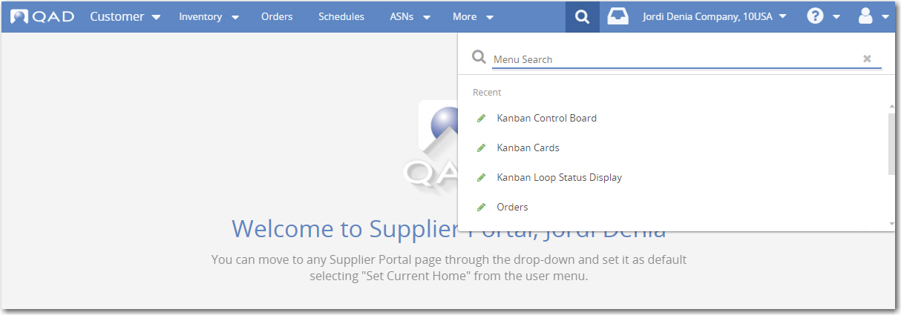
Menu Bar — Search
Supplier Portal — Web UI Overview
Click the Magnifying Glass icon to open the search
Notes:
Select the Menu Search icon to open the search facility. Use the menu search to find all the menu items available to you. The menu search features “type ahead” behavior so you can easily find items with similar names.
Icons indicate the menu item types, including forms, browses, and views.
You can set a menu item as a favorite directly from the listing of menu items, and see which are already favorites.

Slide 9
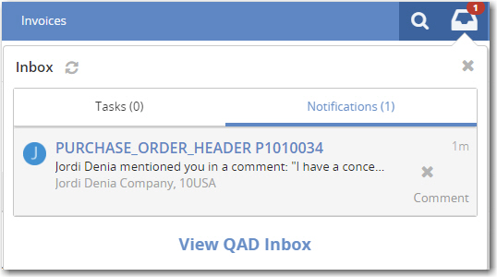

Menu Bar — Inbox
Supplier Portal — Web UI Overview
Click the Inbox icon to open the inbox
Notes:
Click on the Inbox to see your messages.
The Inbox lets you know how many new messages you have with an indicator on the icon. The messages include notification messages. Notifications indicate activity such as system events and comments from other users.
Initially, the Inbox displays a listing of your recent messages in a drop-down box. You can toggle between the Tasks and Notifications tabs and scroll within each tab to view the messages. Some notifications link to the related views for quick access. And for some notification messages, you can click Comment and enter your comments in the comment box directly.
To view all notification messages, you can go to the Extended Inbox. To go to the Extended Inbox, click View Inbox.

Slide 10
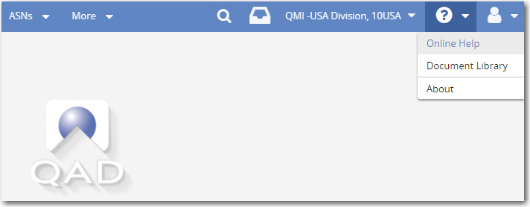
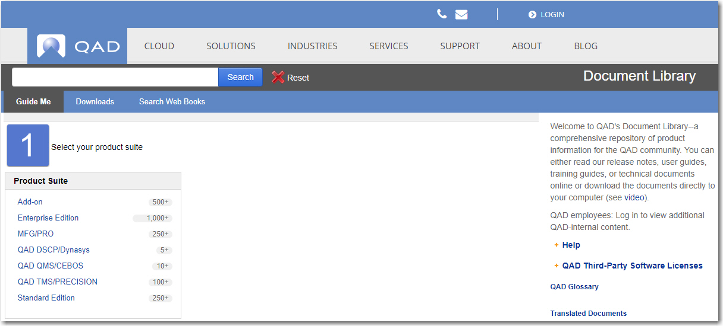
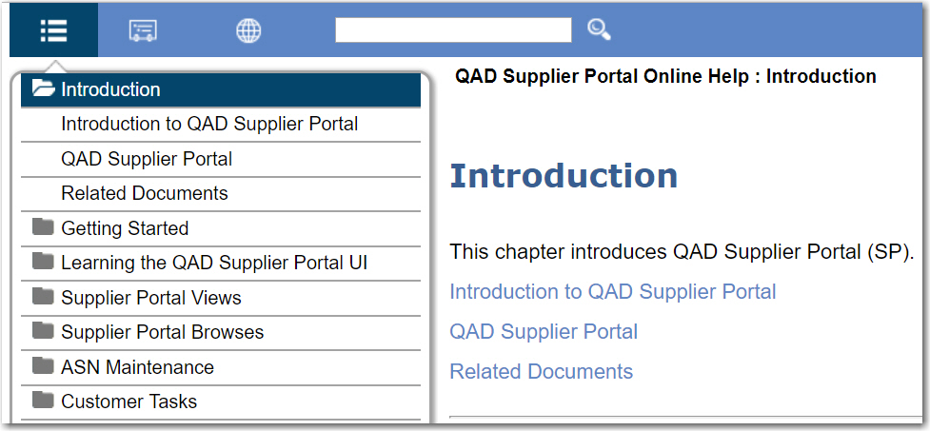
Menu Bar — Online Help
Supplier Portal — Web UI Overview
Click the Question icon to open the help
QAD Document Library
Supplier Portal Help
‹#›
Notes:
From the help drop-down menu; you can view the online help, open process maps, and access the QAD Document Library.

Slide 11
Views
Supplier Portal — Web UI Overview
The QAD SP Web UI offers views in which you can interact with the system
Because views combine forms and browses, they are also called hybrid views
A view includes:
  A toolbar along the top
  A grid (or browse), displaying a list of records
  A form for completing work
Notes:
The QAD SP Web UI offers views in which you can interact with the system. Because views combine forms and browses, they are also called hybrid views.
A hybrid view, or simply view, includes a toolbar along the top, a grid (or browse) displaying a list of records, and a form for completing work. The form organizes everything you need on a single page, typically starting with a summary panel at the top. Related fields and functions are grouped within panels. The navigation bar, located just below the summary panel, allows for quick access to any panel of interest. You can quickly access anything on the form by scrolling or using the navigation bar.
Some hybrid views include complete access, combining the grid with the form; other hybrid views only provide read-only access and display the grid. Hybrid views with complete access include the New and Edit buttons along the top.

Slide 12
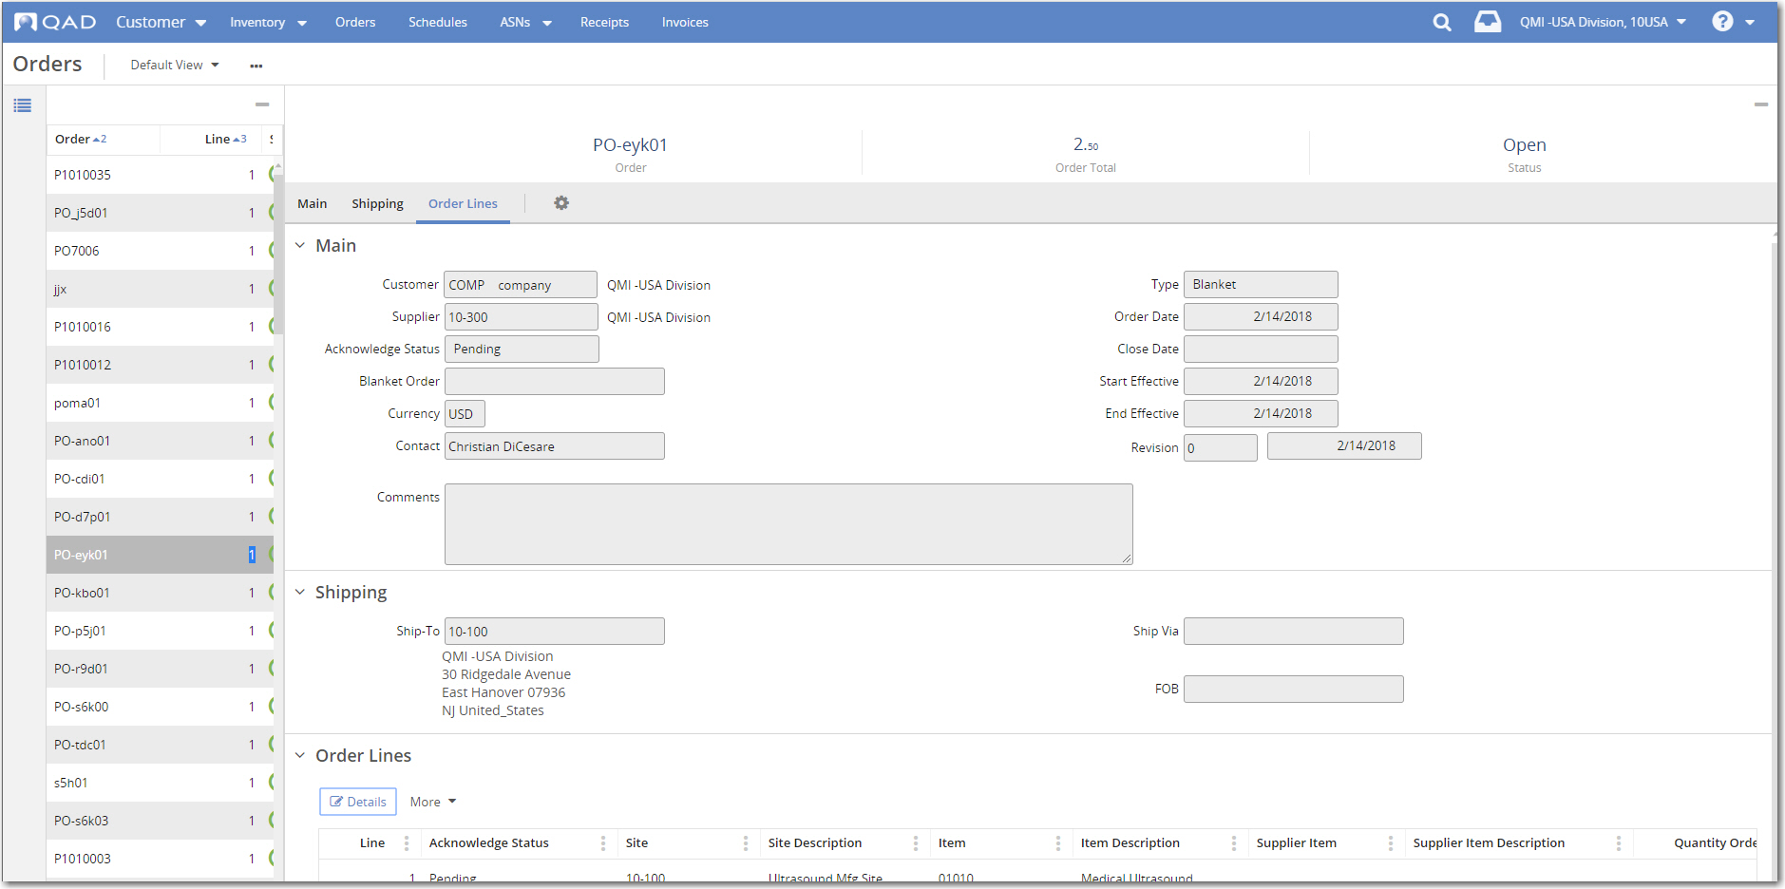
Views (Continued)
Supplier Portal — Web UI Overview
Summary Panel
Navigation Bar
Browse
Gear Icon (Configuration)
Main Panel
Form
Detail Panels

Slide 13
Browses
Supplier Portal — Web UI Overview
When you first open a view, the browse grid displays records in rows.
Browses include the following features:
  Quickly search for data or add search conditions
  Sorting on columns
  Paging controls along the bottom of grid display
  Hide/show columns with configuration settings
  Save column configurations as a stored view
  Save search filters as stored searches
Notes:
When you first open a view, the browse grid displays records in rows.
Browses include the following features:
• Quickly search for data or add search conditions
• Sorting on columns
• Paging controls along the bottom of the grid display
• Hide and show columns with configuration settings
• Save column configurations as part of a stored view
• Save search filters as stored searches
Selected browse grids include New and Edit buttons, indicating you can create new records and edit existing records in a form. For these, you can also edit an existing record by double-clicking on a row. Double-clicking on a row opens the form for editing the selected record.

Slide 14
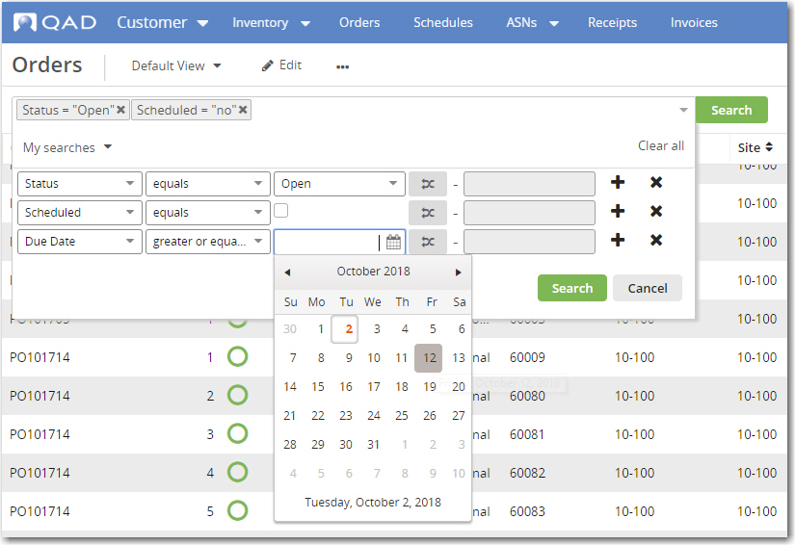
Browses — Searching and Filtering
Supplier Portal — Web UI Overview
Filter using the Search function
Use the Toggle button to compare values from two browse columns
Define search conditions
Select dates from the calendar
Notes:
Searching and Filtering
You can filter the grid display using the Search function.
In the Search box, enter the field you are searching on, along with a condition (such as “starts at” or “greater than”), and then a string or value. For doing a quick search, just enter a string to search based on the default condition for the grid. The default field is typically a key field for the grid. You can enter as many search criteria as you need to get the display results you need.
The Toggle button lets you compare the values from two different browse columns.
Click on the drop-down icon in the Search box to add, change, or remove search conditions.

Slide 15
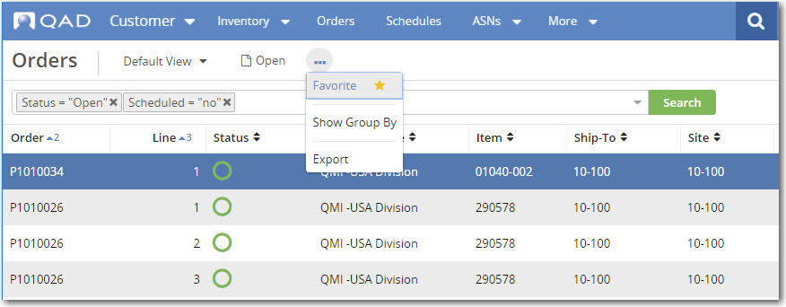
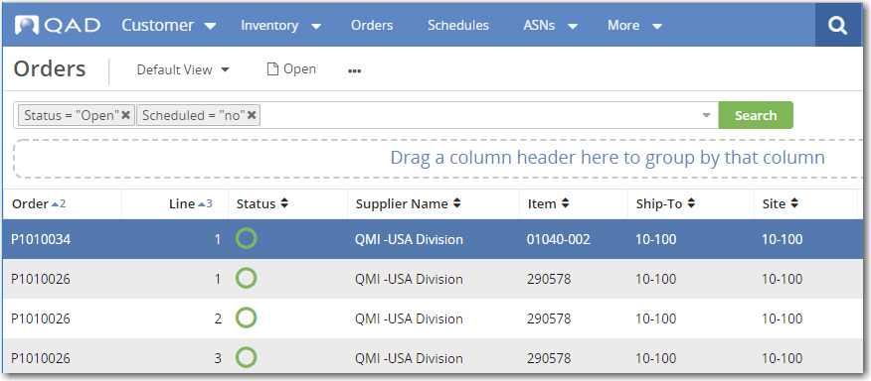
Browses — Group By
Supplier Portal — Web UI Overview
Click the More (...) icon and then Show Group By
Drag the column headers to group by them
Notes:
Group By
With the Group By feature, you can display data hierarchically based on selected columns. To use Group By on a browse grid, from the More (...) icon, select Show Group By. For Group By, all the records must be on the page. You might need to increase the records per page or apply Search filters to the browse in order to display all the records on the page. With Group By active, you can drag-and-drop column headers to group the display by the selected columns. You can then expand or collapse the groupings as needed.
Important: You can only apply the Group By feature to results that are listed on a single page. So, if you have two pages of results, you cannot apply Group By. The Group By feature is particularly useful in grouping data that you can analyze at a glance. If your search produces thousands of lines of results, grouping results of that size to analyze at a glance is not effective anyway.

Slide 16
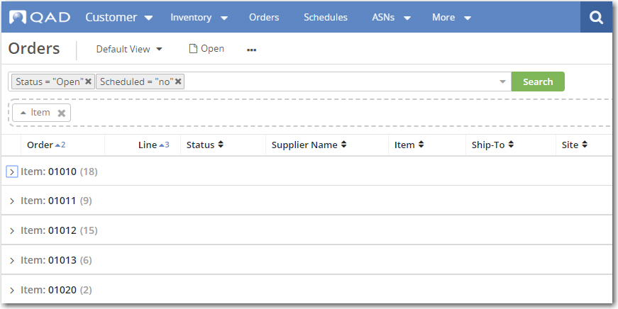
Browses — Group By (Continued)
Supplier Portal — Web UI Overview
Orders view, grouped by Item
Notes:
The Orders browse with the data grouped by item.

Slide 17
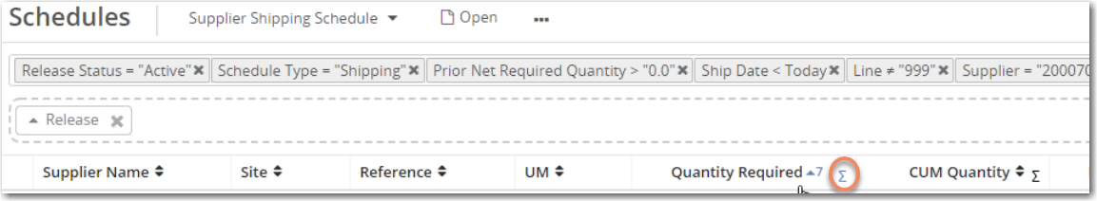
Browses — Group By, Summation Symbol
Supplier Portal — Web UI Overview
Displayed in integer/number columns when you use Group By
Notes:
The summation symbol appears in all columns that are integers/numbers when using group by.

Slide 18
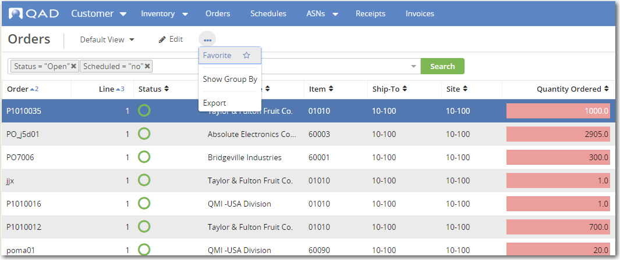
Browses — Export
Supplier Portal — Web UI Overview
Click the More (...) icon and then Export
Notes:
Export
You can export browse data to a variety file formats. To export, from the More (...) drop-down, choose Export. In the File Properties panel, enter the file name and select the file type. Click Export.

Slide 19
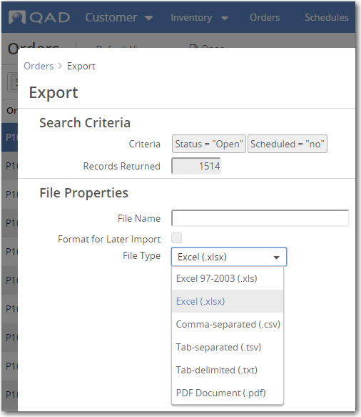
Browses — Export Dialog Box
Supplier Portal — Web UI Overview
Search criteria applied and the number of records returned
Multiple export formats are available
Notes:
You can export browse data to a variety file formats, including:
• Excel (.xlsx)
• Excel 97 - 2003 (.xls)
• Comma-separated values (.csv)
• Tab-separated values (.tsv)
• Tab-delimited values (.txt)
• Portable Document Format (PDF) (.pdf)
To export, from the More ( ... ) drop-down, choose Export. In the modal dialog, the Search Criteria panel shows any browse search criteria that you have applied, along with the number of records returned. In the File Properties panel, enter the file name and select the file type. If you would like to export the data to Excel, make some changes, and then the re-import data from Excel, select the Format for Later Import option. When you format the data for later import, the data is exported to Excel in a format that is based on the Business Component data structure, which can be different than the browse column order. In Excel, the order of the columns might not match the order of the columns in the browse grid you are currently working with in the QAD Web UI.

Slide 20
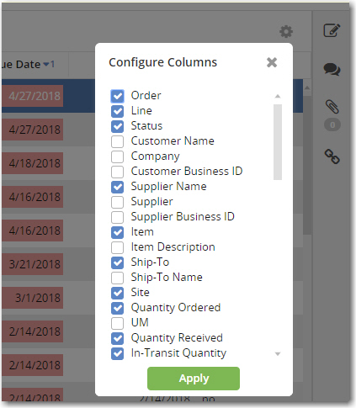
Browses — Configuring Columns
Supplier Portal — Web UI Overview
Select the columns that you want to display and click Apply
Notes:
You can configure which columns to display in a browse using the Configure Columns dialog. Open the dialog by clicking on the gear icon located by the Search button, and select which columns you want the grid to display. You can save the column configuration changes as part of a stored view.

Slide 21
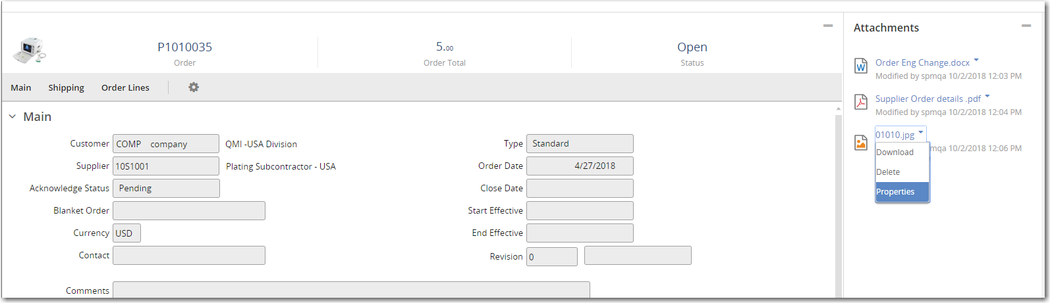
Attachments
Supplier Portal — Web UI Overview
Attachments Panel
Drop-down list for an attachment
Notes:
You can attach files to views to keep relevant documents together for a particular transaction. For example, you can attach spreadsheets, Word documents, and PDFs to an order. To attach a file, you can drag the attachment to the attachments drop area, or click Upload to select the attachments. Right-click on the attachment to delete the attachment, view its properties, or download it.

Slide 22
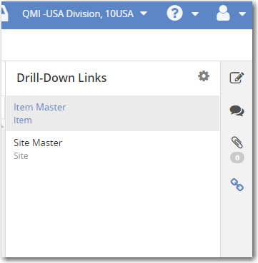
Drill-Down Links
Supplier Portal — Web UI Overview
2. Click the Link icon
1. Select the drill-down view you want
Notes:
Selected views, such as Orders, include the drill-down links feature. By clicking on the Link icon located on the right side of the view, you can quickly access browses related to data in the currently selected record.

Slide 23
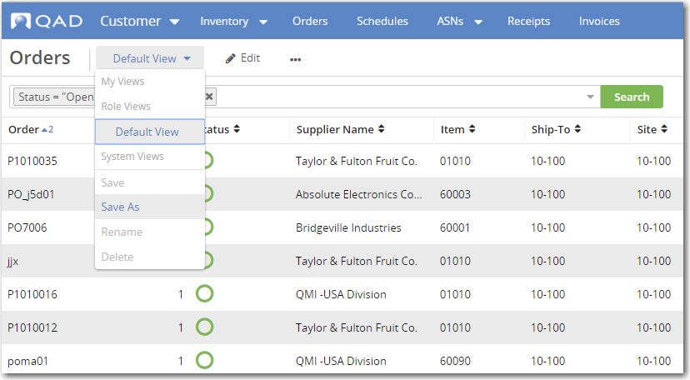
Stored Views
Supplier Portal — Web UI Overview
Pull-down menu, next to the view title
After you configure the view, choose Save As to store the settings
Notes:
You can modify a view and then save it for later use as a stored view. Aspects of a view that you can modify include the grid columns and form panels. After configuring a view, you can save it as a stored view from the drop-down located next to the view title. Once saved, a stored view is available from a pull-down menu located next to the view title. Your stored views are available to you alone.

Slide 24
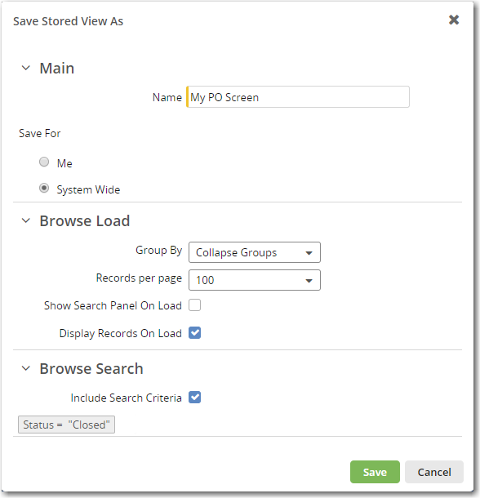
Saving a Stored View
Supplier Portal — Web UI Overview
All users can save a view for their own use
Only Customer Admin users have the option to save a view as system wide
You can choose to save the search criteria too
Notes:
If you customize a view (by changing the sort, search, columns, or panels) and save it, the customized view will be for your use only, unless the view is saved as a system-wide view. Only Customer Admin users can save views as system wide.
Customer Admin users can tailor particular views; for example, Orders, and make those changes system wide for their suppliers and other customer users. Only Customer Admin users can edit system-wide views.
When you first access the system and open a view, the system-wide view for that screen is displayed. If there is no system-view for that screen, the QAD default view is displayed. However, when you next access a view, the last view you accessed for that screen will display, regardless of whether the view was system wide, a QAD default view, or a custom view that you created.

Slide 25
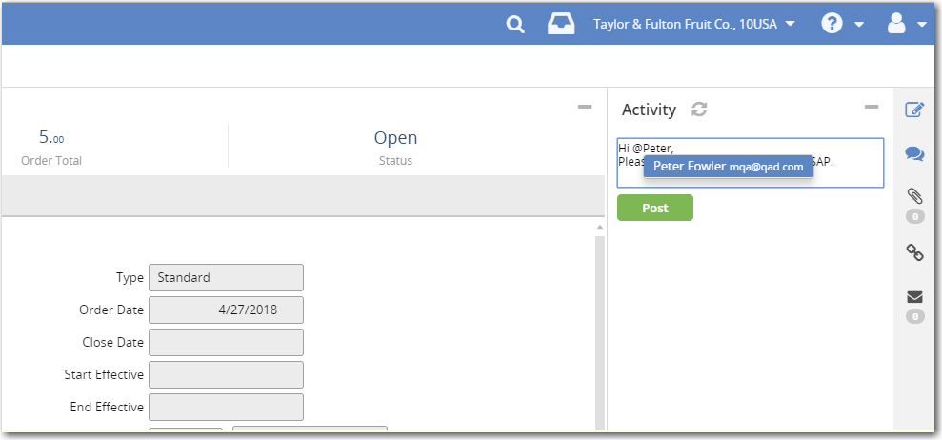
Activity Panel
Supplier Portal — Web UI Overview
Comment on activity — like using social media
Comment created for the attention of the user, Peter Fowler
Notes:
With the Activity panel, you can comment on activity in a way similar to how you use social media. The system can track comments, and attachment uploads for the current record and displays them in the Activity panel.
From a form, open the Activity panel on the right side of the page by clicking on the Activity icon along the right.
You can add comments directly to the activity feeds, and mention the names of other uses in the comments by first typing the @ symbol.

Slide 26
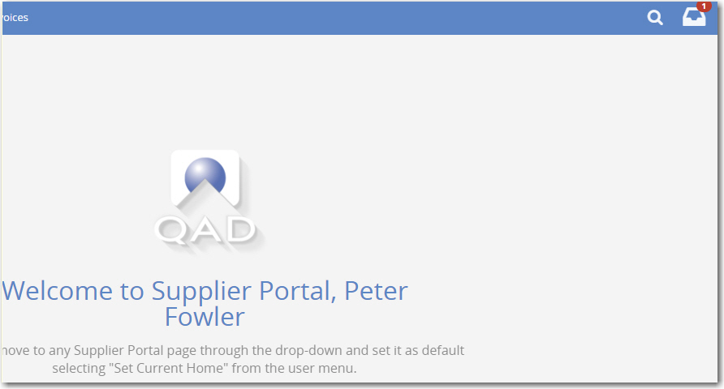
Activity Panel (Continued)
Supplier Portal — Web UI Overview
Peter Fowler now has a new message notification
Notes:
Tagged users receive Inbox notifications that they have been mentioned in a comment. They can then go directly from their Inbox notification to the form and its activity panel. They can also simply reply to the Inbox notification.

Slide 27
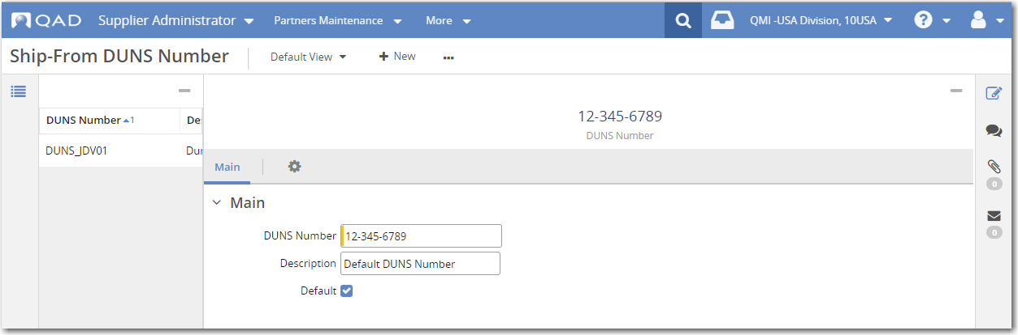
Messages Panel
Supplier Portal — Web UI Overview
A supplier admin enters a new DUNS number and sets it as the default. The record has not been saved yet.
Information and warning messages are displayed in a Messages panel, accessed using the Envelope icon.
Notes:
Information and warning messages provide feedback as you enter data. Information and warning messages are displayed in a Messages panel, which reduces potential distractions during data entry while improving message accessibility. While working in a form, you can quickly access the messages panel by clicking on the messages icon located on the right side of the view.
In this example, a supplier admin is creating a ship-from DUNS number and setting it as the default. There is currently no default DUNS. The record has not been saved yet.

Slide 28
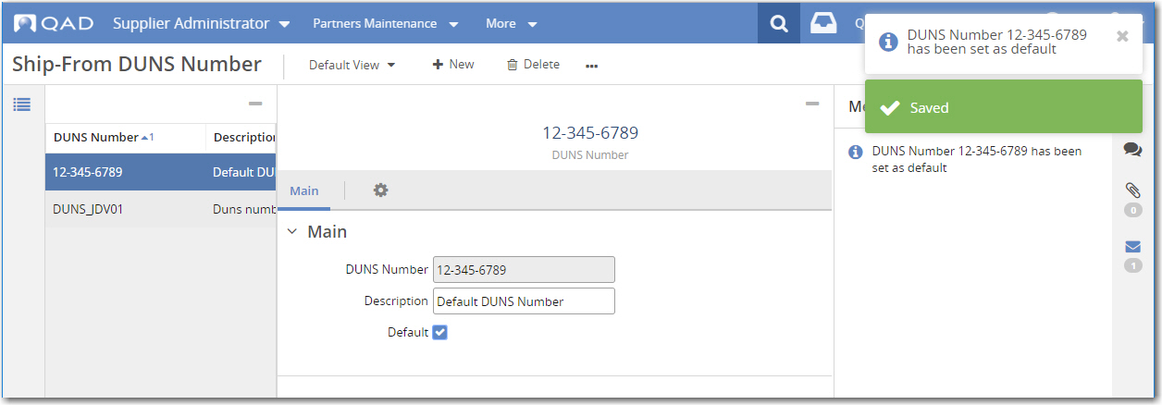
Messages Panel (Continued)
Supplier Portal — Web UI Overview
The supplier admin saves the new DUNS number, which generates a message.
Notes:
When the supplier admin saves the default DUNS number, a message regarding the default number is displayed in the Messages panel.

Slide 29
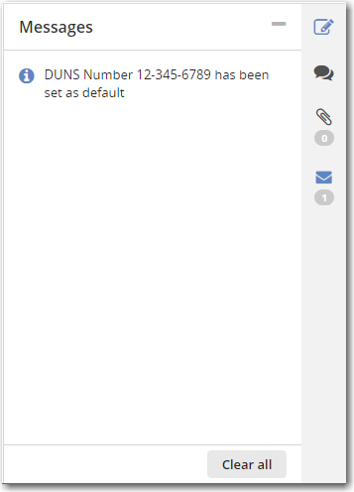
Messages Panel (Continued)
Supplier Portal — Web UI Overview
Click Clear All to clear the Messages panel
Notes:
To reduce clutter, you can clear currently displayed messages by clicking on the Clear All button, located in the lower right corner of the Messages panel. Note that error messages are displayed at the bottom of the form, in an Errors grid.

