Slide 1
QAD Supplier Portal: Advance Shipment Notices (ASNs)

Slide 2
Course Overview
Supplier Portal — ASNs
Discusses ASNs and their benefits
Shows how ASNs are implemented
Introduces ASN views
Describes how to add lines to ASNs
Discusses how to add lots and containers to ASN lines (if applicable for customer)

Slide 3
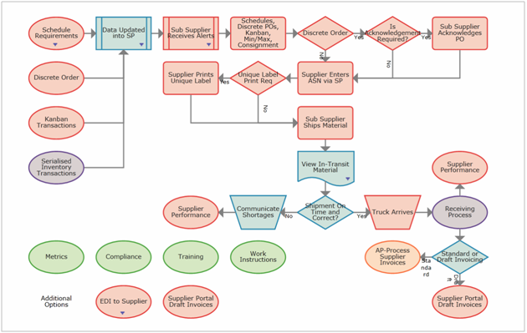
Supplier Portal — ASNs

Slide 4
ASNs
Supplier Portal — ASNs
Provide detailed information about a pending delivery
Notify the customer when shipping occurs
Provide information about:
  Which items are being shipped
  How many of each item is being shipped
  Physical characteristics of the shipment
    The shipment weight
    The number of boxes
    A description of how the shipment units are packaged
Notes:
Advanced shipping notice (ASN) is a document that provides detailed information about a pending delivery. The purpose of an ASN is to notify the customer when shipping occurs and provide physical characteristics about the shipment so the customer can be prepared to accept delivery. An ASN, which is usually sent over the Internet in an electronic data information (EDI), provides information about when an order will be shipped, which items are being shipped, how many of each item is being shipped, and physical characteristics about the shipment such as the shipment’s weight, the number of boxes and a description of how the shipment units are packaged. An ASN also tells the customer which mode of transportation is being used for shipping and provides carrier information.

Slide 5
Benefits of Using ASNs
Supplier Portal — ASNs
Arrive before the goods — aids planning
Enable inbound shipment visibility
Contents can be quickly identified using barcodes and matched to POs
Help reduce amount of stock held in warehouses or distribution centers
Notes:
Benefits of using ASNs:
The ASN arrives before the goods, so logistics and operational staff can plan for delivery and schedule accordingly.
The ASN enables inbound shipment visibility and an exception based framework. Alerts help improve inventory management to drive changes in production plans or expedited ordering to meet demand when shipments will be late.
Contents can be quickly identified using barcodes and matched with PO numbers, item numbers, and quantities, so data quality is higher and received goods are processed faster.
ASNs can reduce the amount of stock held in a warehouse or distribution center and help retailers to plan stock on the shop floor more accurately.

Slide 6
Supported ASN Sources
Supplier Portal — ASNs
ASNs created interactively in QAD Supplier Portal by suppliers
ASNs loaded from an alternate source (file upload)
ASNs created in customer ERP systems and loaded into Supplier Portal by the poller
Notes:
QAD Supplier Portal supports ASNs from the following sources to increase the visibility of in-transit inventory:
ASNs created interactively in QAD Supplier Portal by suppliers.
Suppliers can manually create ASNs in response to customer inventory levels and POs or released supplier schedules. In QAD Cloud ERP and QAD Enterprise Applications, the shipper ID from the ASN line must be used in the Shipper ID or Packing Slip field when processing receipts. Other ERP systems may have different methods and criteria for referencing these ASNs.
Suppliers can maintain all parts of these ASNs in QAD Supplier Portal; customers can maintain only the status.
ASNs loaded from an alternate source.
QAD SP provides suppliers the ability to upload a file containing the ASN information already created on their own system, avoiding the manual introduction of each single ASN.
ASNs created in customer ERP systems and loaded into QAD Supplier Portal by the SP poller.
If an ASN has not been created in QAD SP but has been introduced into the ERP system through another process, QAD SP will get this information to expose it in the portal.
In addition, because these ASNs have already been shipped by the supplier (otherwise, they would not be recorded in the customer’s ERP), the ASNs cannot be edited in Supplier Portal.

Slide 7
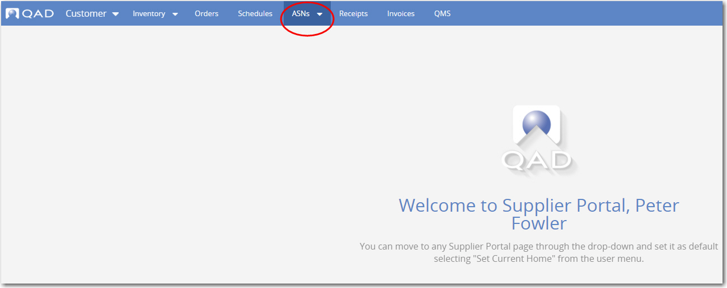
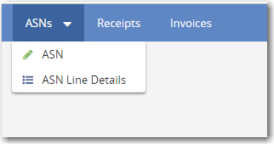
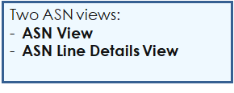
Accessing the ASN Views
Supplier Portal — ASNs
Notes:
To open the ASN views in QAD SP, click the link at the top of the Supplier Portal screen as shown in the slide.

Slide 8
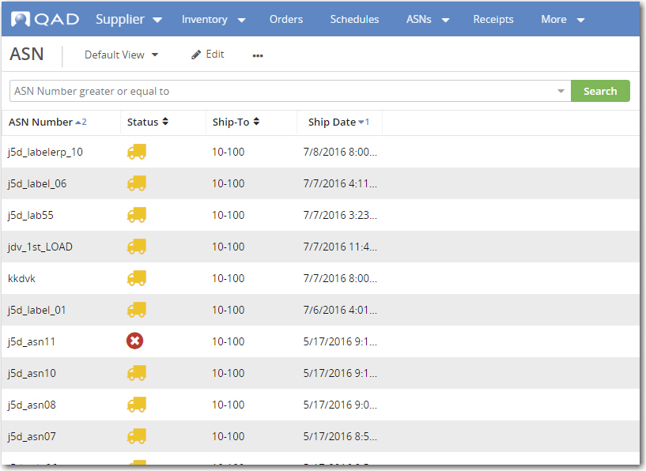
ASN View
Supplier Portal — ASNs
Supplier options for manual ASN creation or upload from flat file. Customer can import to QAD EA from QAD SP
Icons show status of
ASNs and indicate planned
or actual shipments
Notes:
The ASN view shows all information about header shipments, including the current status, ship ID numbers, and dates. When a supplier is still working on an ASN, the status is Incomplete. When the ASN is in-transit, the status shows as Shipped. When the ASN has been received, canceled or exported, corresponding statuses display.
You not create shipments in the ASNs screen; you can only use the screen to view information. To create shipments, click the Actions → Create a new ASN option available in the Orders, Schedules, or Kanban screen.

Slide 9
ASN Statuses
Supplier Portal — ASNs
 | Incomplete
 | Pre-Ship
 | Shipped, Not Exported
 | Shipped, Exported
 | Shipped, Exported, and Confirmed
 | Received, Not Exported
 | Received, Exported
 | Received, Export Confirmed
 | Forecasted
 | Canceled
Notes:
The color of the shipped and received icons in the Status column of the ASN view indicates the export status of the ASN: whether it has been exported to the ERP system and whether receipt has been confirmed in the ERP system.
Once the Status is changed to Shipped, you cannot make any other changes to the ASN. For ASNs created manually or imported into QAD Supplier Portal by suppliers, users logged in as customers or consolidated customers can change the status for an ASN to Canceled. These same users can change the status from Canceled to Shipped or Received. The Export related statuses indicate whether the ASN is already sent to the ERP via EDI or if it has been sent and also loaded into the ERP.
However, keep in mind that any changes made to the status of an ASN once it has the status Shipped are not sent back to the ERP -- the status change is relayed within QAD SP only.

Slide 10
Configuring the ASN View
Supplier Portal — ASNs
Columns required depend on your business processes
Often, customers recommend how they want suppliers to configure views
The most important columns are:
ASN Number/Ship ID | Order
Ship Date | Item
Ship Qty | Status
No changes to GHSP ASN requirements. Please see GHSP Supplier Standards Manual for additional details.
Notes:
Some of the important columns to display in the ASNs screen are:
ASN Number/Ship ID
Ship Date
Ship Quantity
Order
Item
Status
Of course, it is important to display any other columns that help you to understand and to manage your inventory system. Remember that you can adjust the column widths by simply placing your mouse on the dividing line of the heading and moving it left or right.

Slide 11
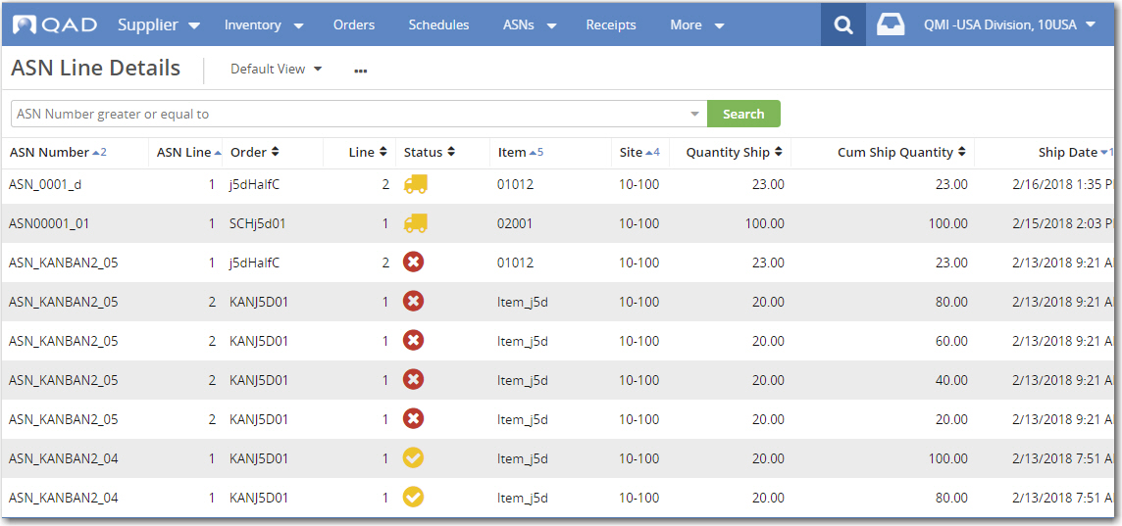
ASN Line Details View
Supplier Portal — ASNs
Notes:
The ASN Line Details view lets you view in-depth information for each ASN line, including lot information. The browse provides a full overview of the whole ASN process and collates all related data in one screen to avoid the need for additional clicks.

Slide 12
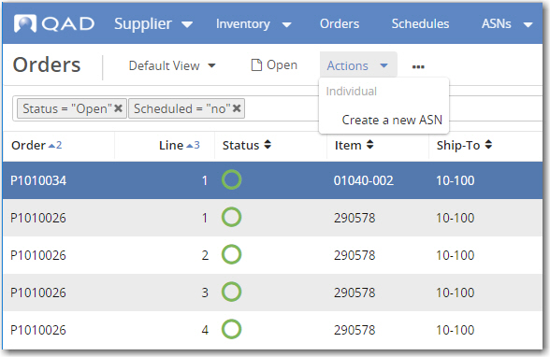
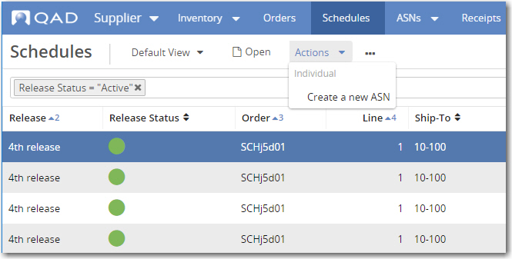
Interactively Creating ASNs
Supplier Portal — ASNs
Notes:
To create an ASN from an order, open the Orders, Schedules, or Kanban view and select the order that you want to ship. In the Actions sub-menu, choose Create a New ASN.
You can only create ASNs from open orders.

Slide 13
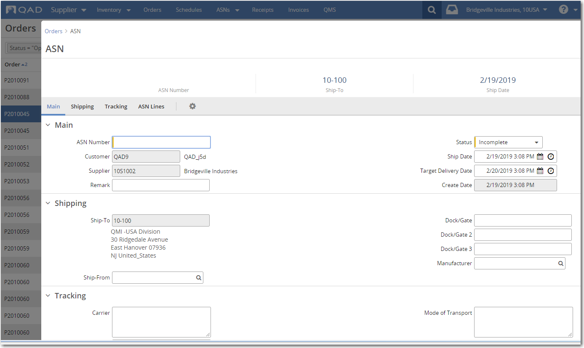
ASN Maintenance, New ASN
Supplier Portal — ASNs
Leave the Status field as Incomplete until you’re ready to ship
Notes:
When you choose Actions -> Create a New ASN, the ASN Maintenance screen opens and, from here, you can start filling in the required data. ASN Maintenance collates all shipper information in a single screen. Shipping data, ASN line data, and container and label panel data are available all together in a single location.
Decide on the status of your ASN. It is important to note that, once the status is updated to Shipped, no changes are allowed to the content of the ASN; you can only update the ASN status from that point on. If you need to add labels and containers, you must first submit the ASN with a status of Incomplete to gain access to the Label and Container panels.
ASN Maintenance contains the following important header fields:
ASN Number: The number that identifies the shipment. Once the ASN number is entered in the ASN header, it is copied to the Shipper ID field in the line item below. Usually, the ASN number is matched with the receipt. For example, in QAD Enterprise Applications, the customer uses the shipper ID from the ASN in the Shipper ID or Packing Slip field. Other ERP systems may have different methods and criteria for matching the shipper ID number to the receipt.
Ship Date: The date and time of the shipment. Since suppliers cannot cancel an ASN once it is shipped in QAD Supplier Portal (the supplier must ask the customer to cancel it), it is recommended that you only enter the ASN when you are actually creating a shipment.
Target Delivery Date: The date on which the shipment is expected to arrive at the customer's site. QAD Supplier Portal provides a default date, which is the ship date plus one day
Carrier: The name of the carrier that is transporting the material. The customer enters this information in QAD Enterprise Applications, but you can modify this information on individual ASNs, as required.
Carrier Reference: This is a unique number that the carrier uses to identify the shipment (that is, a tracking number). Specify the reference if you know it.
Transportation Mode: The mode of transportation used (for example, Ground, Truck, Air, Milkrun).
In the Shipping panel, you can fill in additional information such as the Dock/Gate. This value can default from the setup, if configured. The values from the Ship-From and Manufacturer fields can come from the DUNs number, if configured this way.

Slide 14
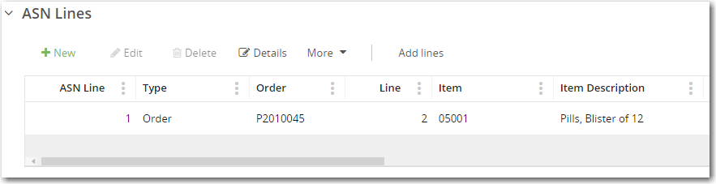
Adding ASN Lines
Supplier Portal — ASNs
Two methods:
  Use New button to add ASN lines one by one
  Use Add lines button to add multiple ASN lines at once
New Button
Add Lines Button
Important: Add Lines is only available if you have saved the new ASN
Notes:
In the ASN Lines panel, you have two options for entering ASN lines: you can add lines one by one using the New button or you can enter multiple lines simultaneously using the Add Lines option.
Important: Add Lines is only available if you have saved the new ASN

Slide 15

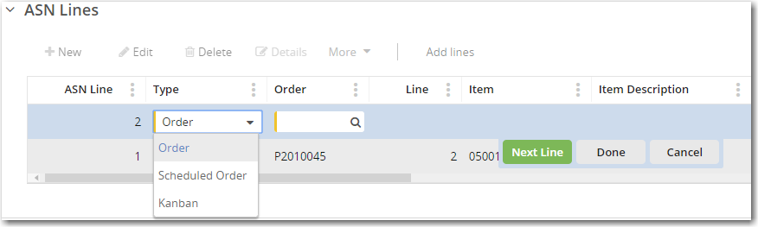

Add Lines One by One
ASN Lines: Method 1
Supplier Portal — ASNs
Notes:
In the ASN Lines panel, you can add more lines from different orders and update information for any line.
Step 1: Click New to add a new ASN line.
Step 2: The second step is to select the type of order that you want to add more lines to: a discrete purchase order, a scheduled order, or a Kanban.

Slide 16
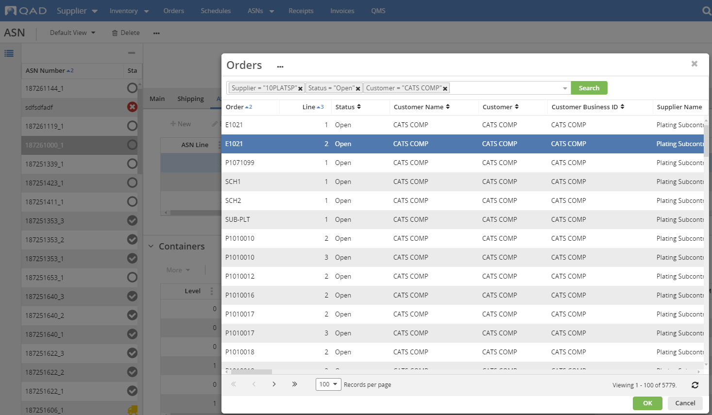


Add Lines One by One, Select Order
ASN Lines: Method 1
Supplier Portal — ASNs
Notes:
Step 3: Click the lookup in the Orders field to open a browse, where you can select the line that you want to add to the ASN.

Slide 17
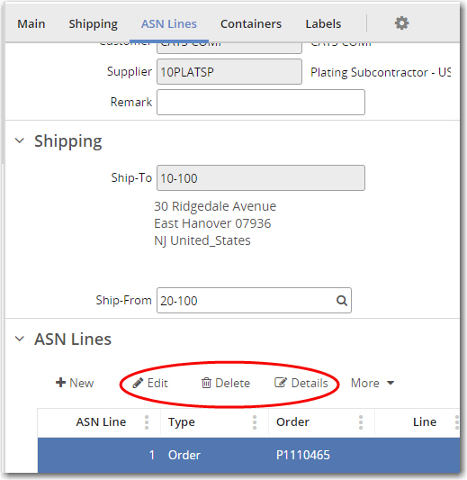


Add Lines One by One, Edit the ASN
ASN Lines: Method 1
Supplier Portal — ASNs
Notes:
Step 4: edit the ASN, as needed.
At this point, the ASN still has the status Incomplete. You can modify the header section or any of the ASN lines. For example, you can change
the shipper IDs of the new lines. You can even remove and edit lines or query more details.

Slide 18

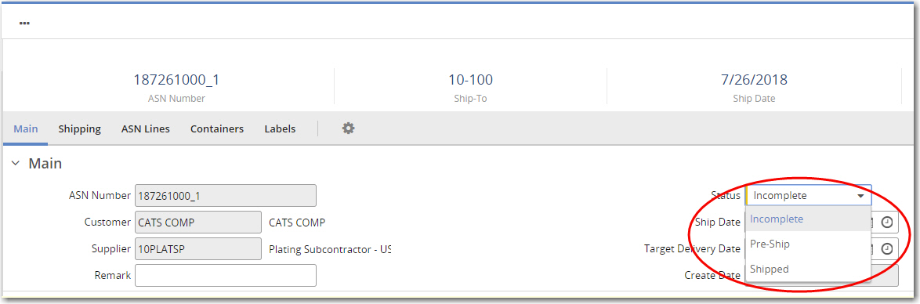

Add Lines One by One, Change the Status
ASN Lines: Method 1
Supplier Portal — ASNs
Notes:
Step 5: Change the ASN status.
If you leave the ASN status as Incomplete means that you will need to return later to complete the ASN. You can view the incomplete shipment in the main ASN screen. Both the customer and the supplier can view incomplete ASNs, which are marked with an Incomplete status icon. When you are ready to ship the ASN, change the status to Shipped in the ASN Maintenance screen and click Save.
Pre-Ship status is used for ASNs that are ready to ship but are not yet in the truck. When an ASN is pre-shipped, nothing on it can be modified, but the information is not yet sent to the customer’s ERP for shipping confirmation.

Slide 19
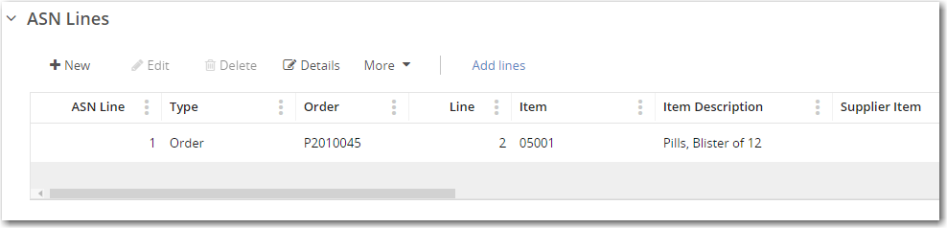
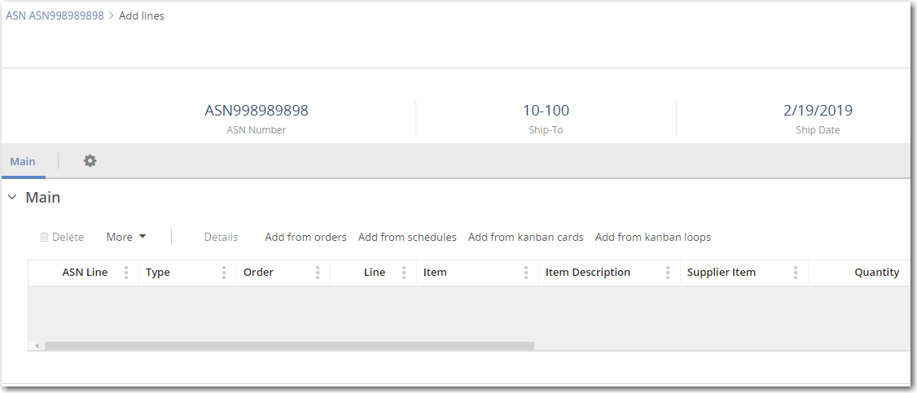
Add Multiple ASN Lines
ASN Lines: Method 2
Supplier Portal — ASNs
Adding Multiple Lines, Step 1
Important: The Add Lines option is only available if the ASN is saved
Adding Multiple Lines, Step 2
Notes:
Method Two: Adding Multiple ASN lines at once.
Step 1: Click Add lines to add multiple ASN lines at once. The new ASN must be saved to access this option.
Step 2: The second step is to select the type of lines that you want to add: order lines, schedule lines, kanban card lines, or kanban loop lines.

Slide 20
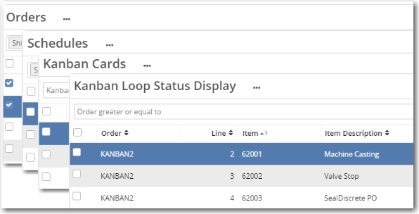
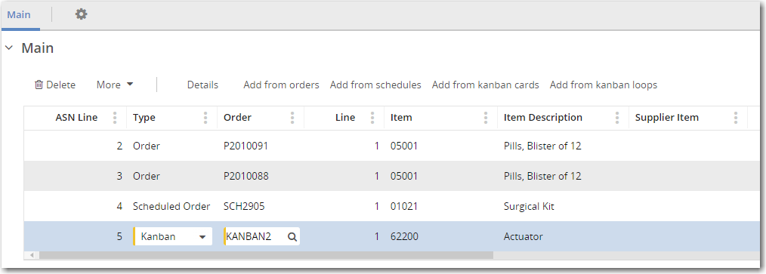
Add Multiple ASN Lines — Continued
ASN Lines: Method 2
Supplier Portal — ASNs
Adding Multiple Lines, Step 3
Adding Multiple Lines, Step 4
Notes:
Step 3: Use the associated browses to select the orders, schedules, kanban cards, or kanban loops that you want to add.
Step 4: Edit the ASN lines, as needed.
Step 5, as shown previously for adding lines one by one, is to update the ASN status to Shipped when you are ready (but not if you are adding lots or containers/labels).

Slide 21
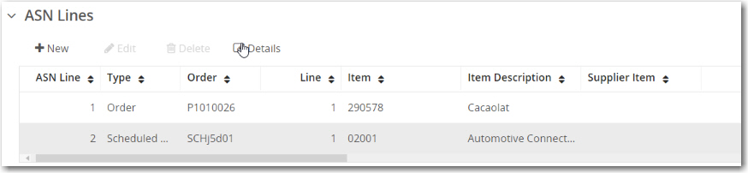
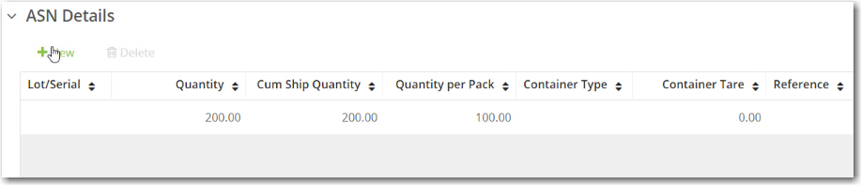
ASN Details, Creating Lots
Supplier Portal — ASNs
Click Details to view ASN line details
1
You can work with lot/serial data in ASN Details
2
In ASN Details, click New to add lots
Notes:
In the ASN Lines panel (shown in the top graphic), click the Details button to view each line in detail.
You can work with lot/serial data in the details of each ASN line.
As you can see in the second graphic, this ASN line is not currently divided into lots. To create the lots, click the New button.

Slide 22
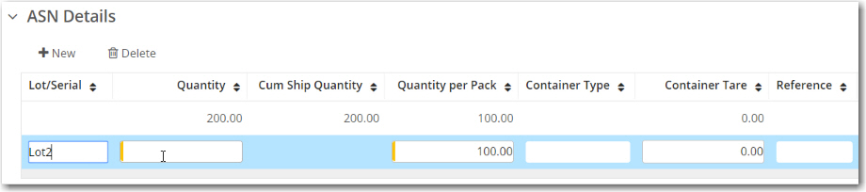
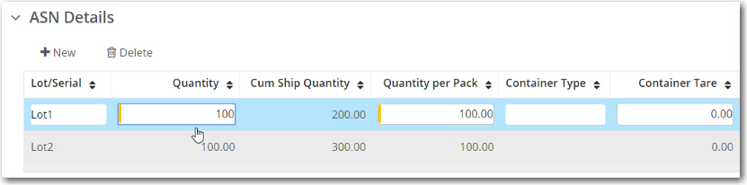
ASN Details, Creating Lots — Continued
Supplier Portal — ASNs
The new line
3
4
The quantity divided into two lots
Notes:
We’re continuing on from the last slide. Clicking New in ASN Details adds a new line, as shown in the top graphic.
Here, the existing line is going to be Lot 1 so this new line will be Lot 2. We enter a value of 100 here to split the quantity into two.
As shown in the second graphic, we return to Line 1, rename it to Lot 1 and change the Quantity field from 200 to 100 and click OK.
Note that the quantity you specify when you create lots must be a divisor of the pack quantity; otherwise, the application displays an error message. For example, if the pack quantity is 25, the application displays an error if you specify a lot quantity of 7.
Note that the quantity you specify when you create lots must be a divisor of the overall quantity; otherwise, the application displays an error message.
Quantity per Pack is also an important field to note. This is the multiple in which orders for this item are shipped; for example, a
box of 144 pencils.
If you were happy with an ASN and did not want to add containers or labels, you would set the Status field to Shipped to ship the ASN. You would then click Submit to send the information to the ERP.
Alternatively, you can keep working on the ASN and add information about containerization.

