Slide 1
Measurement Systems Analysis
Components and Acceptance Criteria

Slide 2
Purpose
To understand key concepts of measurement systems analysis
To understand potential sources of measurement error and its affect on both process and part quality

Slide 3
Why do we care about Measurement Systems Analysis(MSA)?
Ensures measurement is accurate and precise
Eliminates false data that can impact decisions about the process
Provides information about the gage(s) being used to evaluate our parts and processes
Reduces risk in calling good parts bad (Type I Error) **Impacts internal throughput, scrap and rework
Reduces risk in calling bad parts good (Type II Error) **Impacts customer
Data you can trust = Good Decisions

Slide 4
Which line has less variation
Line 1
Line 2

Slide 5
Which line has less variation?
Line 1
Line 2
Gage Variation
Total Variation

Slide 6
Which line has less variation?
Line 1
Line 2
Part Variation
+
Gage Variation
=
Total Variation
(Observed)
Line 2 has
Less variation
Part Variation
Gage Variation
Total Variation

Slide 7
Understanding Variation
What is the best course of action?
Assume the total observed variation is below
1.33 Ppk for an initial process study on a starred
dimension (1.67 Ppk or greater required)
Measure a different sample of parts (Gather more data)
Investigate process changes to reduce process variation
Investigate gage changes to reduce measurement variation
Part Variation
+
Gage Variation
=
Total Variation
(Observed)

Slide 8
How do you decide what to do?
How do you decide what to do?
What are typical reactions to measuring a part out of tolerance?
  Adjust processes / implement additional detection methods
  Quarantine / Sort / Scrap parts
  Review PFMEAs and Control Plans
Before doing all this verify the measurement system

Slide 9
MSA Components
What does a measurement system analysis consist of?

Slide 10
MSA Components
Resolution (Discrimination)
Accuracy
Linearity
Stablity
Repeatability (Test / Retest)
Reproducibility
Gage R&R

Slide 11
Sources of Variation
Location of the Measurements
  Accuracy / Bias
  Stability
  Linearity
Variation of Measurement
  Repeatability
  Reproducibility
Resolution / Discrimination
Each source of variation can result in incorrect measurements

Slide 12
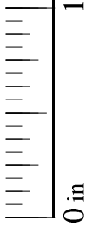

Resolution
Can the gage detect change?
Which logo below is larger?
How is the measurement different?

Slide 13
Resolution - Response
Select gages that have greater levels of discrimination (smaller increments)
Record all measurement data, i.e. if a gage measures to 3 decimal points record all three
As a general rule gage discrimination should be 1/10th of the product tolerance
  Product tolerance: 0.100
  Gage tolerance: 0.010 (Recommended minimum)

Slide 14
Accuracy
What is accuracy?
The difference between the measured average value and the master value or the ‘Shift’ from ‘True’ value
The master value needs to come from a traceable measurement source (ex. CMM)
Although accuracy and bias are often used interchangeably it is best practice to refer to this difference in values as bias

Slide 15
Accuracy
What is accuracy?
Master value
(reference standard)
Measured values
In this case the accuracy of the gage is ‘bias’ by 0.5 above the master
Let’s also assume the average measurement is 5.5
Let’s assume the master value is 5

Slide 16
How to Determine Bias
Take three samples
  Ideally these samples would be at the high, middle and low ends of the process
Determine the reference value for each sample using a traceable measurement method (CMM, calibrated height gage, etc.)
Measure each sample at least 10 times. Calculate the average and subtract from the reference value
Determine if the accuracy is acceptable or needs to be corrected
  This is to be determined by the working team

Slide 17
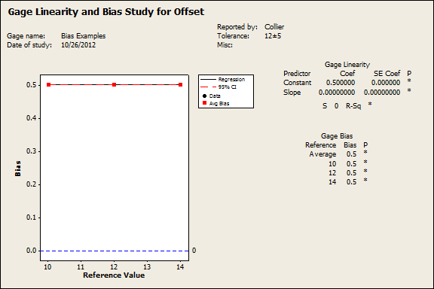
Bias Example
Note: With multiple samples a linearity study may be completed

Slide 18
Potential Bias Causes
Gage needs calibration
Worn gage, equipment or fixture
Error in master part (worn or damaged)
Improper setting of master in gage
Differing measurement methods (set, loading, clamping, technique, etc.)
Environment (temperature, humidity, vibration, cleanliness, etc.)

Slide 19
Bias - Response
Increase calibration schedule
Implement gage operating instructions
Verify gage was made to correct specifications
Check gage for wear
Cleaning of gage
Evaluate gage environment

Slide 20
Linearity
What is linearity?
  Linearity is the change in bias across the operating range of the gage

Slide 21
Linearity
Bias
(Difference between the measured average value and the master value)
No Bias
(Master value equals measured average value)
Full Range of Gage (Master Value)

Slide 22
How to Determine Linearity
Pick 5 parts covering the entire product tolerance
Determine reference value of each part (ex. CMM)
Measure each part 10 times or more and determine averages
Subtract the average values from the determined reference values and decide if linearity is acceptable

Slide 23
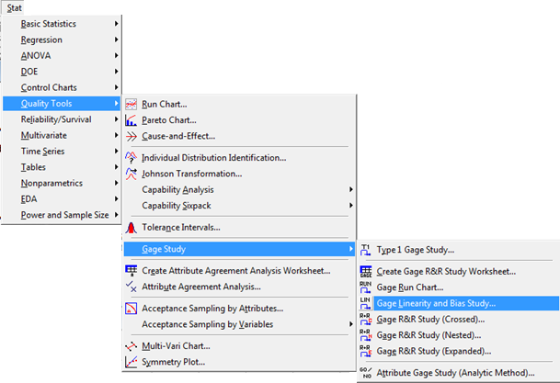
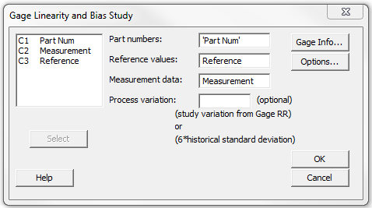
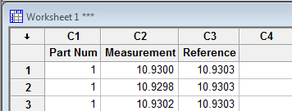
Linearity Calculation (Minitab)
2. Go to ‘Stat’, ‘Quality Tools’, ‘Gage Study’, ‘Gage Linearity and Bias Study’
Fill in column ID’s for Part Number, Reference Values and Measurement Data. Don’t forget to fill in the Gage Info!
1. Enter Part Number, Measurement and Reference Value in the Worksheet

Slide 24
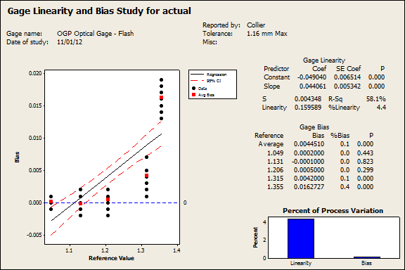
Linearity Analysis (Minitab)
However, there is significant bias (P<0.05) at 1.31 and 1.35
This gage has little bias between 1.0 and 1.2

Slide 25
Linearity – Acceptance Criteria
Study must use 5 or more parts
Parts must cover entire operating range of gage
A p-value of less than 0.05 (P<0.05) indicates statistically significant bias

Slide 26
Linearity - Response
Implement correction factor / table / curve
Review gage and adjust
Restrict use of range (Need to consider specification limits)
Verify proper calibration (through entire operating range)
Verify part / fixture is not distorted with change in part size

Slide 27
Linearity Question
Question: Is this linearity study acceptable?
Yes, all points are statistically acceptable across the range
No, at 1.355 there is significant bias
No, at 1.315 and 1.355 there is significant bias
There is no bias, this is a linearity study

Slide 28
Stability
What is stability?
  The variation in measurements obtained with the same master part(s) on a single feature over a period of time
  Also known as ‘measurement drift’ and the ‘change in bias over time’

Slide 29
Stability
Measurements taken Monday
Measurements taken Friday
Measurement results are changing over time. Gage is not stable

Slide 30
How to Determine Stability
Select a master part
  Part may be a reference part (master) or a production part
  You can select multiple parts (low, middle and high end of expected range) and track stability for each
Determine the reference value for each part via a master measurement method
Measure each part 3 – 5 times at a chosen interval (daily, weekly, etc.)
  Frequency should be determined based on knowledge of the gage. If frequency is unclear you should start at a high frequency and reduce over time as deemed acceptable.
Plot the ongoing data on a Xbar & R chart

Slide 31
Stability – Potential Causes
Calibration issues
Gage wear
Poor maintenance
Master part damage / wear

Slide 32
Stability - Response
Increase frequency of calibration
Increase frequency of PM
Change / Adjust gage
Establish ‘life’ of gage or master part

Slide 33
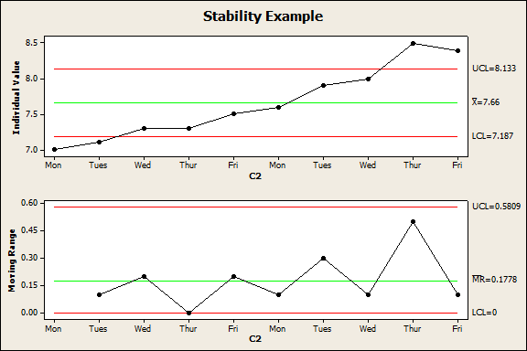
Stability Question
The gage is not stable.
Larger ‘jumps’ appear to happen every other day. The team should decide how often calibration should take place.
Question: Assuming the same part was measured is this gage stable?
Can this gage be used?
Process tolerance is 9.0/6.0
Yes, the process is stable. Use the gage.
No, the gage is not stable. Do not use the gage.
No, the gage is not stable. Develop calibration schedule and use the gage.

Slide 34
Precision
What is precision?
  According to AIAG it is “the net effect of discrimination, sensitivity and repeatability over the operating range of the measurement system.” (AIAG MSA Third Edition)
So what does that mean?
  Precision quantifies how close repeated measurements are to each other
Not Precise
Precise

Slide 35
Precision - Components
Repeatability
  Best known as within user variation
  Also encompasses all ‘within’ variation
    Within part
    Within gage
    Within standard
    Within method
    Within user
    Within environment
Reproducibility
  Best known as between user variation
  Also encompasses all ‘between’ variation
    Between systems
    Between conditions
    Between methods
    Between Environment

Slide 36
Precision - Components
Repeatability
(Within Variation)
Operator 1
Operator 2
Operator 3
Reproducibility
(Between Variation)

Slide 37
Variable Data GRR

Slide 38
Variable Data Gage R&R
How do you conduct a Variable Gage R&R?
Determine the need for the study. What do you want to accomplish?
  %Study – For process control
  %Tolerance – For product control
Determine specifics about the study (number of appraisers, number of trials, etc.)
Select appraisers
  Appraisers should be selected that will used the gage in production
Select the sample parts to be used
  Based upon chosen need from study
  If for process control parts must be chosen from process range

Slide 39
Variable Data Gage R&R
Verify gage resolution is acceptable
Measure parts in random order to prevent ‘measurement memory’
The standard measurement process should be observed by all users (gage instructions)
The study should be observed by the engineer to ensure reliability of the data

Slide 40
Variable Data Gage R&R
General Rules
  Three appraisers
  Ten parts
  Three measurements per part per appraiser (Ninety total measurements)
  Parts should make use of the entire range of process variation
    This does not mean the entire product tolerance
    A capability study should accompany a completed GRR
  Parts should be collected over time
    Parts collected in a row will usually have low between part variation
  Use ANOVA method if possible
    Xbar & R method does not account for operator interaction
  Report %Study or %Tolerance (whichever applies)

Slide 41
Variable Data Gage R&R
General Rules
  Three appraisers
  Ten parts
  Three measurements per part per appraiser (Ninety total measurements)
  Parts should make use of the entire range of process variation
    This does not mean the entire product tolerance
    A capability study should accompany a completed GRR
  Parts should be collected over time
    Parts collected in a row will usually have low between part variation
  Use ANOVA method if possible
    Xbar & R method does not account for operator interaction
  Report %Study or %Tolerance (whichever applies)

Slide 42
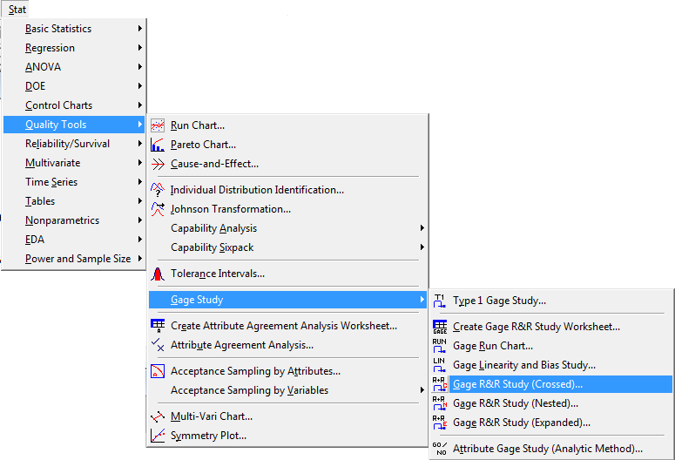

Variable GRR Calculation (Minitab)
1. Enter Appraiser, Part number and Measurement in the Worksheet
2. Go to ‘Stat’, ‘Quality Tools’, ‘Gage Study’, ‘Gage R&R Study (Crossed)’
“Crossed” is when the same parts are used between trials
“Nested” is when different parts are used between trials

Slide 43
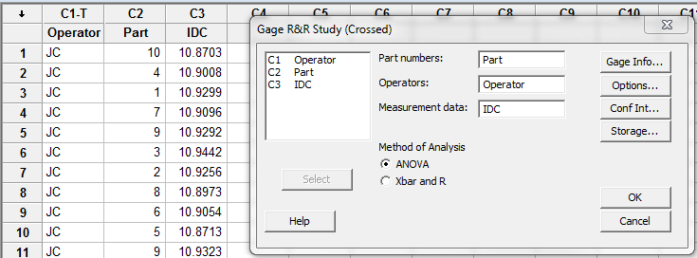
Variable GRR Calculation (Minitab)
Fill in part number, Operators and Measurement Data and select ANOVA
Complete Gage Info
Click Options

Slide 44
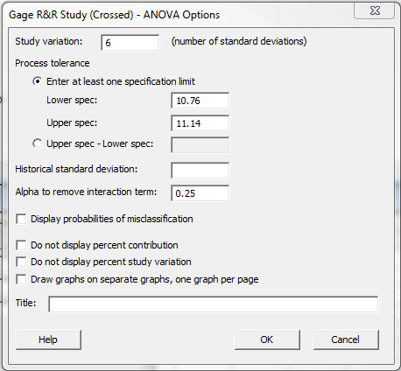
Variable GRR Calculation (Minitab)
Fill in upper and lower limits
and include a title of the GRR
Click OK

Slide 45
Gage R&R (ANOVA) for IDC

Slide 46
Variable GRR - Analysis
Pay attention to the overall sample range to understand ‘scale’ of error
Inside the Xbar r Chart control limits is the blind spot of the gage

Slide 47
Variable GRR - Analysis
Part to part variation should be the largest contributor
R Chart should have all points in control. An out of control condition indicates poor repeatability
Xbar r Chart should be 50% out of control. This indicates each operator can tell a good part from a bad part
Want:
Small spread around mean
Similar mean and spread by operator
Lines to be close to being on top of each other

Slide 48
Variable GRR – Graphical Metrics
Components of Variation
  Indicates repeatability / reproducibility / parts
  Want low Gage R&R, High part to part variation
R Chart
  Indicates repeatability / resolution
  No outliers are permitted, helps to I.D. unusual measurements
  Plateaus or steps indicate resolution limitation
Xbar r Chart
  Reproducibility / Sensitivity
  Want to see similar patterns for each operator

Slide 49
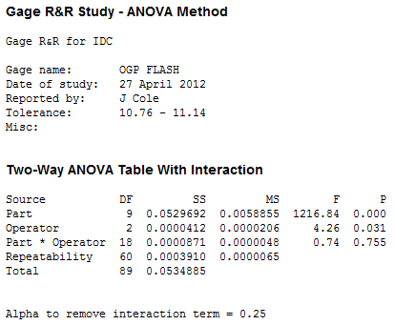
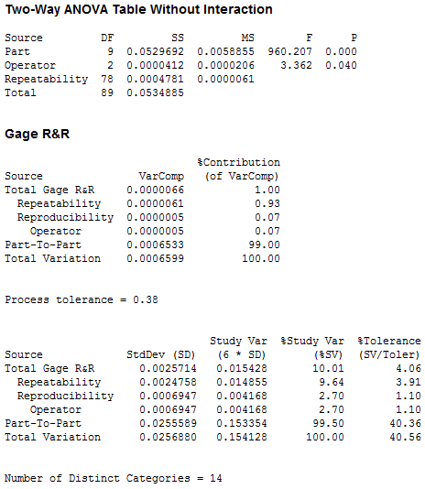
Variable GRR – Numerical Metrics
Report %Study or %Tolerance (Whichever applies) More on this later…
Report number of distinct categories

Slide 50
Variable GRR – Numerical Metrics
%Study or %Tolerance should be below 10%
  Between 10% and 30% may be acceptable
  Above 30% is not acceptable
Number of distinct categories must be at least 5

Slide 51
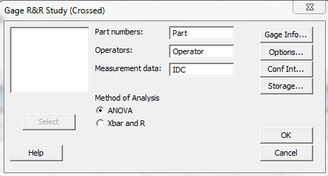
Why ANOVA?

Slide 52
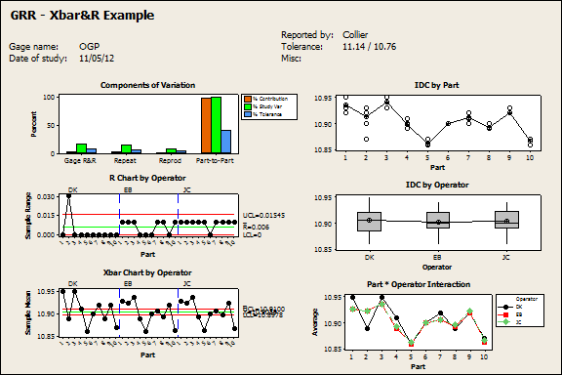
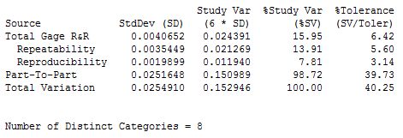
Xbar/R GRR

Slide 53
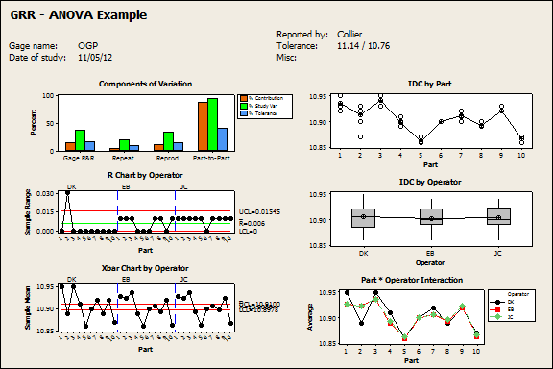
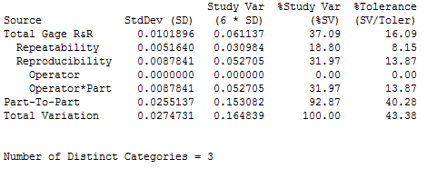
ANOVA GRR

Slide 54
Xbar/R & ANOVA Comparison
The same data was used for both studies
The only difference is method used to analyze the gage
WHY?
The Xbar/R method ignores operator to part interaction and as a result can appear to ‘boost’ gage performance

Slide 55
Xbar/R & ANOVA Comparison
Xbar/R Method ANOVA Method
Operator interaction is ignored using the Xbar/R method

Slide 56

Understanding % Tolerance
%Tolerance is the measurement error as a percent of the product specification (tolerance)
%Tolerance determines if the gage can be used for product control (determining a good part from a bad)
If the gage cannot pass %Tolerance it cannot determine if a part within specification

Slide 57

Understanding %Study
%Study is the measurement error as a percent of total variation (standard deviation)
%Study determines if the gage can be used for process control
If the gage cannot pass %Study it cannot distinguish one part from another within normal process variation or monitor process improvements / process changes

Slide 58
Specification vs. Total Variation
Product Specification
Total Variation

Slide 59
Outlier Effect on %Study
Product Tolerance
Adding an outlier will increase total variation
This will reduce the reported %Study and can make the gage look acceptable when it really isn’t

Slide 60
Outlier Effect on %Tolerance
Product Tolerance
Adding an outlier will not affect %Tolerance
$σ$_{observed} (Total Observed Variation)
%Tolerance relies upon the USL-LSL in its calculation. An outlier does not affect the product specification

Slide 61
Minimizing %Study by Part Selection
%Study is heavily dependent on the parts selected for the study
The more variation between parts selected for the study the lower %Study will be
When selecting parts be sure to include parts across the entire process variation
  Do not select parts outside of the process variation as this can mislead you to think the gage is better than it is

Slide 62
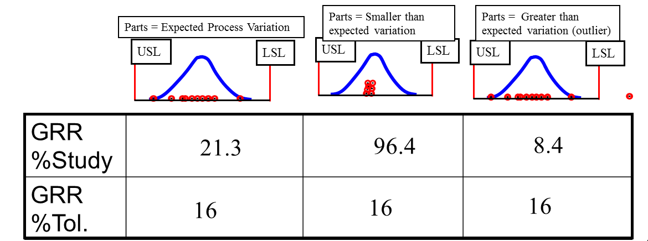
Part Selection for GRR
%Study is a measure of how well the gage sees inside the range of parts selected. Part selection is critical
%Tolerance is not affected by part selection

Slide 63
Confidence Interval and Distinct Categories
Confidence Interval
The actual size of a measured part can be anywhere within the confidence interval
Measurement
Actual Size

Slide 64
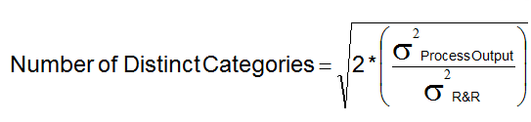
Distinct Categories
Distinct categories is the number of confidence intervals (divisions) that the measurement system can accurately measure across the process variation.
Also known as effective resolution (not gage resolution)

Slide 65
Distinct Categories
1 Distinct Category
2-4 Distinct Categories
5+ Distinct Categories
Number of distinct categories is an indication of how well a measurement system can detect product variation
Used to establish if the measurement system has acceptable resolution (discrimination)

Slide 66
Confidence Interval and Distinct Categories
Confidence Interval surrounding a measurement
Number of Distinct Categories is roughly four
Looking at the measurements what is your estimate of the number of distinct categories?
Conceptually the number of distinct categories is equal to the number of confidence intervals that span the distribution
Notes:
High %Study we can say that we have a wide confidence interval. This results in more overlap of confidence intervals from one measurement to the next.
Low %Study results in narrow confidence intervals, thus we can be more confident that our measurement if giving us good information.

Slide 67
When to Report % Tolerance
There are cases when you want to report %Tolerance instead of %Study
  When the manufacturing process is stable, in control, and…
  When the parts selected for the GRR cover the entire range of process variation, and…
  When the distribution is not close to the specification limits, and…
  When the process is highly capable (Ppk>=2.5)
  When the dimension is not a SC/CC/ and severity <8

Slide 68
What Does That Look Like?

Slide 69
Troubleshooting Variable GRR
Repeatability Issues
  Verify / Review gage instructions
  Verify clamping sequence
  Verify part is not loose in gage
  Verify measuring location is the same between trials
  Verify sufficient gage resolution
  Verify maintenance schedule is sufficient
  Verify operator method does not vary
  Review environmental impact (heat, vibration, etc.)

Slide 70
Troubleshooting Variable GRR
Reproducibility Issues
  Verify / Review gage instructions
  Verify clamping sequence is the same
  Verify appraiser to appraiser methods are the same
  Appraiser ergonomics (size, strength, etc.)
  Review environmental impact (heat, vibration, etc.)

Slide 71
Reducing Variation – Multiple Readings
  If improving of gage instructions and appraiser training fail to provide an acceptable outcome you can use multiple readings to gain a better result
  One drawback to this is that it can take significantly longer to conduct the study and this method will need to be used until further gage improvements can be made

Slide 72
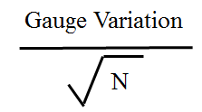
Reduction Variation – Multiple Readings
  Variation may be reduced by taking multiple measurements of a part and averaging the readings.
  This average can then be substituted for the individual measurement
Where N = Sample size

Slide 73
Multiple Readings – Why?
Confidence Interval
Measurement
Actual Size
Average Measurement

Slide 74
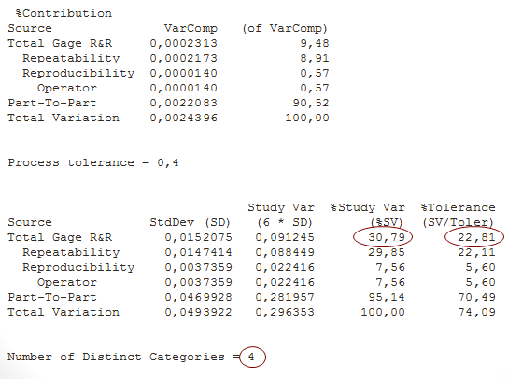
Multiple Readings - Example

Slide 75
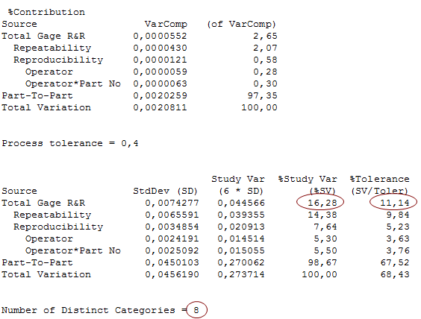
Multiple Readings - Example
Five measurements were taken and averaged to help reduce variation
Initial GRR (1 Measurement) | 30.79 %Study
Repeat GRR (5 Measurements) | 16.82 %Study

Slide 76
Attribute Data GRR

Slide 77
Attribute GRR
What is the goal of an attribute GRR?
  100% match within and between operators measurement and the correct (master) attribute
  To have all Kappa values greater than 0.75

Slide 78
Attribute GRR
What you need
  At least 50 parts
  At least 3 appraisers
  Each appraiser should measure each part 3 times

Slide 79
Attribute GRR Part Selection
25% close to the LSL
30% from normal process variation
25% close to the USL
10% outside of LSL
10% outside of USL

Slide 80
Attribute GRR
How to conduct an attribute GRR
  Select parts for study (50 minimum)
  Select appraisers for study (recommend 3)
  Measure all 50 parts on a master measurement system (ex. CMM)
  Build a master truth table
    This table lists the known disposition of each part (pass/fail) as well as associated variable data

Slide 81
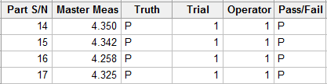
Attribute GRR
Conduct the GRR study (Measure parts in random order, observe study while in progress.
Input data into Minitab
Input part number, master measurement and truth
Input trial number, appraiser and outcome

Slide 82
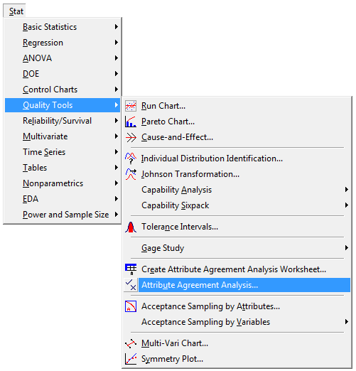
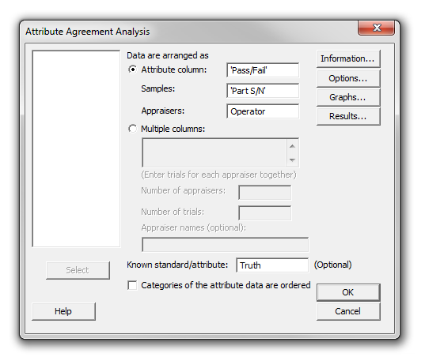
Attribute GRR
Don’t forget to fill in the gage information!
1. Go to ‘Stat’, ‘Quality Tools’, ‘Attribute Agreement Analysis’
If appraiser data is in multiple columns fill in here
Select the appropriate columns for each field.

Slide 83
Assessment Agreement - Attribute
How well each appraiser agrees with themself
How well each appraiser agrees with the truth

Slide 84
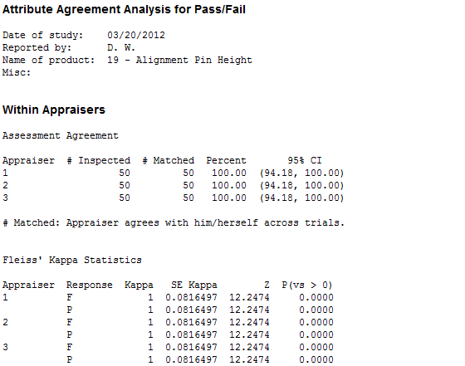
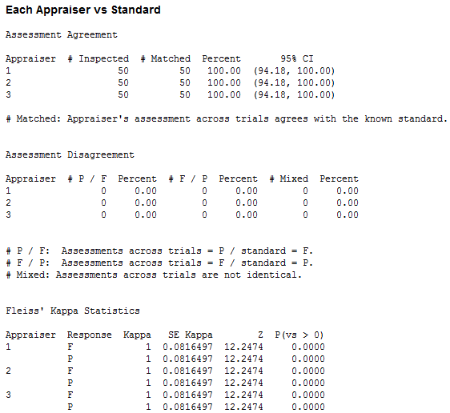
Attribute Agreement Analysis for Pass/Fail
Kappa Values
(Must be greater than 0.75)

Slide 85
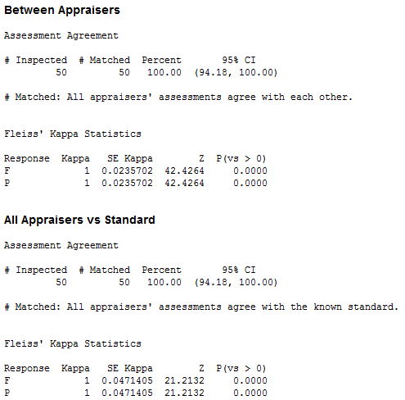
Between Appraisers
Kappa Values
(Must be greater than 0.75)

Slide 86
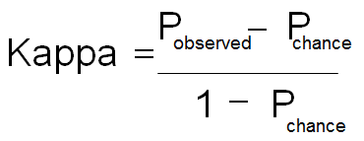
Kappa Value
What is a kappa value?
  Fleiss’ kappa value is used to measure the level of agreement between two appraisers rating the same data set
  This equation is comparing the proportion of agreement between appraisers after removing chance

Slide 87
Attribute Agreement
How many Kappa values are calculated?
  Within Appraiser
  Between Appraiser
  Each Appraiser to Standard
  All Appraisers to Standard
All Kappa values must be greater than 0.75
Notes:
Fleiss’ Kappa value is generally accepted as being more robust than a simple percent agreement as the kappa value takes into account the agreement potentially occurring by chance.
Cohen’s kappa value is not generally used as you can only have 2 appraisers and one trial per appraiser.

Slide 88
Attribute GRR – More Info
How many Kappa values are calculated?
  Within Appraiser
  Between Appraiser
  Each Appraiser to Standard
  All Appraisers to Standard
All Kappa values must be greater than 0.75
Notes:
Within – Repeatability
Between – Reproducibility

Slide 89
Guard Banding

Slide 90
Guard Banding – General Rules
Guard banding is shrinking the product acceptance limits from the product tolerance
This can only be done if a gage has repeatability issues. It will do nothing to correct a reproducibility concern
Typically used when a product is not capable and the part is measured 100%

Slide 91
Guard Banding – How to Implement
10%
10%
Both the LSL and USL should be shrunk by 10% (toward nominal)
Let’s assume a gauge has 20% Tolerance Variation measurement error (GRR)
What would you do?

Slide 92
Acceptance Criteria - Summary
Resolution
  Gage should be 1/10th of product tolerance
  Range charts with 5 or less possible values (steps) could be an indicator of inadequate resolution
  Range charts where 25% or more points have 0 range values indicates poor resolution
Linearity
  Must include 5 or more samples
  Parts selected must cover entire product tolerance
  All p-values should be greater than 0.05 (P>0.05)

Slide 93
Acceptance Criteria - Summary
Variable GRR
  10% or less %Study with 5 or more distinct categories (10%-30% may be acceptable)
  10% or less %Tolerance with 5 or more distinct categories (10%-30% may be acceptable)
  If reporting %Tolerance process must have high capability (ex Ppk>2.5), be stable and in control. Number of distinct categories is not used when reporting %Tolerance with a high capability process
  R-Charts should have all points within control limits
  Xbar charts should have more than 50% of points outside of control limits.
  Part to part variation should account for almost all of the variation in the study

Slide 94
Acceptance Criteria - Summary
Attribute GRR
  All Kappa values must be greater than 0.75
    Within Appraiser
    Between Appraiser
    Each Appraiser to Standard
    All Appraisers to Standard

