Slide 1
GHSP Supplier Training – Cumulative Order Maintenance

Slide 2
GHSP Supplier CUM Training
The generation, verification, tracking, and reconciliation of CUM (Cumulative) order quantities is the standard for Automotive Tier 1 suppliers, including GHSP.
GHSP requires suppliers to reconcile CUMs upon receipt of each release, and to identify discrepancies and initiate resolution when necessary.
This training will cover:
Reading the GHSP Supplier Release
The basics of Cum Order Maintenance

Slide 3
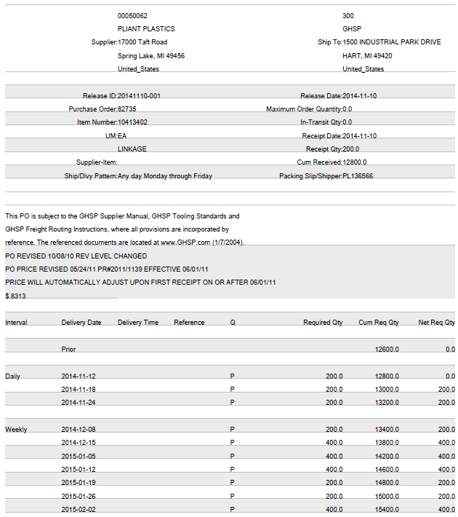
GHSP Supplier CUM Training
The sample provided on the right is typical of a release suppliers will see in the SV portal
The following slides will provide a tutorial on how to read this product release and outline a GHSP suppliers responsibilities in supporting the cumulative based scheduling system.

Slide 4
GHSP Supplier CUM Training
Prior row – any requirements showing due in this row are considered past due. The supplier needs to contact GHSP immediately to resolve past due requirement issues.
In this example there are no current past due quantities.

Slide 5
GHSP Supplier CUM Training
Reviewing the example one might easily assume the next qty due is 200pcs on 11/18/2014.
Under normal circumstances, this is correct, however, there are many instances where this may not be the case.
This is where the cumulative portion of the release comes into play. Utilizing the cum information allows for verification of actual requirements

Slide 6
GHSP Supplier CUM Training
The Net Req Qty of 200pcs is the result of the following equation. Cum Req Qty minus Cum Received
The Cum Received number is integral in this equation from a supplier perspective. This number is a running (cumulative) total of product received in GHSP’s ERP system.

Slide 7
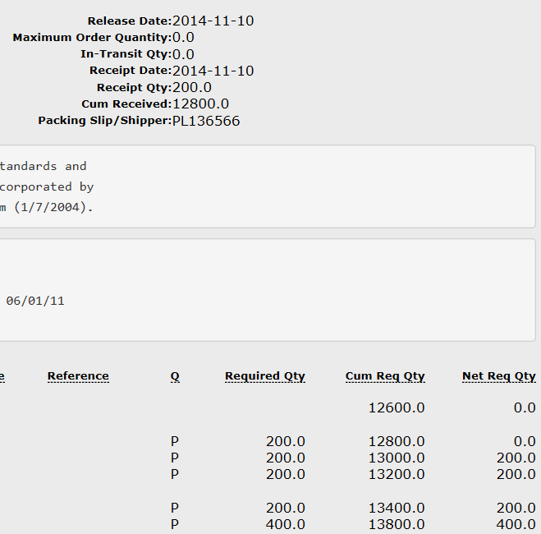
GHSP Supplier CUM Training
GHSP requires suppliers to keep a cumulative total of product shipped either electronically or manually and reconcile this number for each release issued. This is considered the suppliers cum shipped.
If a suppliers cum shipped matches the GHSP cum received the Net Req Qty is valid.
If there is a discrepancy the supplier needs to contact their GHSP materials contact to resolve the issue immediately.

Slide 8

GHSP Supplier CUM Training
Common errors that will effect GHSP’s Cum Received total
Issuance of a Problem Tracking Report (PTR) due to a receiving variance (qty is over/under the packing slip quantity issued by supplier)
A Supplier Material Return has been processed by the quality department
CUM resets (may be done annually and suppliers will be notified of the reset prior to the action being taken)
Prior receiving error corrections

Slide 9
GHSP Supplier CUM Training
To assist you in tracking your Cum Shipped the GHSP Material Release will provide you with:
Receipt Date – the last date that the material was received in GHSP’s ERP system
Receipt Qty – number of parts received on the Receipt Date
Packing Slip / Shipper – the unique ID assigned to the shipment

Slide 10

GHSP Supplier CUM Training
Following the Cum Reconciliation process for each product release will help to ensure that you’re providing GHSP with the right amount of product at the right time

